Slide 1



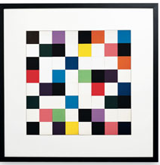
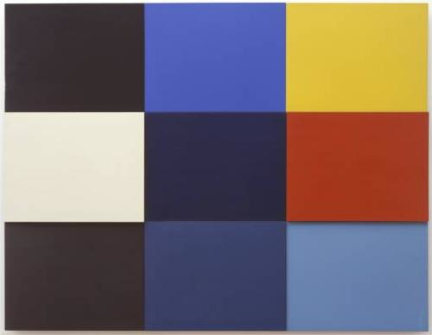
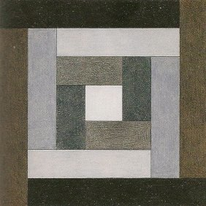
L.O. To be able to represent equivalent fractions, decimals and percentages

Slide 2
FRACTIONS
The Maths!

Slide 3
DECIMALS
The Maths!
0
1
2
3
4
5
6
7
0
0.1
0.2
0.3
0.4
0.5
0.6
0.7
0.8
0.9
1

Slide 4
Zooming In Still More
The Maths!
0
.1
.2
.3
.4
.5
.6
.7
.1
.11
.12
.13
.14
.15
.16
.17
.18
.19
.2

Slide 5
DECIMALS
The Maths!
£
£
0
1
2
3
4
5
6
7
0
0.10
0.20
0.30
0.40
0.50
0.60
0.70
0.80
0.90
1.00

Slide 6
PERCENT
The Maths!

Slide 7
FRACTIONS, DECIMALS AND PERCENT
The Maths!

Slide 8
Use HUNDREDTHS to compare fractions, decimals and percentages
Practice
And Apply!
COLOUR | NUMBER | FRACTION | DECIMAL | PERCENT
Create your own Maths-art.
Choose at least 5 different colours to create a mosaic from the hundred square.
Then complete the table above.

Slide 9
50 SQUARES
x2
25 SQUARES
x4
20 SQUARES
x5

Slide 10

WINK: What I Now Know
Review!
1 2 3
RAG
Understanding
Effort
Struggling to understand this work.
Unsatisfactory effort: not trying hard and distracted from learning.
R
3
3
Good understanding for most of the work.
Good effort; mostly concentrating but could have tried harder.
A
3
2
Excellent understanding; can explain to someone else.
Excellent effort: concentrated, focussed and tried hard.
G
3
1

Slide 11
