Slide 1
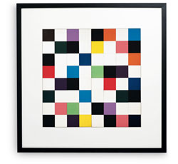

Maths and Art

Slide 2
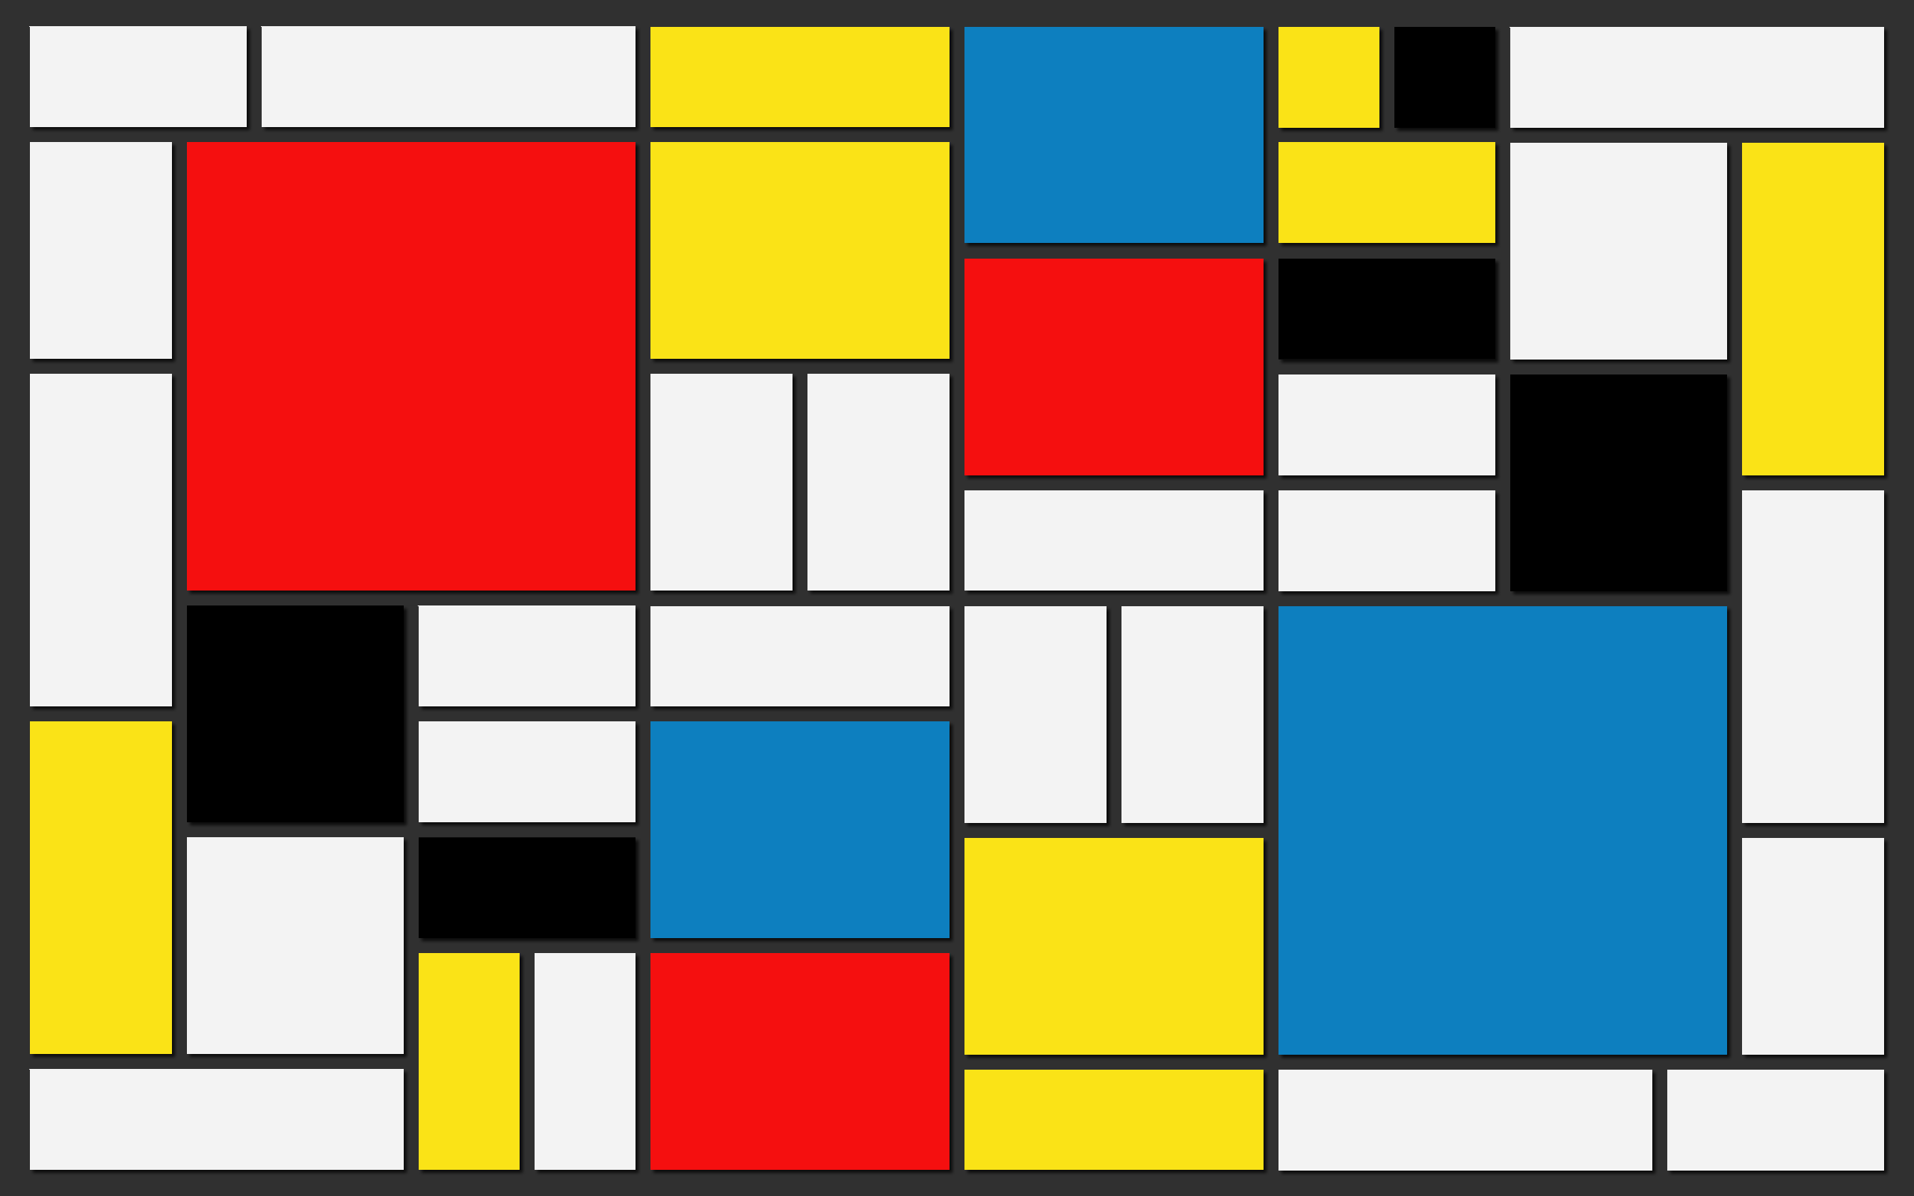
Piet Mondrian

Slide 3
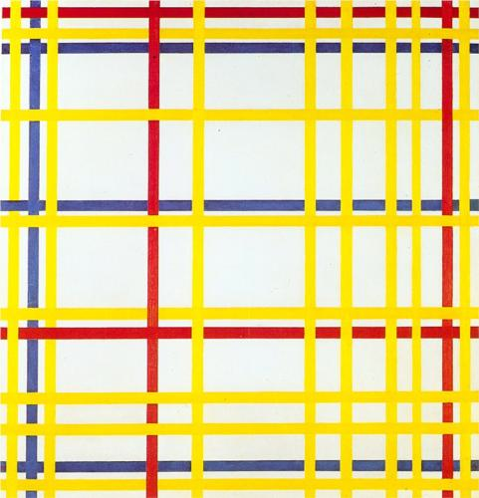
New York City 1

Slide 4
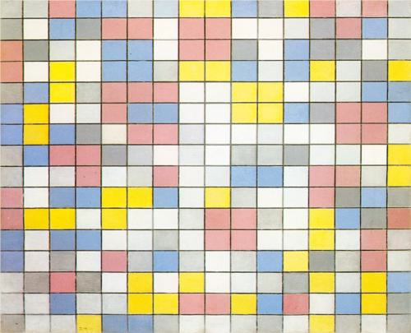
Composition with Grid

Slide 5
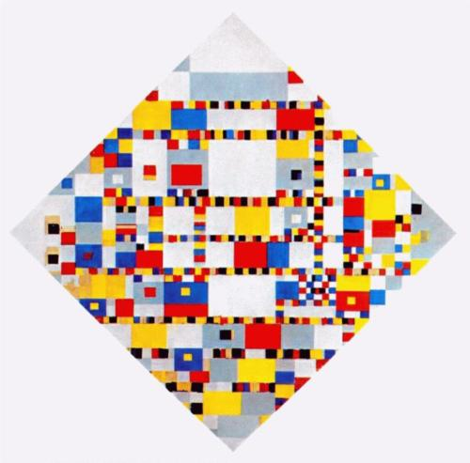
Victory Boogie Woogie

Slide 6
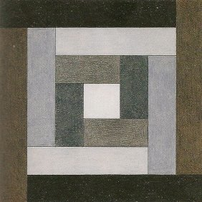
Victor Vasarely
Etudes Bauhas A

Slide 7
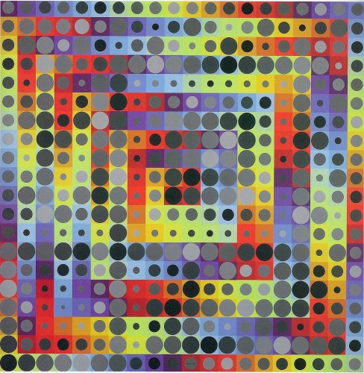
Orion Gris

Slide 8
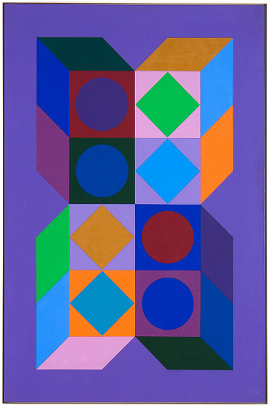
Sonora Do

Slide 9
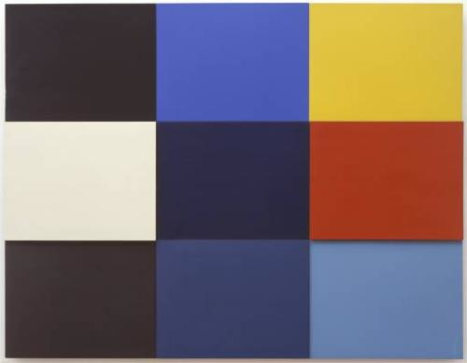
Ellsworth Kelly
Mediterannee

Slide 10
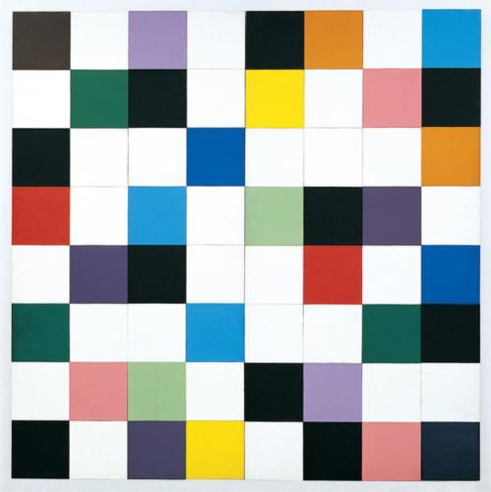
Colours for a Large Wall

Slide 11
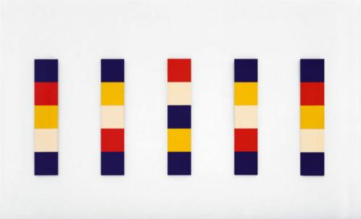
Red Yellow Blue White

Slide 12
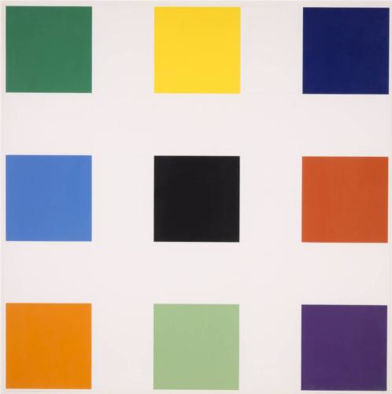
Nine Squares

Slide 13
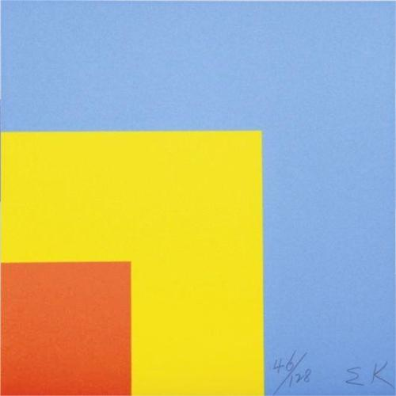
Red Yellow Blue

Slide 14
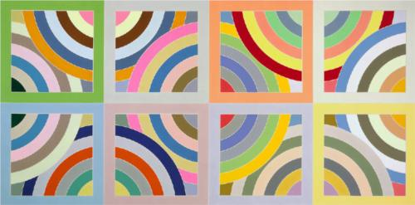
Frank Stella
Tahkt-I-Sulayman Variation

Slide 15
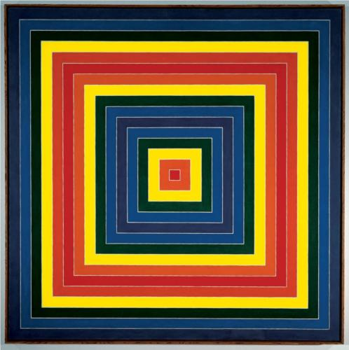
Gran Cairo

Slide 16
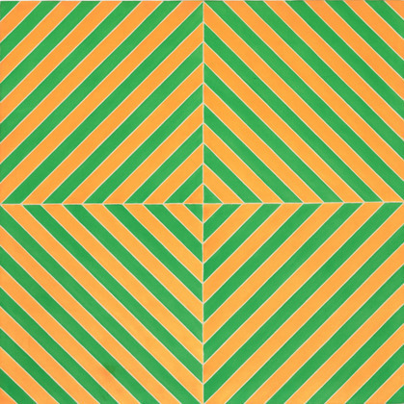
Fez 2

Slide 17
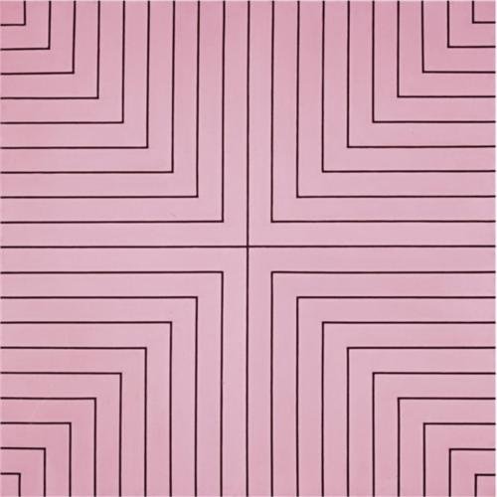
Delaware Crossing

Slide 18
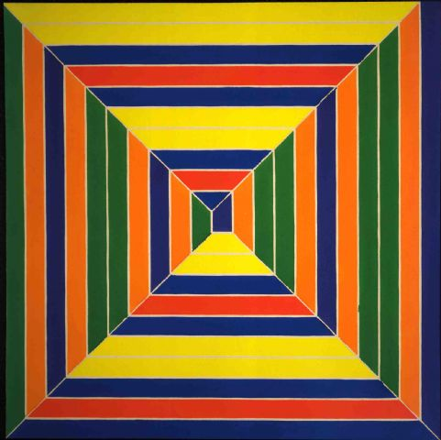
Color Maze

Slide 19
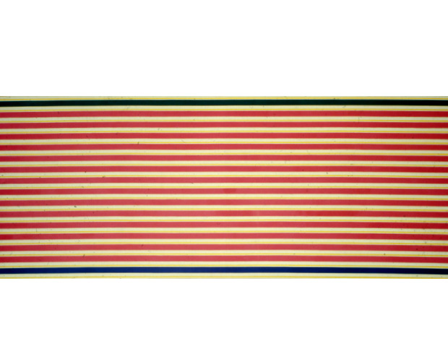
Kenneth Noland
Open End

Slide 20
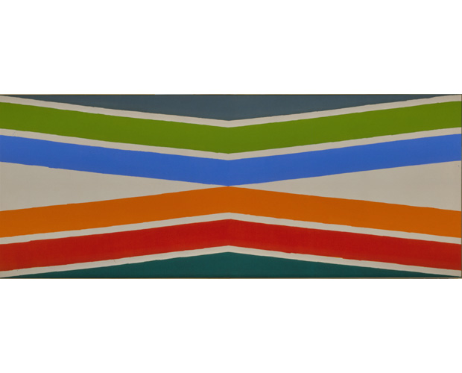
Tropical Zone

Slide 21
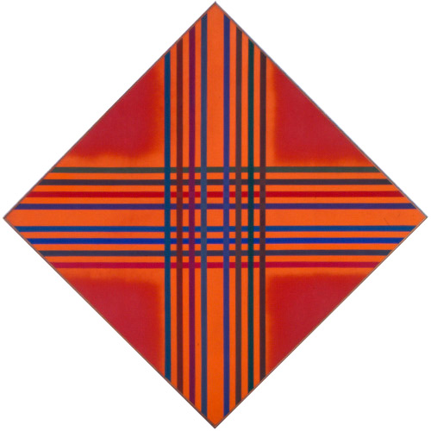
Interlock Colour

Slide 22
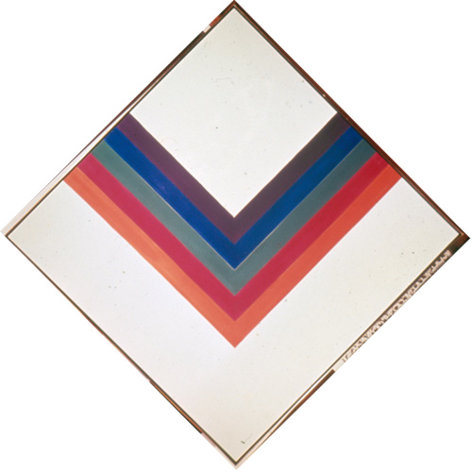
And Again

Slide 23
