Slide 1
TT Rocks

Slide 2
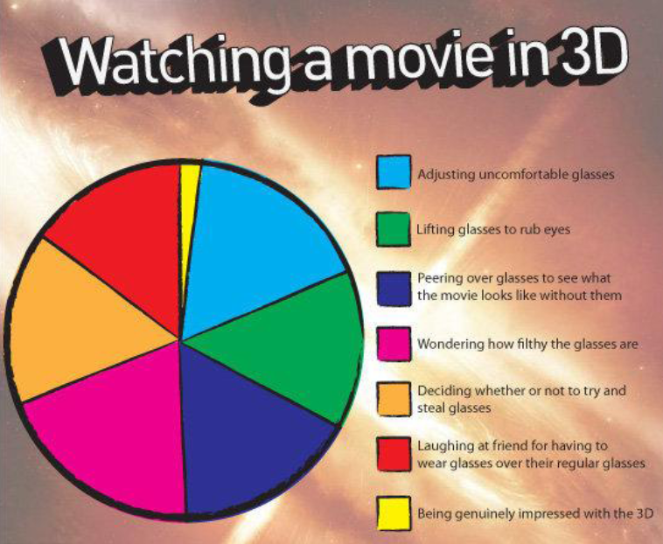
L.O. To be able to interpret pie charts
L.Q.?
Think
Pair
Share

Slide 3
The chart shows 40 skittles from a pack. There are:
10 red skittles
4 green skittles
8 blue skittles
5 orange skittles
13 yellow skittles
The Maths!
1
Starting at 1, colour in the skittles.
Divide the pie chart into the sections.
Label each section with the appropriate fraction and percentage.

Slide 4
25%
1 (approx)
3
1
4
33.3%
10%
1
10
1
8
20%
12.5%
1
5

Slide 5

WINK: What I Now Know
Review!
1 2 3
RAG
Understanding
Effort
Struggling to understand this work.
Unsatisfactory effort: not trying hard and distracted from learning.
R
3
3
Good understanding for most of the work.
Good effort; mostly concentrating but could have tried harder.
A
3
2
Excellent understanding; can explain to someone else.
Excellent effort: concentrated, focussed and tried hard.
G
3
1

