Slide 1
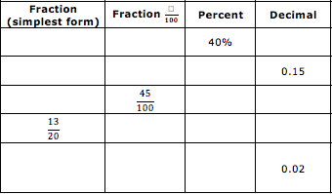
Starter
Think
Pair
Share

Slide 2
L.O. To be able to convert between fractions, decimals and percentages
Starter
Think
Pair
Share

Slide 3
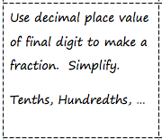
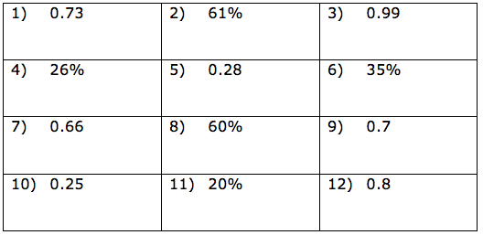
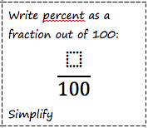
Decimal and percentages to fractions
Practice and apply!

Slide 4
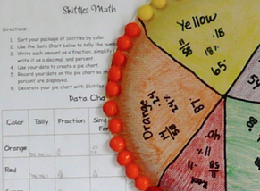
Skittle FDP Pie Charts
The Maths!
On the plain paper, arrange your skittles in a circle, with each colour grouped together.
Trace the circle and divide the coloured sections into a pie chart.
Write the fraction, decimal and percentage of each section.

Slide 5

WINK: What I Now Know
Review!
1 2 3
RAG
Understanding
Effort
Struggling to understand this work.
Unsatisfactory effort: not trying hard and distracted from learning.
R
3
3
Good understanding for most of the work.
Good effort; mostly concentrating but could have tried harder.
A
3
2
Excellent understanding; can explain to someone else.
Excellent effort: concentrated, focussed and tried hard.
G
3
1

