Slide 1
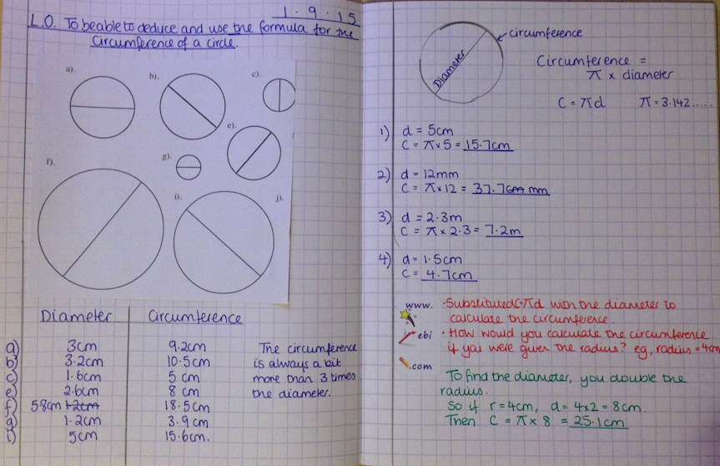
Prepare for your exam
P2: Blue/black pen for writing;
pencil for drawing,
ruler for straight lines.
P1: Margin on every page, date and learning objective underlined.
Easier to revise
P3: Worksheets glued in
P4: Problem written and numbered in margin. Question answered and clearly worked
Feel proud
Easier to read and give better feedback
Prepare for the future
P6: Write neatly. Single line through mistake. No scribbles or tippex.
P5: Feedback responded to in green pen, answering the task given.

