Slide 1

Week 5 Session 1
Get your Skill Books ready…

Slide 2










Your time is up!
Get ready to mark your answers
Click the logo to begin

Slide 3

Week 5 Session 1
Mental Strategies Answers
Q | Question | Answer
1 | ☐ + 9 = 10 | 1
2 | What is double 6? | 12
3 | Halve 24 | 12
4 | 143 + 60 | 203
5 | 94 + 97 | 191
6 | 41 + 10 = 41 + 9 + ☐ | 1
7 | 1 + 700 | 701
8 | 31 + 47 = 30 + 40 + ☐ | 8
9 | What is double 56? | 112
10 | What is half of 4? | 2

Slide 4
Week 5 Session 1
Timestables Answers
Q | Question | Answer
1 | 7 × 10 = ☐ | 70
2 | 21 ÷ 3 = ☐ | 7
3 | 3 × ☐ = 18 | 6
4 | 5 ÷ ☐ = 1 | 5
5 | 1 × 2 = ☐ | 2
6 | 30 ÷ 3 = ☐ | 10
7 | ☐ × 2 = 8 | 4
8 | ☐ ÷ 3 = 6 | 18
9 | 3 × 6 = ☐ | 18
10 | 63 ÷ 7 = ☐ | 9

Slide 5
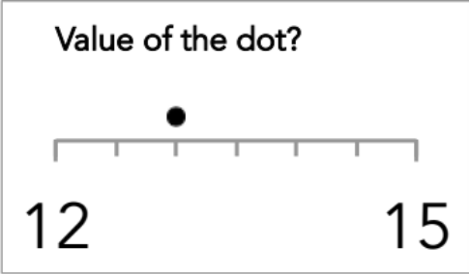
Week 5 Session 1
Key Skills Answers
Q | Question | Answer
1 | What is 25% of £190? | £47.50
2 | 6146 ÷ 7 | 878
3 | 4 + 5 × 1 | 9
4 | 462.2 ÷ 5 | 92.44
5 | 1000 × 0.64 | 640
6 | 69.12 − 9.2 | 59.92
7 | Write 35/49 in its simplest form | 5/7
8 | 10 − 10 | 0
9 | See number line | 13
10 | What is the lowest common multiple of 6 and 8? | 24

Slide 6
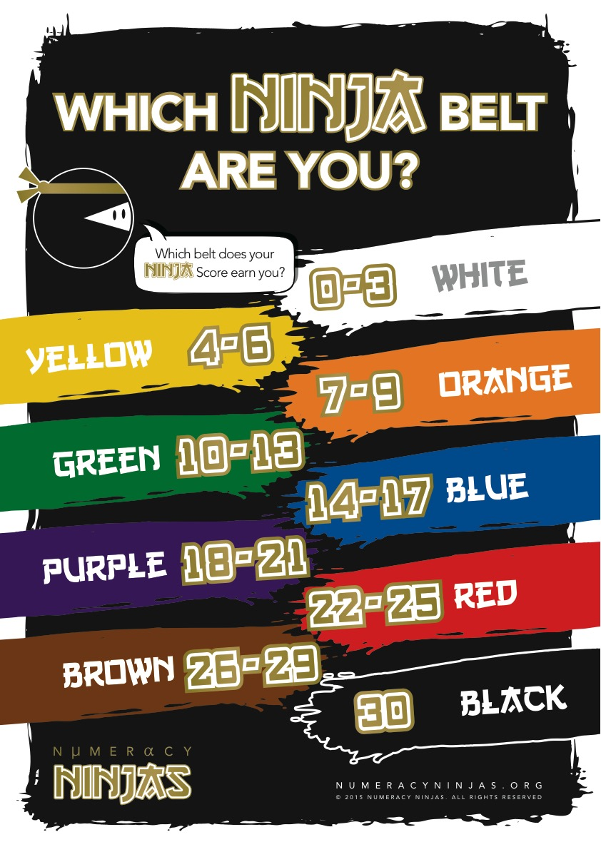
Week 5 Session 1
Calculate your Ninja Score to see which Ninja Belt you’ve earned today!

Slide 7
L.Q. How do I know which order to complete a calculation in?
L.Q.?
What is:
5 + 5 + 5 – 5 + 5 + 5 x 0?

Slide 8
The Maths!
B
4 × (2 + 3) =
rackets
I
```````````
2 x 3² = ```````````
ndices
D or M
2 + 10 ÷ 2 = 10 – 6 × 2 ÷ 3=
ivide
ultiply
A or S
3 – 2 + 7 = 7 + 3 – 2 =
dd
ubtract

Slide 9



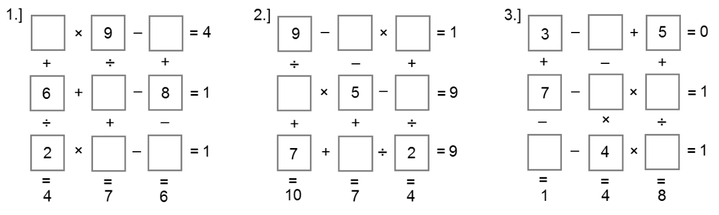

( 16 - 7 ) x 3 =
9 x ( 8 - 6 ) =
50 – 3 x 11 =
7 + 5 x 7 =
32 + 12 ÷ 4 =
29 + 30 ÷ 5 =
24
18
17
42
35
35
4 + 4² =
(4 + 4)² =
(3 x 2)² =
3 x 2² =
5 + 3² – 7 =
(5 + 3)² – 7 =
20
64
36
12
7
57
(80 + 20) ÷ (4 x 5) =
(2 + 3)² ÷ (6 – 1) =
(4² + 3² ) ÷ 5 =
3 x 5 – 6 ÷ 3 x 5 =
2 x 5² – 2³ x 5 =
5 x 3 – 2² x 3 ÷ 4 – 3 =
5
5
5
5
10
9
Practice
And Apply!

Slide 10
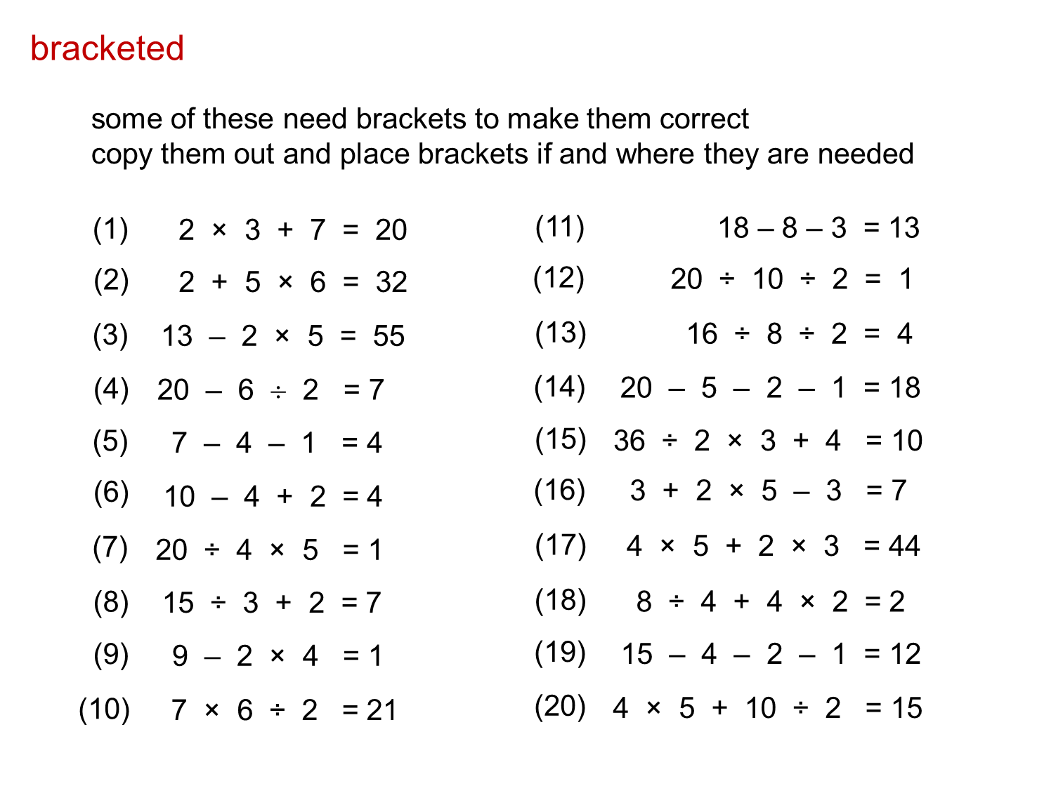
Problem Solving

Slide 11
Review!
1 2 3
RAG
Understanding
Effort
Struggling to understand this work.
Unsatisfactory effort: not trying hard and distracted from learning.
R
3
3
Good understanding for most of the work.
Good effort; mostly concentrating but could have tried harder.
A
3
2
Excellent understanding; can explain to someone else.
Excellent effort: concentrated, focussed and tried hard.
G
3
1

