Slide 1


The exam
Don’t panic!!!!
Take your time
You are brilliant
Read and think
Have a good go!
Notes:
DO operant conditioning

Slide 2
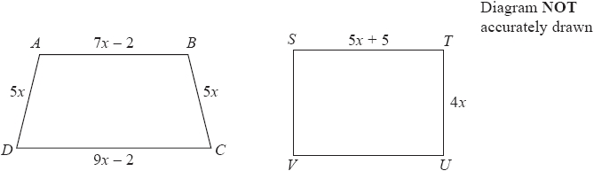
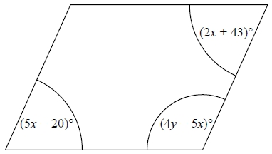
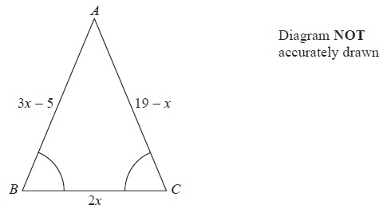
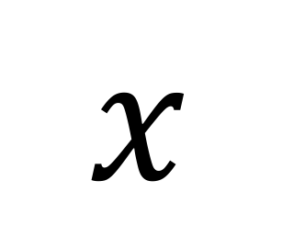
“Some amount”
Worded
Perimeter OR area.
Gemma has the same number of sweets as Betty.
Gemma gives 24 of her sweets to Betty.
Betty now has 5 times as many sweets as Gemma.
Work out the total number of sweets that Gemma and Betty have.
$$x$$
Angles
You’ve worked so hard
Simultaneous
The Singh family and the Peterson family go to the cinema.
The Singh family buy 2 adult tickets and 3 child tickets.
They pay £28.20 for the tickets.
The Peterson family buy 3 adult tickets and 5 child tickets.
They pay £44.75 for the tickets.
Find the cost of each adult ticket and each child ticket.
Equal lengths
Notes:
DO operant conditioning

Slide 3
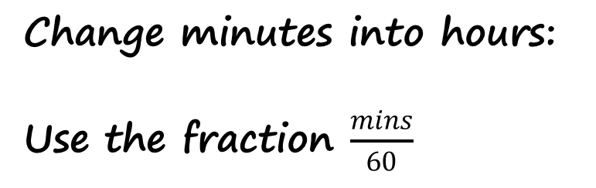
Speed, density or mean
You can’t add speeds, densities or means.
Total Group
Group A
Density
Speed
Distance
Time
Mass
Volume
Group B
Frequency
Journey A
Liquid A
Relax and stay calm
Journey B
Mean
Liquid B
Total
Liquid
Total
Total journey
Change minutes into hours:
Use the fraction $\frac{mins}{60}$
Notes:
DO operant conditioning

Slide 4
Try a question
The mean of 4 numbers is 7.
The mean of 6 different numbers is 9.
What is the mean of all ten numbers?
Show off what you know
Notes:
DO operant conditioning

Slide 5

Angles
Get started with any angle you can
Annotate diagram
Reasons: words
You’re going to do great
Show: calculations
Start with exterior angle, then interior angle.
$$x$$
Notes:
DO operant conditioning

Slide 6
Similar solids or converting units
Area AEFG = 36cm²
I believe in you
m to cm
Length
Area
Volume
x 100
Scale Factor
SF²
x 100²
SF³
x 100³
Notes:
DO operant conditioning

Slide 7
Describe Transformations
Name and detail
Line of reflection
Direction and angle
Centre of rotation
Vector
Scale factor
Centre of enlargement
I believe in you
Notes:
DO operant conditioning

Slide 8
Describe Transformations
Name and detail
Line of reflection
Direction and angle
Centre of rotation
Vector
Scale factor
Centre of enlargement
I believe in you
Notes:
DO operant conditioning

Slide 9
Loci
Closer to AD than AB
Closer to A than B
I believe in you
Notes:
DO operant conditioning

Slide 10
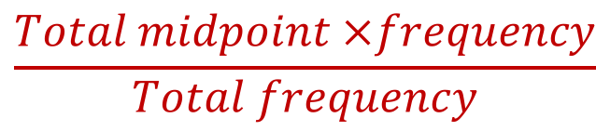
Grouped Data – what do you use?
Mean
$$\frac{Total midpoint ×frequency}{Total frequency}$$
Frequency polygon
Weekly wage (£x) | Frequency
100 < x ≤ 200 | 8
200 < x ≤ 300 | 15
300 < x ≤ 400 | 30
400 < x ≤ 500 | 17
500 < x ≤ 600 | 7
600 < x ≤ 700 | 3
Plot midpoint against frequency
I believe in you
Cumulative Frequency
Plot upper bound against cumulative frequency
(running total)
Notes:
DO operant conditioning

Slide 11
Comparing Data
Compare mean or median in context
Compare inter-quartile range
I believe in you
Notes:
DO operant conditioning

Slide 12
Interpreting cumulative frequency
Median
I believe in you
Interquartile Range
Notes:
DO operant conditioning

Slide 13
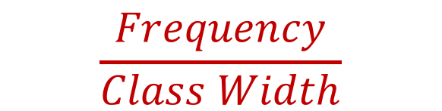
Histograms
Area = frequency
FD
I believe in you
Frequency Density =
$$\frac{Frequency}{Class Width}$$
Notes:
DO operant conditioning

Slide 14
Trigonometry
Write down the calculation you would put into your calculator
I believe in you
Replace the sin/cos/tan of the angle
with the exact ratio to solve
Notes:
DO operant conditioning

Slide 15
Ratio
Pam and Martin share some money in the ratio 3 : 7.
Martin has £24 more than Pam.
How much do they share?
Draw the boxes to help
Use fractions of (x) fractions
I believe in you
White shapes and black shapes are used in a game.
Some of the shapes are circles.
All the other shapes are squares.
The ratio of the number of white shapes to the number of black shapes is 3:7
The ratio of the number of white circles to the number of white squares is 4:5
The ratio of the number of black circles to the number of black squares is 2:5
Work out what fraction of all the shapes are circles.
Notes:
DO operant conditioning

Slide 16
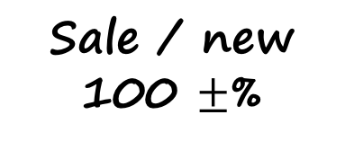
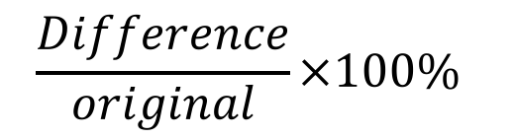
Percentages
Jules buys a washing machine.
20% VAT is added to the price of the washing machine.
Jules then has to pay a total of £600
What is the price of the washing machine with no VAT added?
Normal / original
100%
Sale / new
100 $±$%
I believe in you
A set of tyres normally costs £500
In a sale there is a 30% discount.
Work out the sale price of the set of tyres.
In a sale, the price of a jacket is reduced.
The jacket has a normal price of £52
The jacket has a sale price of £41.60
Work out the percentage reduction in the price of the jacket.
$$\frac{Difference}{original}×100\%$$
Notes:
DO operant conditioning

Slide 17

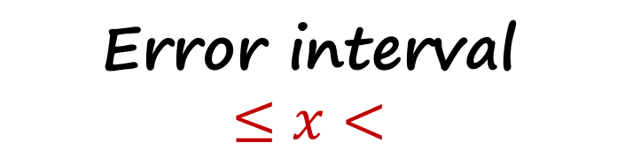
Final remembers
Estimate
1 significant figure
Circles
Keep $π$
Go and kick some
Error interval
$$≤x<$$
Notes:
DO operant conditioning

Slide 18
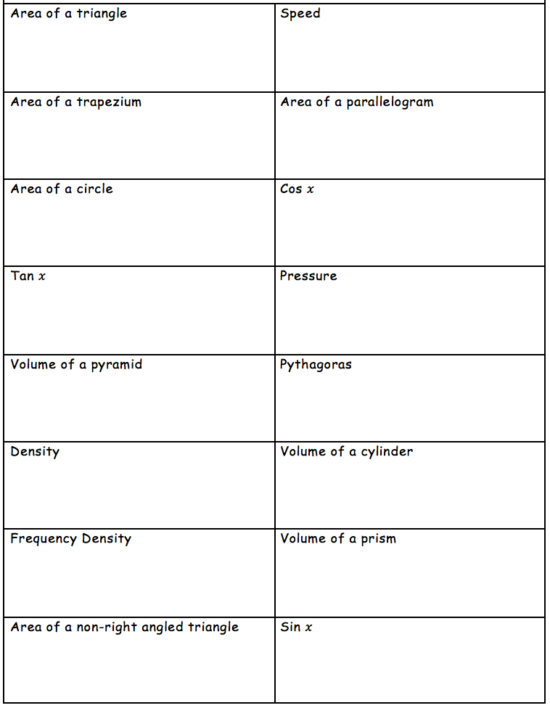
Formula
Which formulae do you need to keep looking at before you go in?
I believe in you
Notes:
DO operant conditioning

Slide 19
Go kick some

