Slide 1
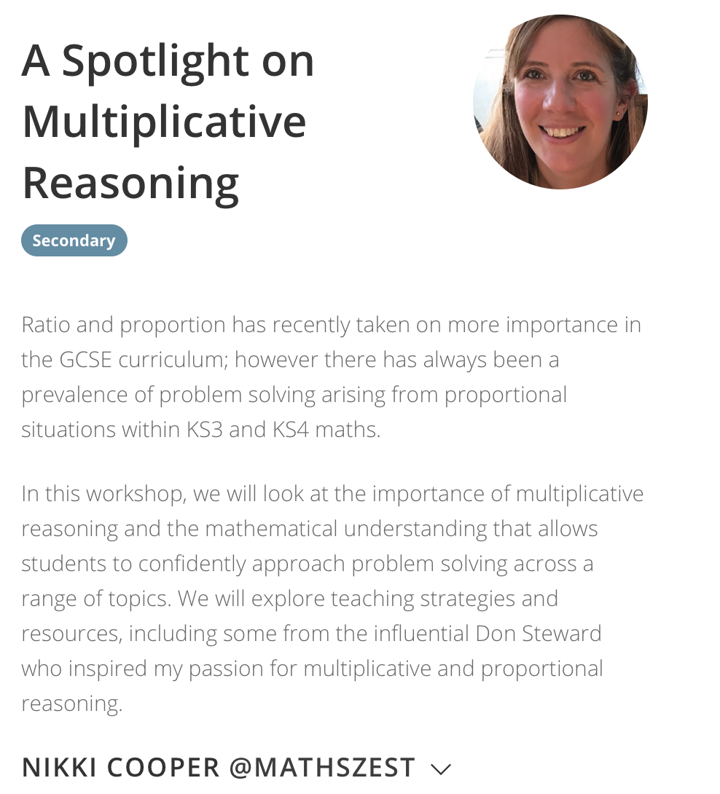

Slide 2
A Spotlight on
Multiplicative Reasoning
Nikki Cooper
@mathszest

Slide 3
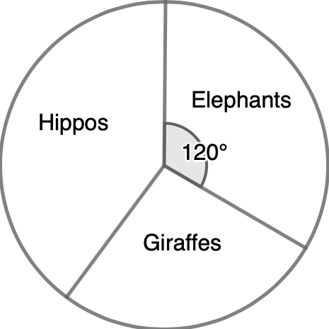


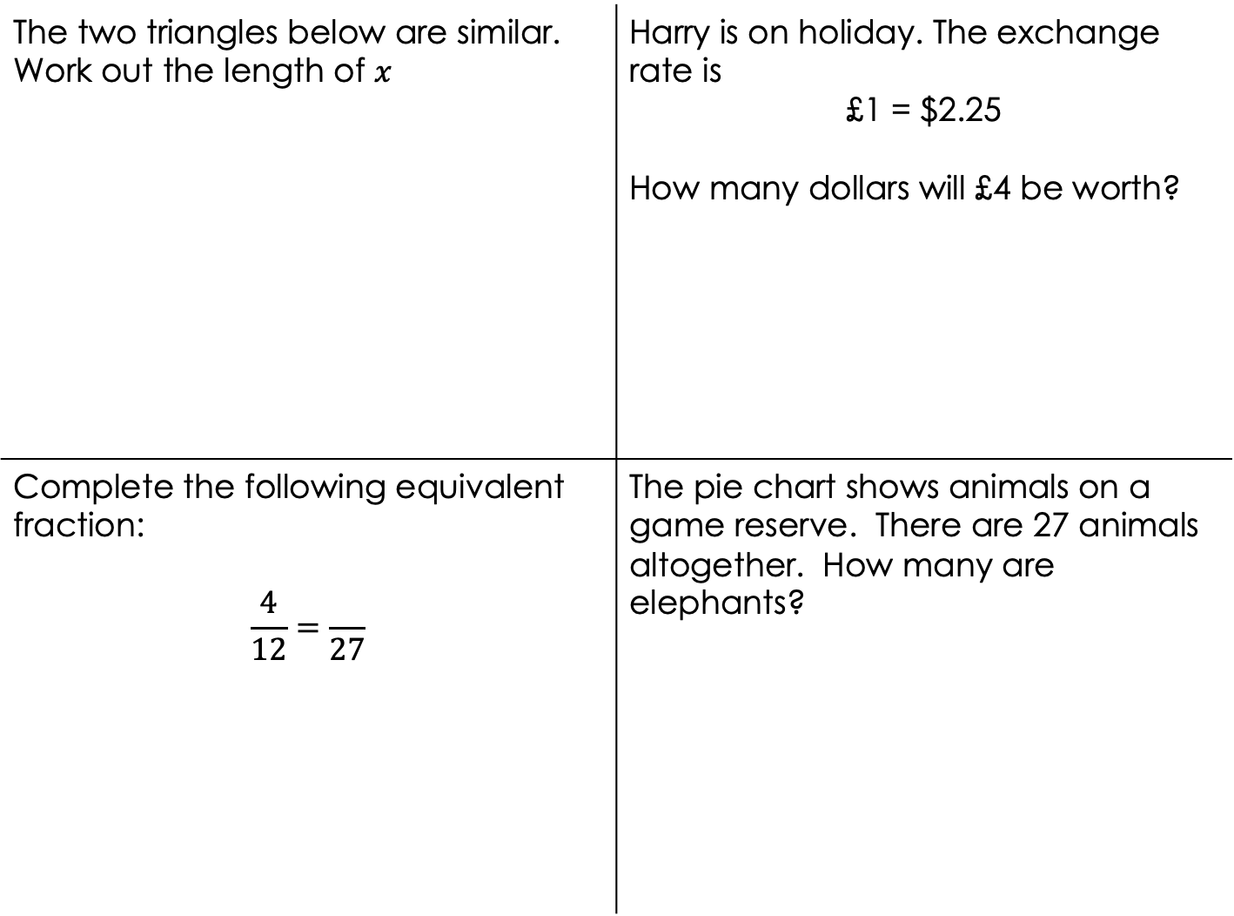

The two triangles below are similar. Work out the length of $x$ | Harry is on holiday. The exchange rate is £1 = $2.25 How many dollars will £4 be worth?
Complete the following equivalent fraction: $$\frac{4}{12}=\frac{}{27}$$ | The pie chart shows animals on a game reserve. There are 27 animals altogether. How many are elephants?
$$x$$
4cm
12cm
27cm

Slide 4
Multiplicative Reasoning
Multiplicative reasoning refers to the mathematical understanding and capability to solve problems arising from proportional situations often involving an understanding and application of fractions as well as decimals, percentages, ratios and proportions.
Multiplicative reasoning professional development programme: evaluation 2015 NCETM
Proportion
Two pairs of numbers are in proportion if the scale factors for the pairs of numbers are equal.
STEM

Slide 5
What multiplicative reasoning concepts do students come across before they get to Year 7?

Slide 6
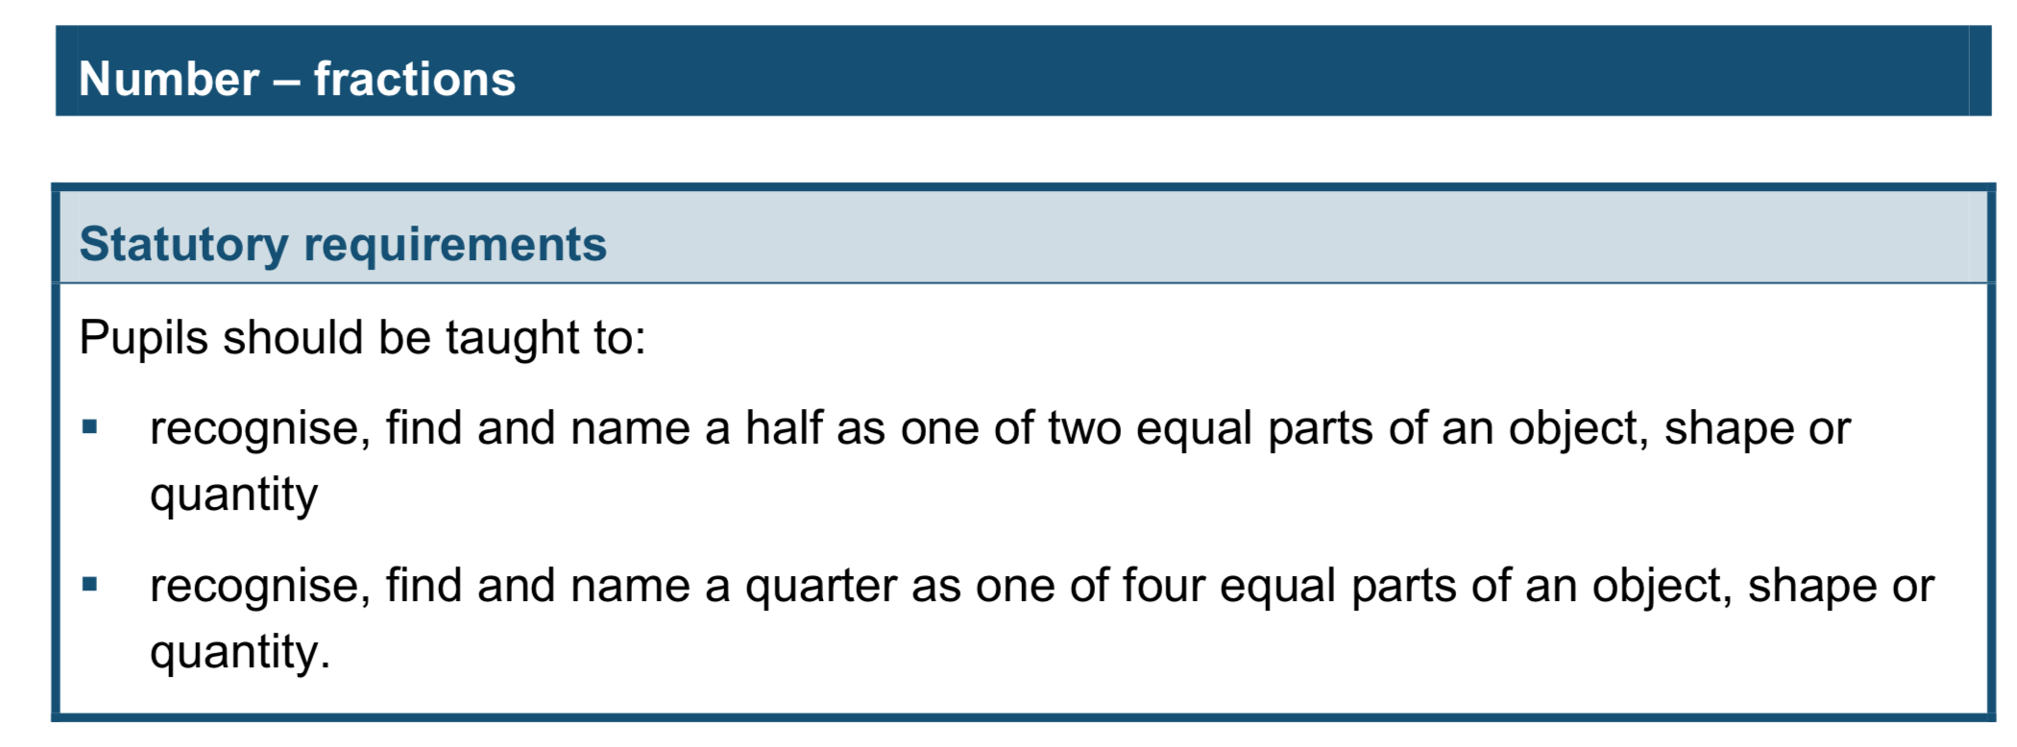
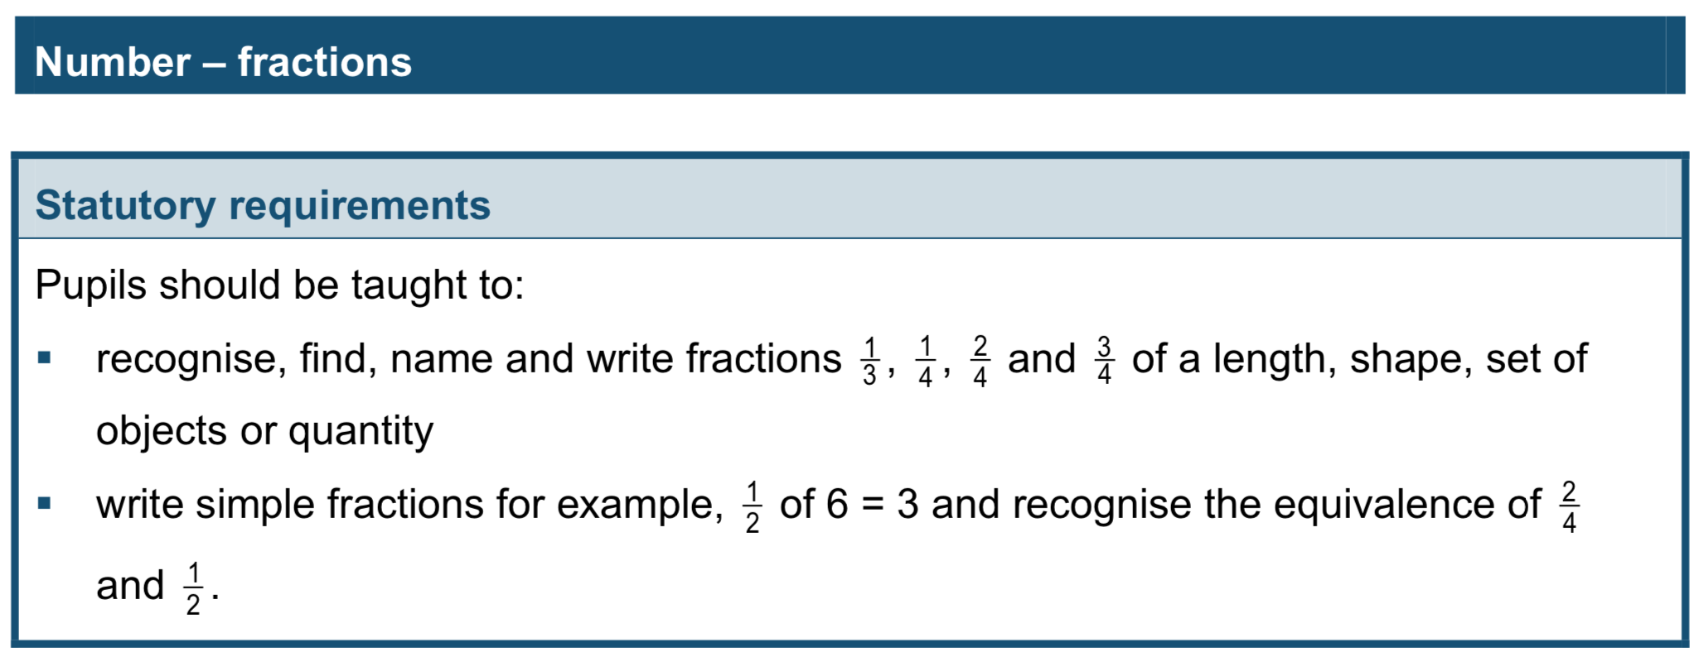
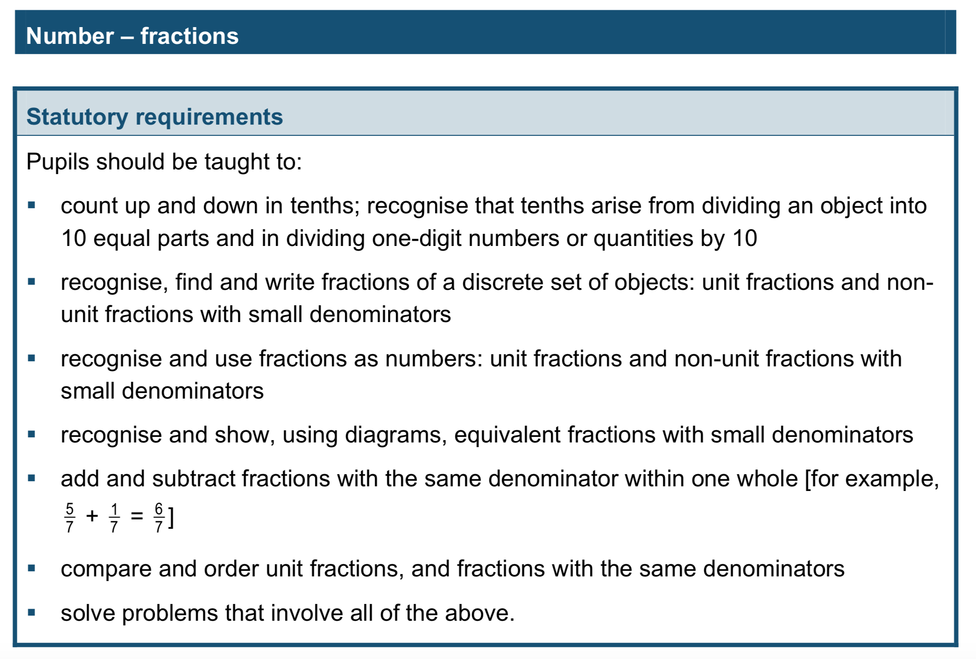
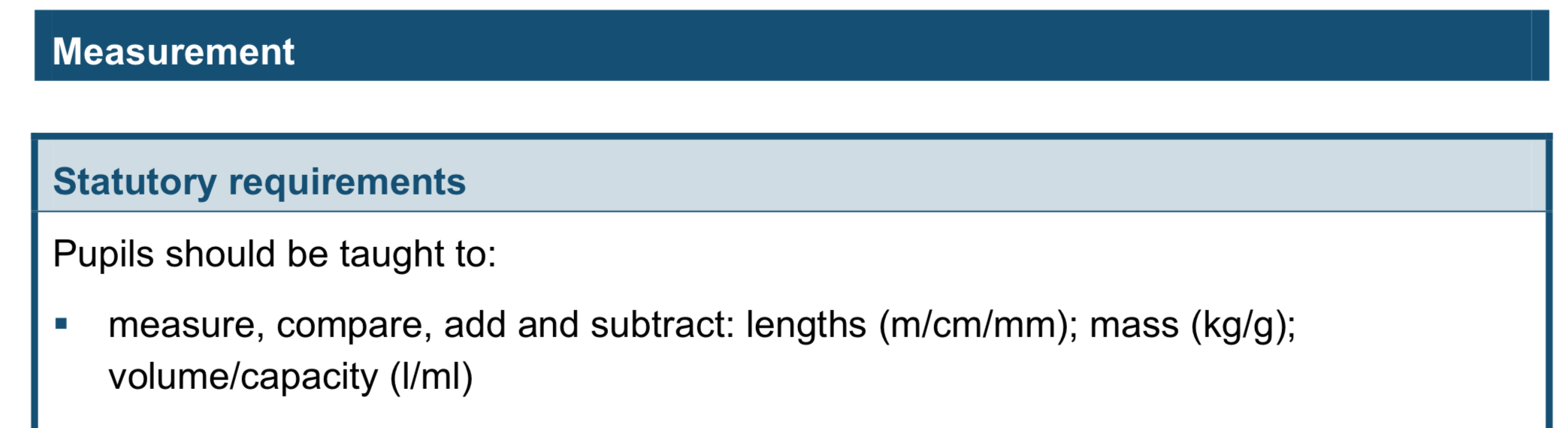
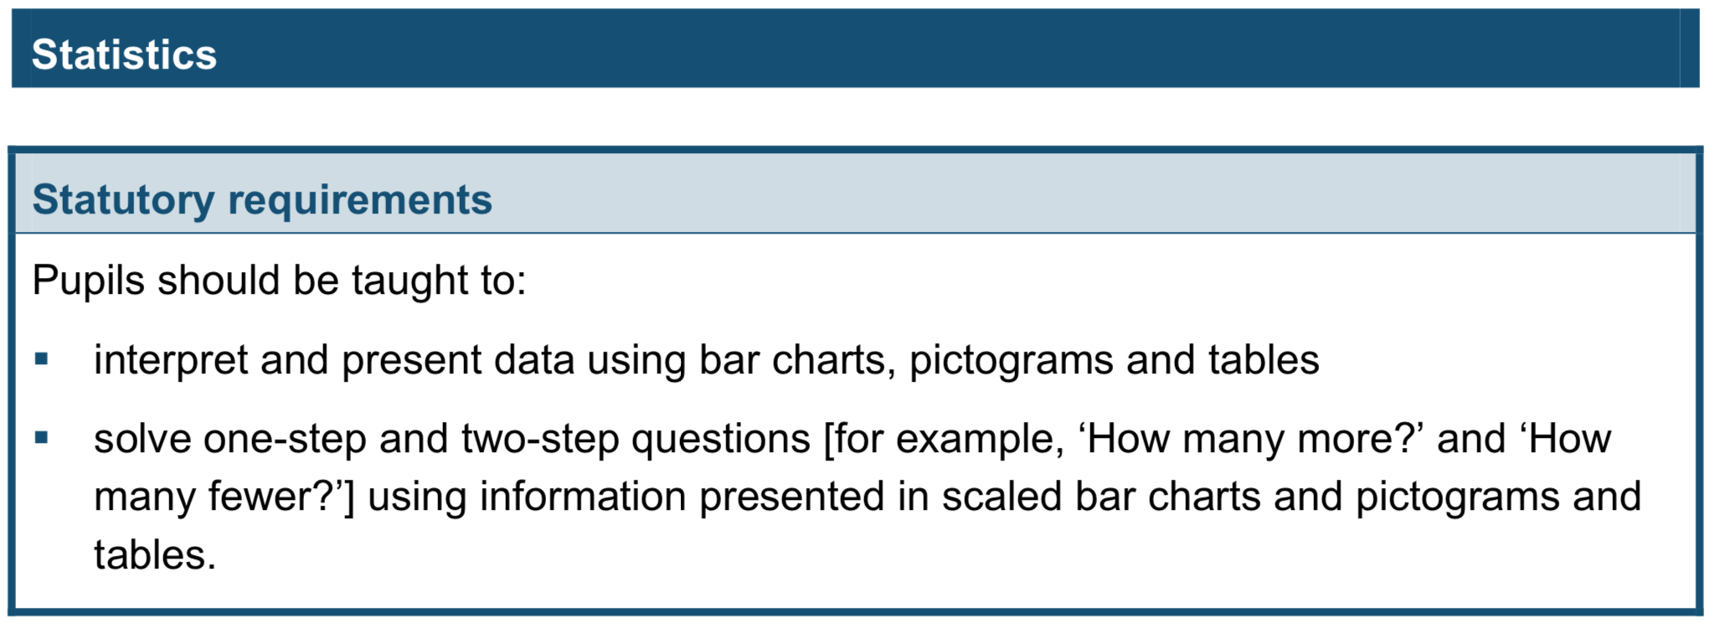
Year 1
Year 2
Year 3
Year 3
Year 3

Slide 7
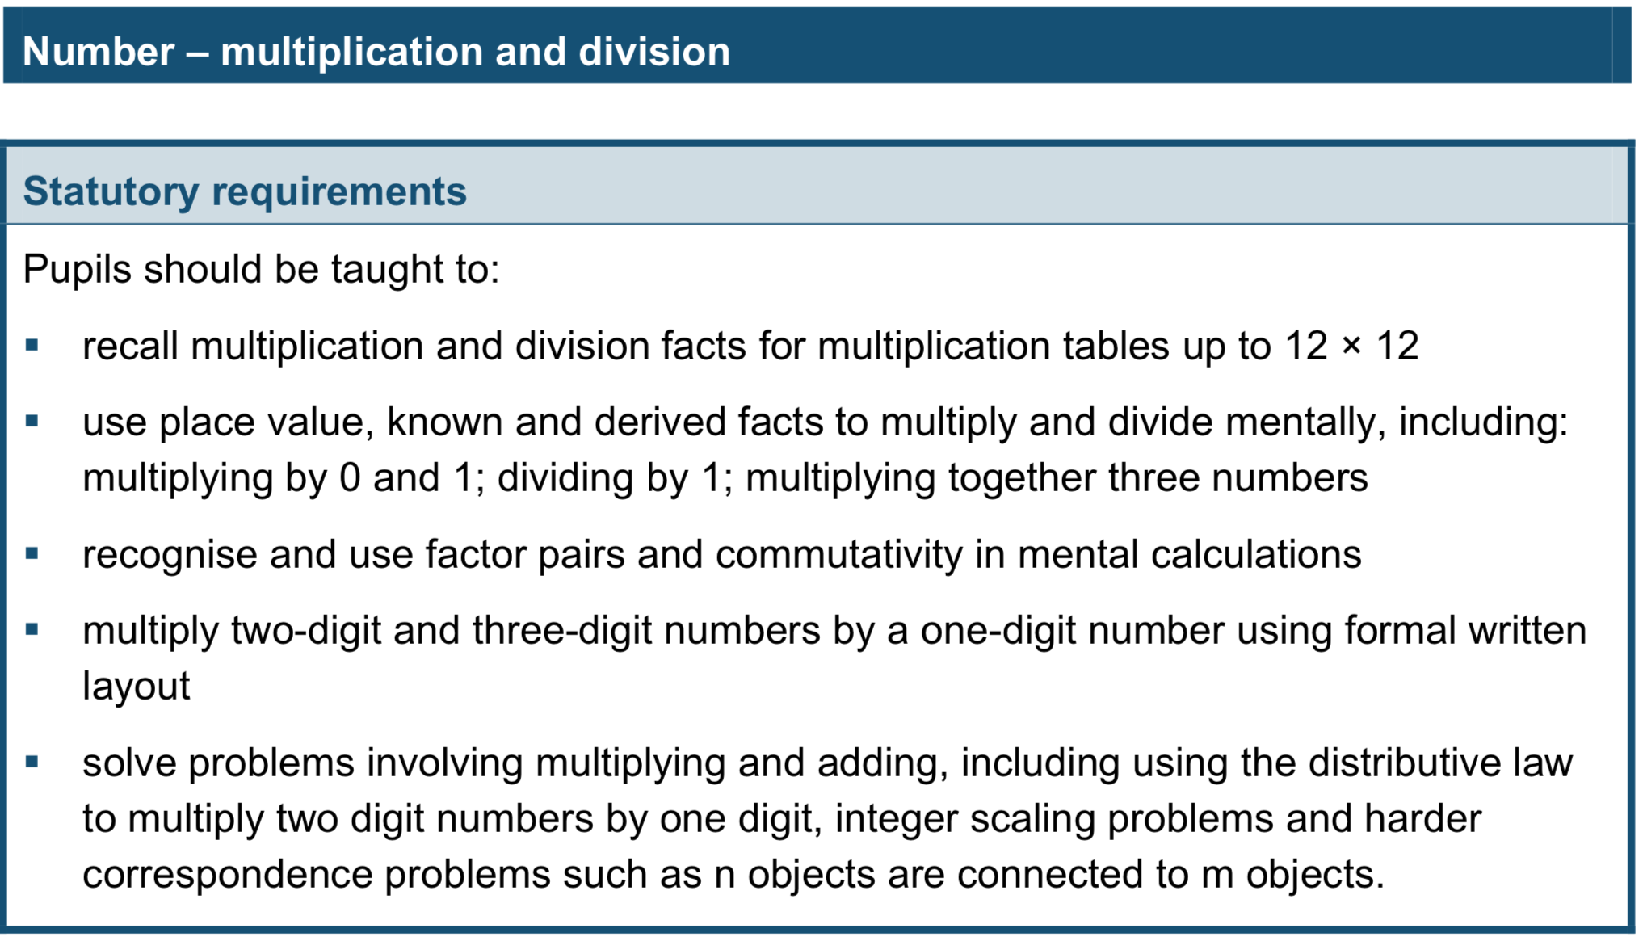
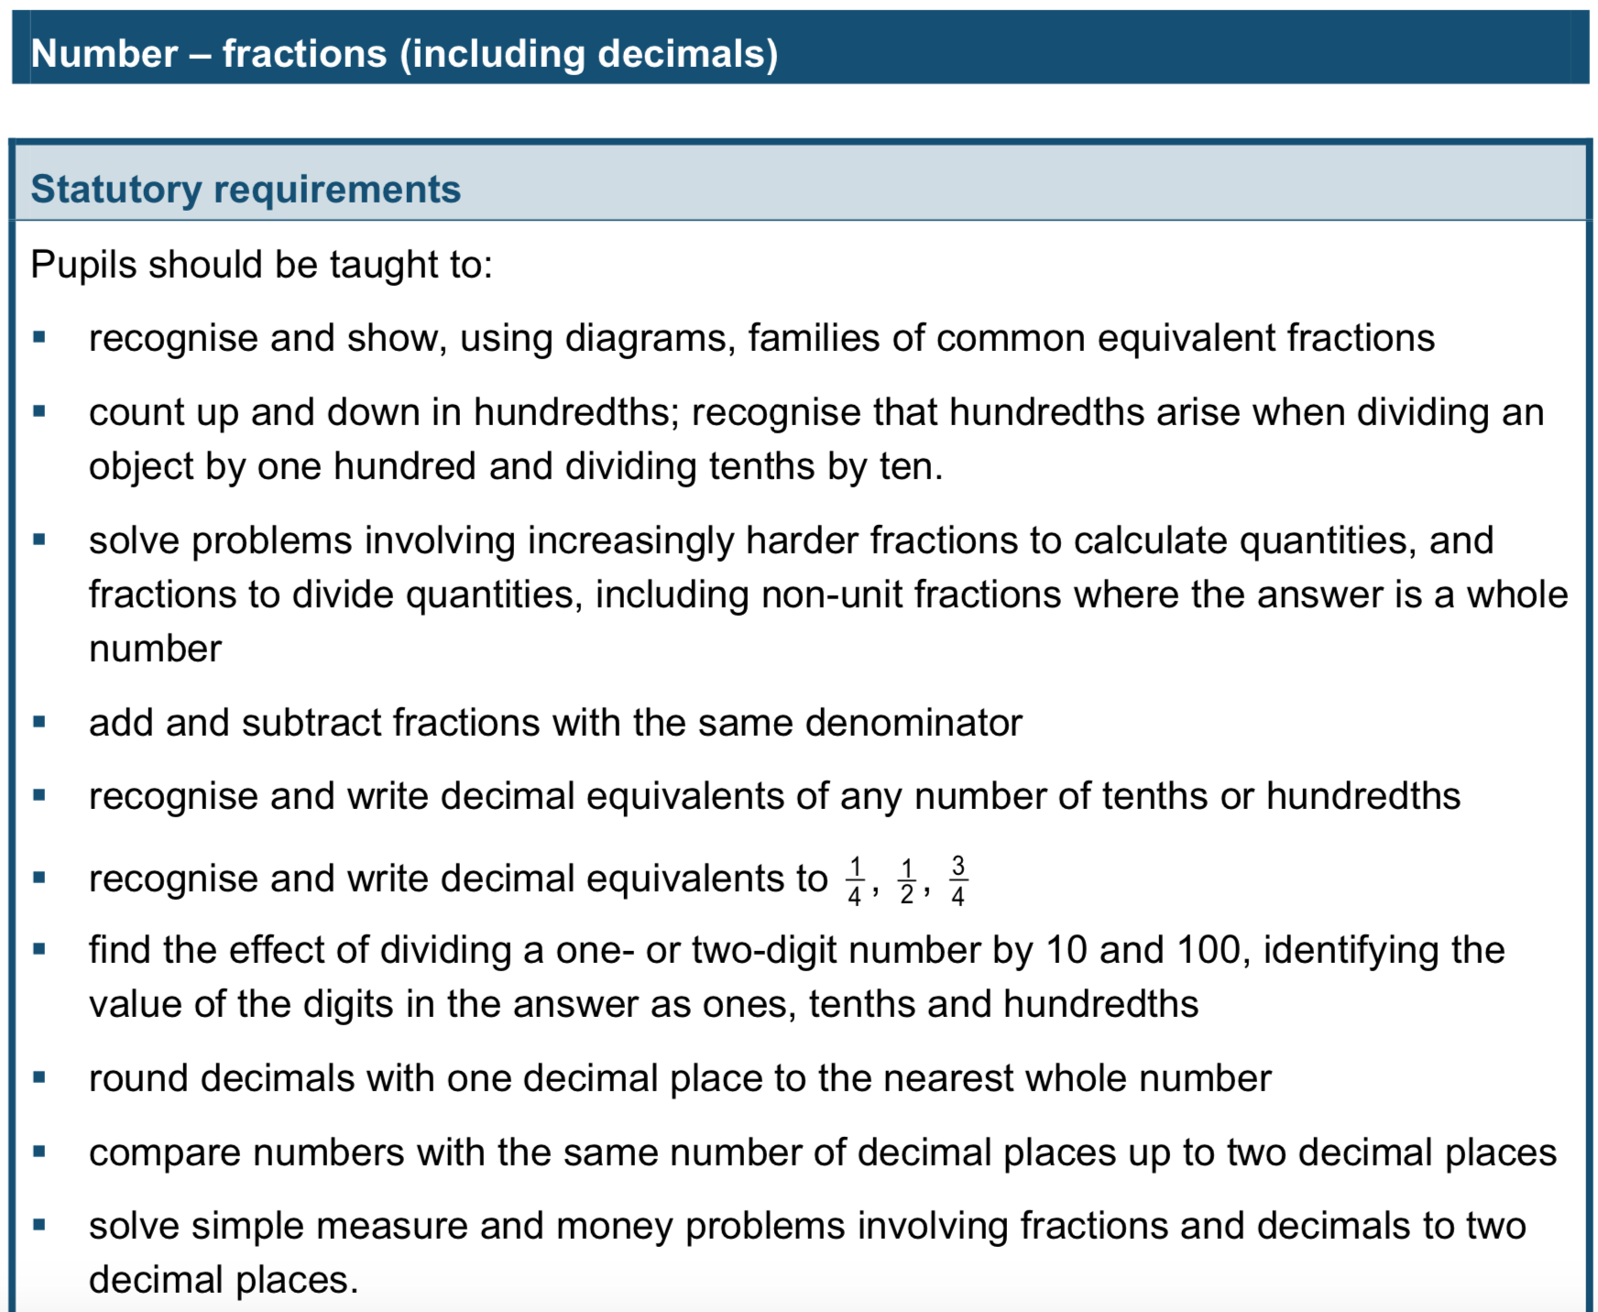
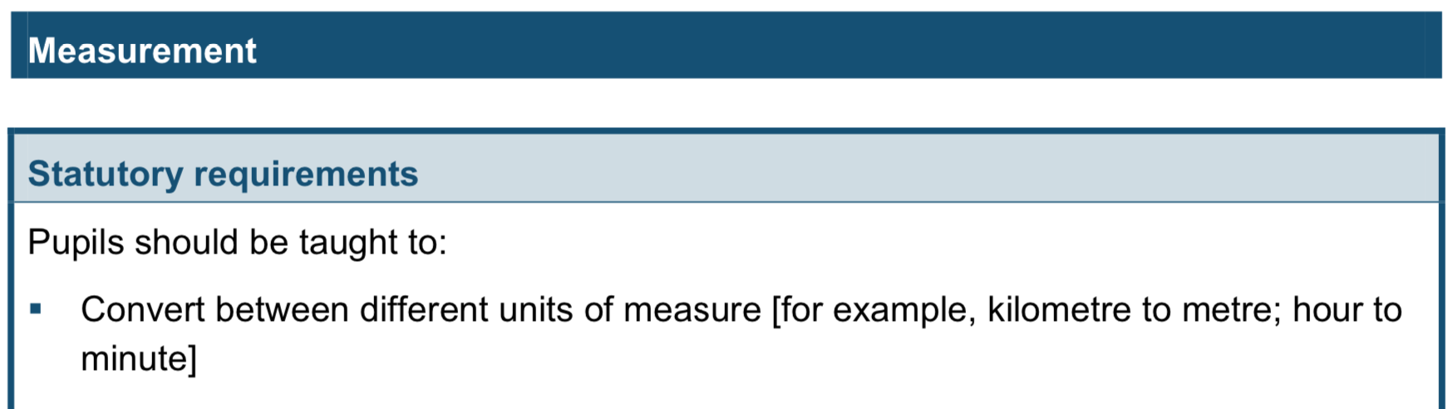
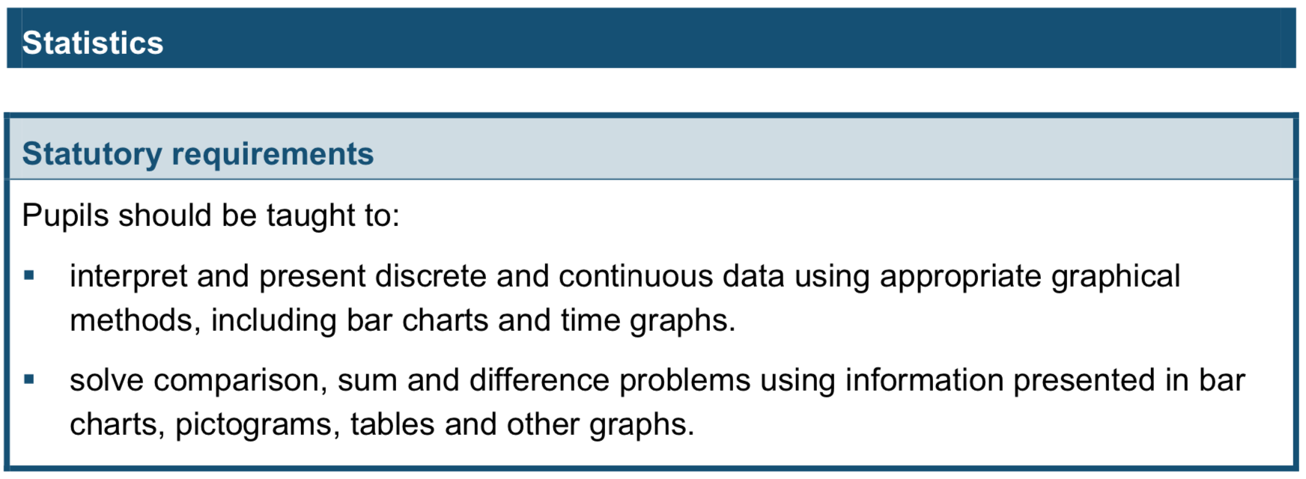
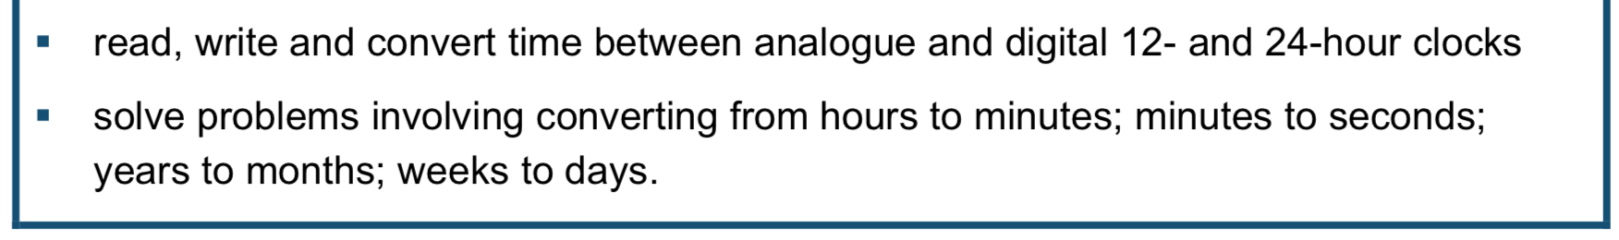
Year 4
Year 4
Year 4
Year 4

Slide 8
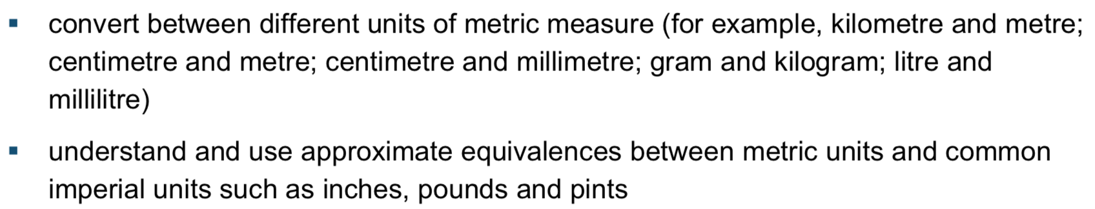
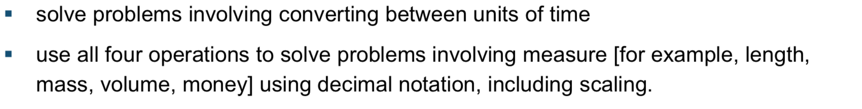

Slide 9
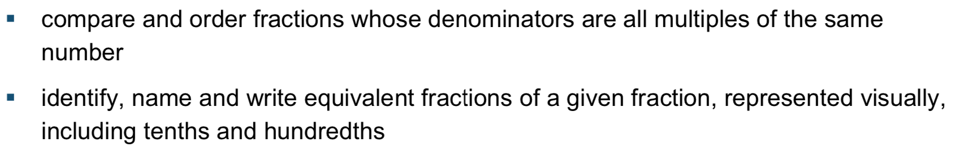
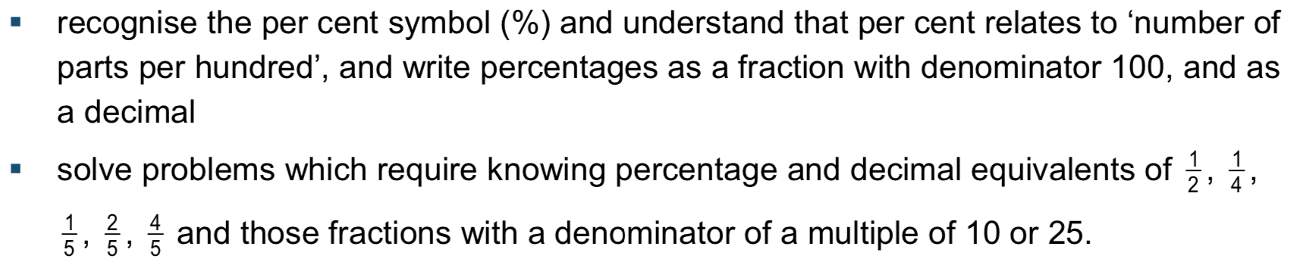
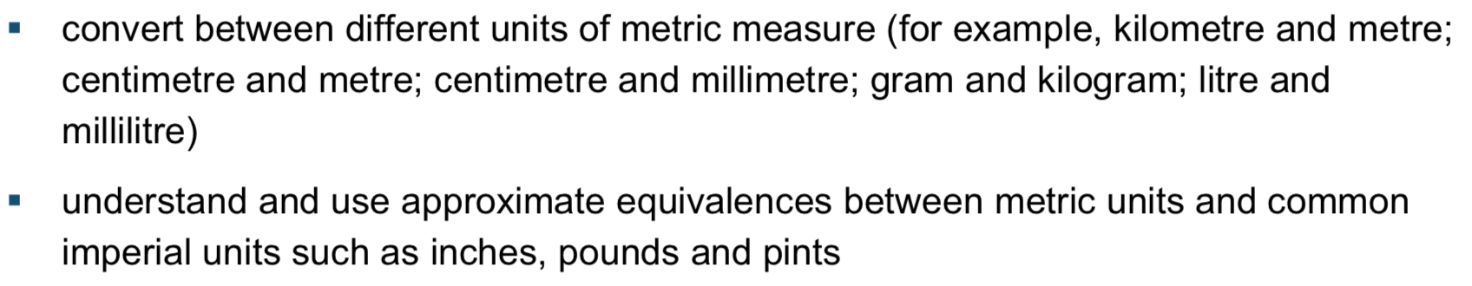

Slide 10
Misconceptions

Slide 11
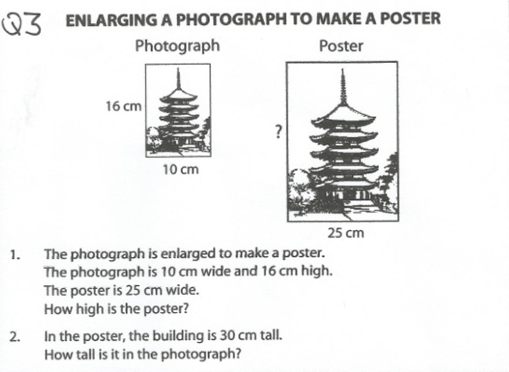
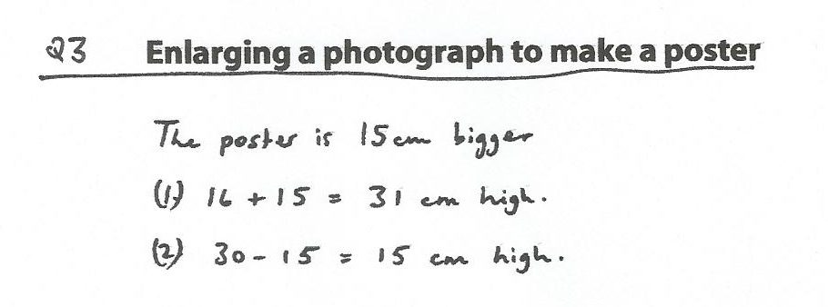
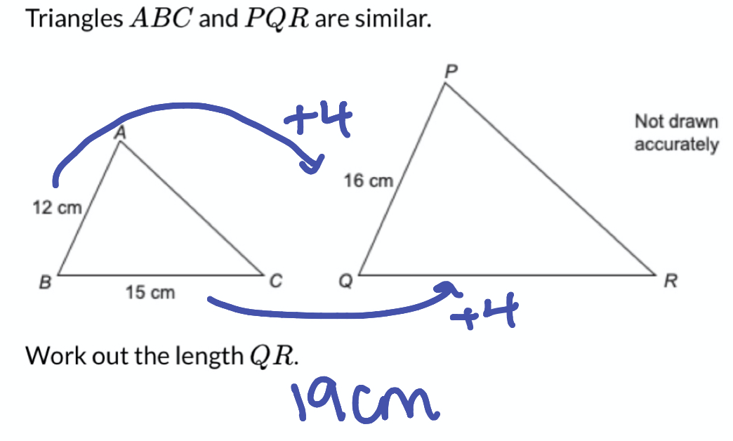
Example taken from Standards Units N6

Slide 12
'It has been suggested by research that many pupils (and adults) fail to move on from additive structures and this can lead to many misconceptions and errors in subsequent mathematical study.'
NCETM July 2013
The connections between repeated addition and multiplication and repeated subtraction and division are somewhat limiting if we are to help them build a strong understanding of multiplicative reasoning.
Caroline Clissold Rising-Stars

Slide 13
What can we do to help strengthen student’s multiplicative reasoning?

Slide 14
Year 7
Explicitly introduce proportion early on.
Practise using a multiplicative relationship between values.
Develop an understanding of what being in proportion is and its connections across topics

Slide 15
Defining Proportion

Slide 16
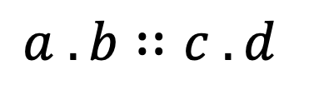
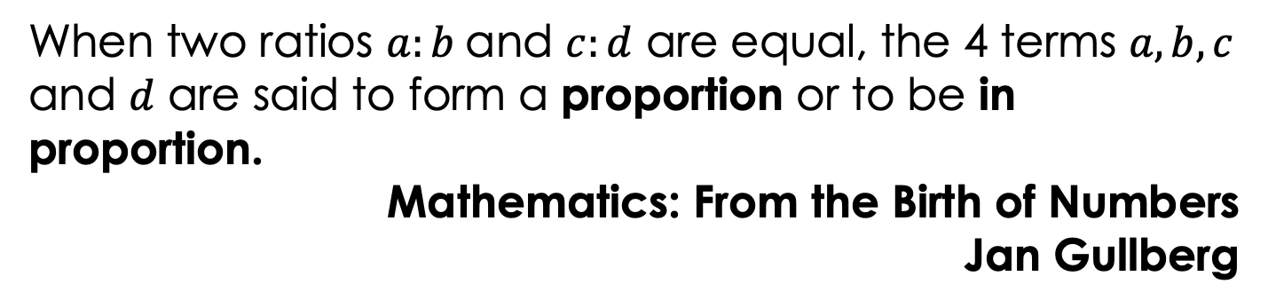
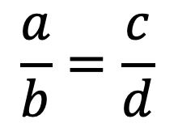
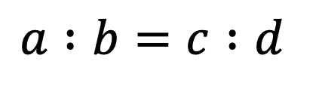
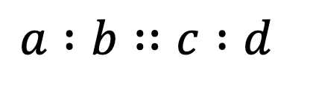
Proportion
When two ratios $a:b$and $c:d$ are equal, the 4 terms $a, b, c$ and $d$ are said to form a proportion or to be in proportion.
Mathematics: From the Birth of Numbers
Jan Gullberg
$$a .b∷c .d$$
William Oughtred 1631
Clavis mathematicae
$$a :b∷c :d$$
Canones sinumm 1657
$$a :b=c :d$$
20th Century
$$\frac{a}{b}=\frac{c}{d}$$

Slide 17
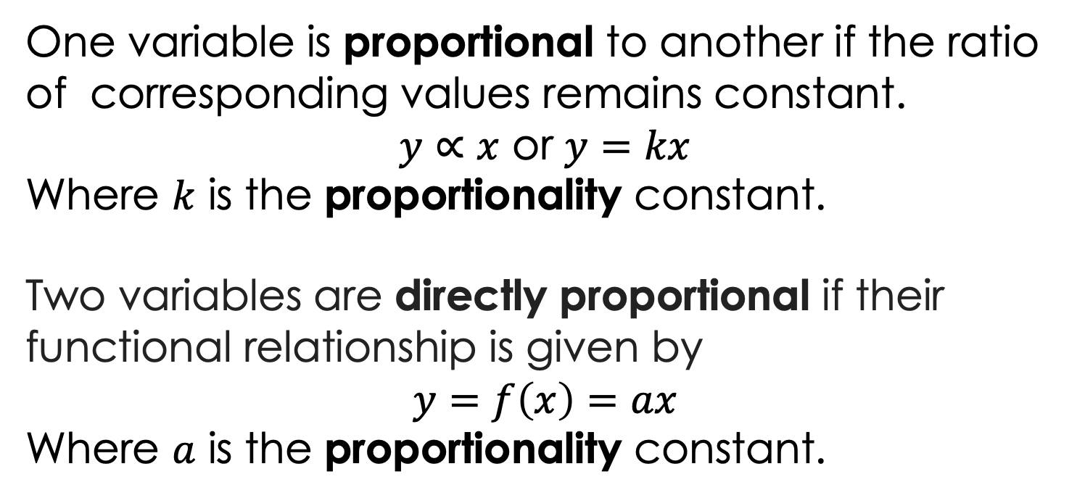
In Proportion
Two pairs of numbers are in proportion if the ratio formed by the first pair equals the ratio formed by the second pair.
Proportional
One variable is proportional to another if the ratio of corresponding values remains constant.
$y∝x$ or $y=kx$
Where $k$ is the proportionality constant.
Two variables are directly proportional if their functional relationship is given by
$$y=f\left(x\right)=ax$$
Where $a$ is the proportionality constant.

Slide 18
Proportionality
The fact of a variable quantity having a constant ratio to another quantity.
A Proportion
The relation of one part to another or to the whole with respect to magnitude, quantity, or degree

Slide 19
Introducing Proportion

Slide 20
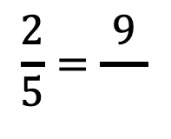
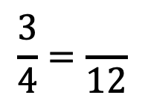
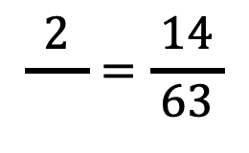
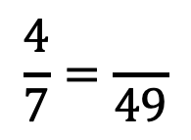
Complete these equivalent fractions:
$$\frac{3}{4}=\frac{ }{12}$$
$$\frac{2}{5}=\frac{9}{ }$$
$$\frac{4}{7}=\frac{ }{49}$$
$$\frac{2}{ }=\frac{14}{ 63 }$$
How did you work out the missing value?

Slide 21
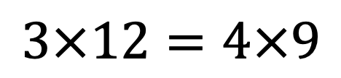
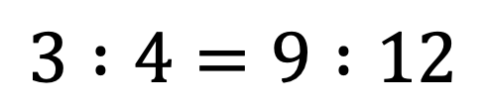
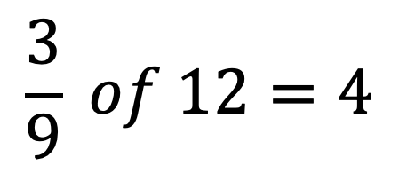
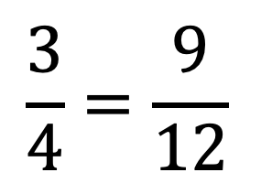
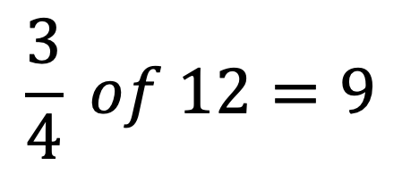
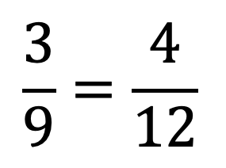
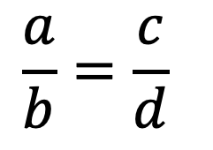
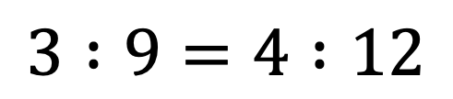
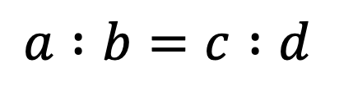
$$a :b=c :d$$
$$\frac{3}{4}=\frac{ 9 }{12}$$
$$\frac{3}{4} of 12=9$$
$$\frac{a}{b}=\frac{c}{d}$$
$$3 :4=9 :12$$
$$\frac{3}{9} of 12=4$$
$$3 :9=4 :12$$
$$\frac{3}{9}=\frac{ 4 }{12}$$
$$3×12=4×9$$

Slide 22
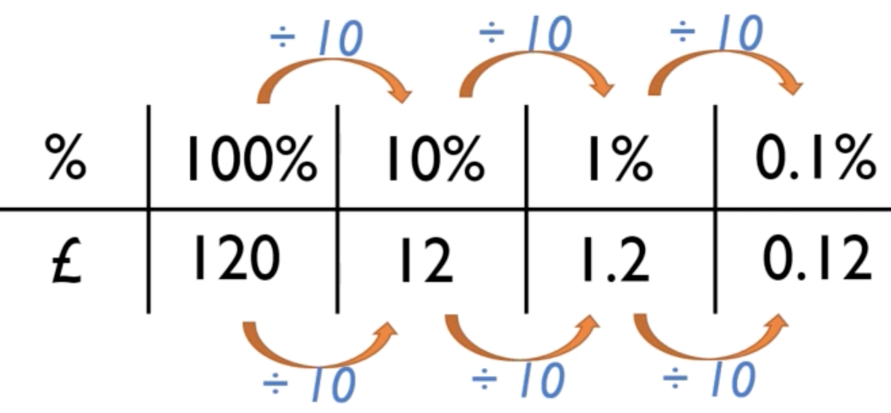
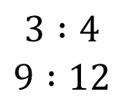
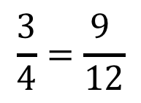
Proportion: a m___________________ relationship between two (or more) quantities;
Both quantities increase or decrease at the same r___________.
Two f__________ (or r_____________) are equal.
$$\frac{3}{4}=\frac{9 }{12}$$
$$3 :4$$
$$9 :12$$

Slide 23
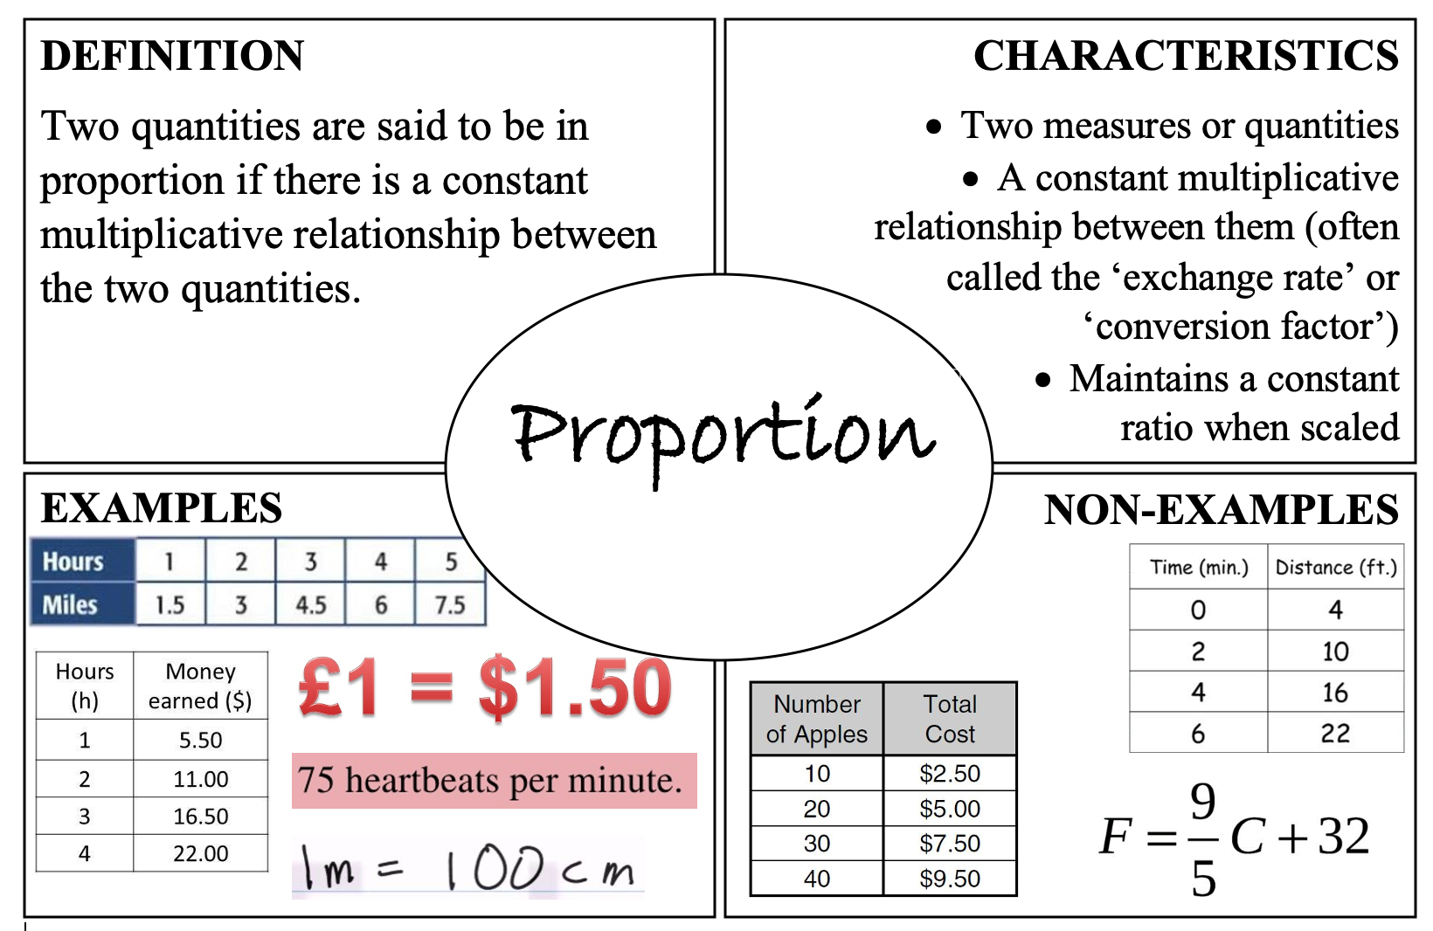
Frayer-model.co.uk

Slide 24
The multiplicative relationship

Slide 25
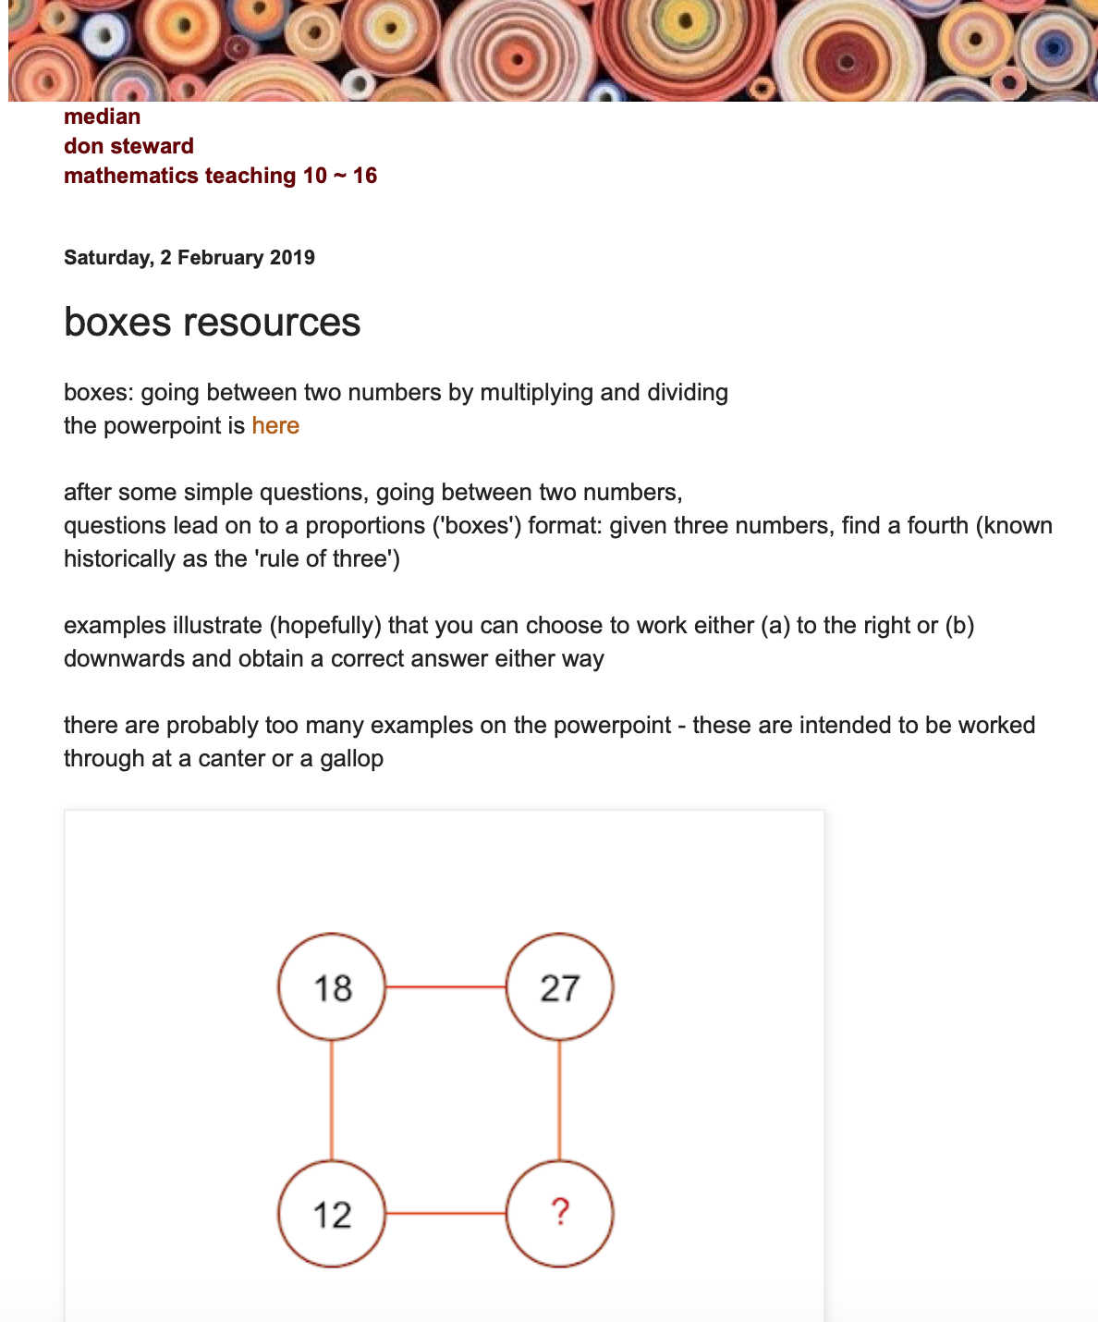
Donsteward.
blogspot.
com

Slide 26

In a proportion table, the horizontal values and the vertical values are in proportion.
2 | 8
 | 24
D______________
to find the M_______________
Think: What is the missing number and why?
2
5 | 7.5

Slide 27

Think: What multiplication and division steps can we use?
6
9
18 |  | 27
6 |  | 15
6 | 10
9
18 | 27
12
4
6 | 15

Slide 28
Applying to “standard” direct proportion problems

Slide 29
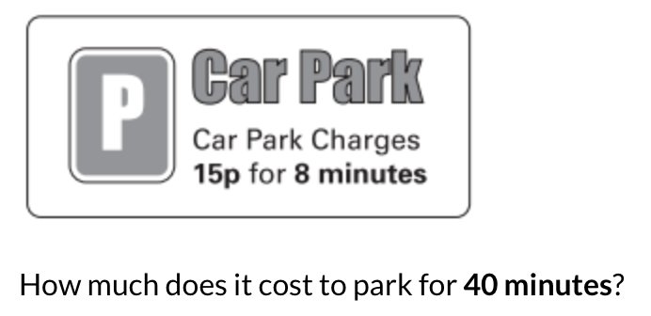

Slide 30
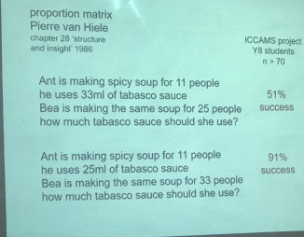



Don Steward – REd Rugby

Slide 31
Extending to variables

Slide 32
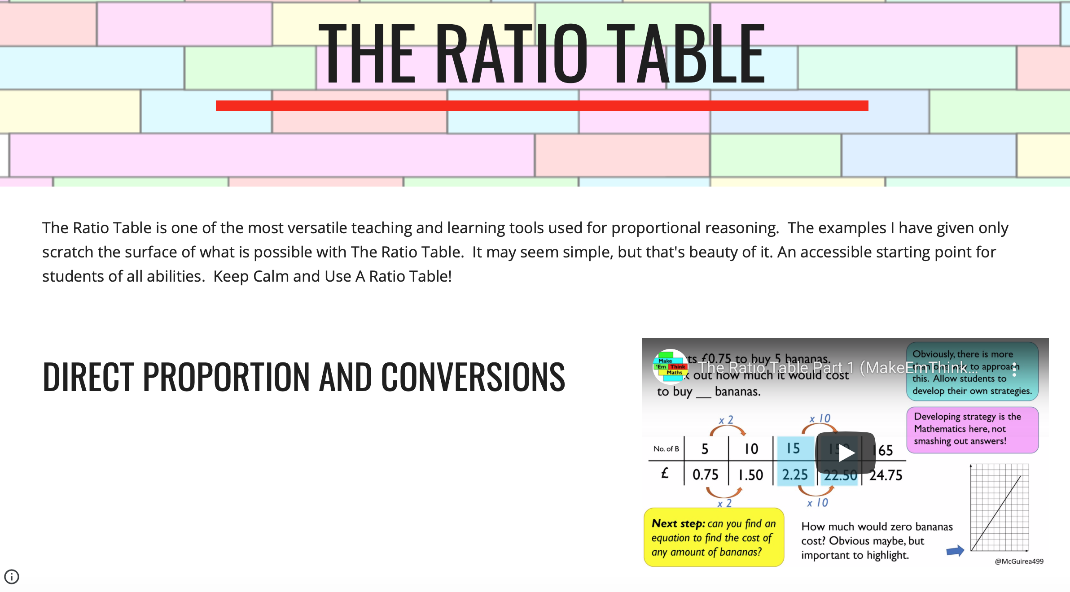
Makeemthinkmaths.com
@McGuirea499

Slide 33
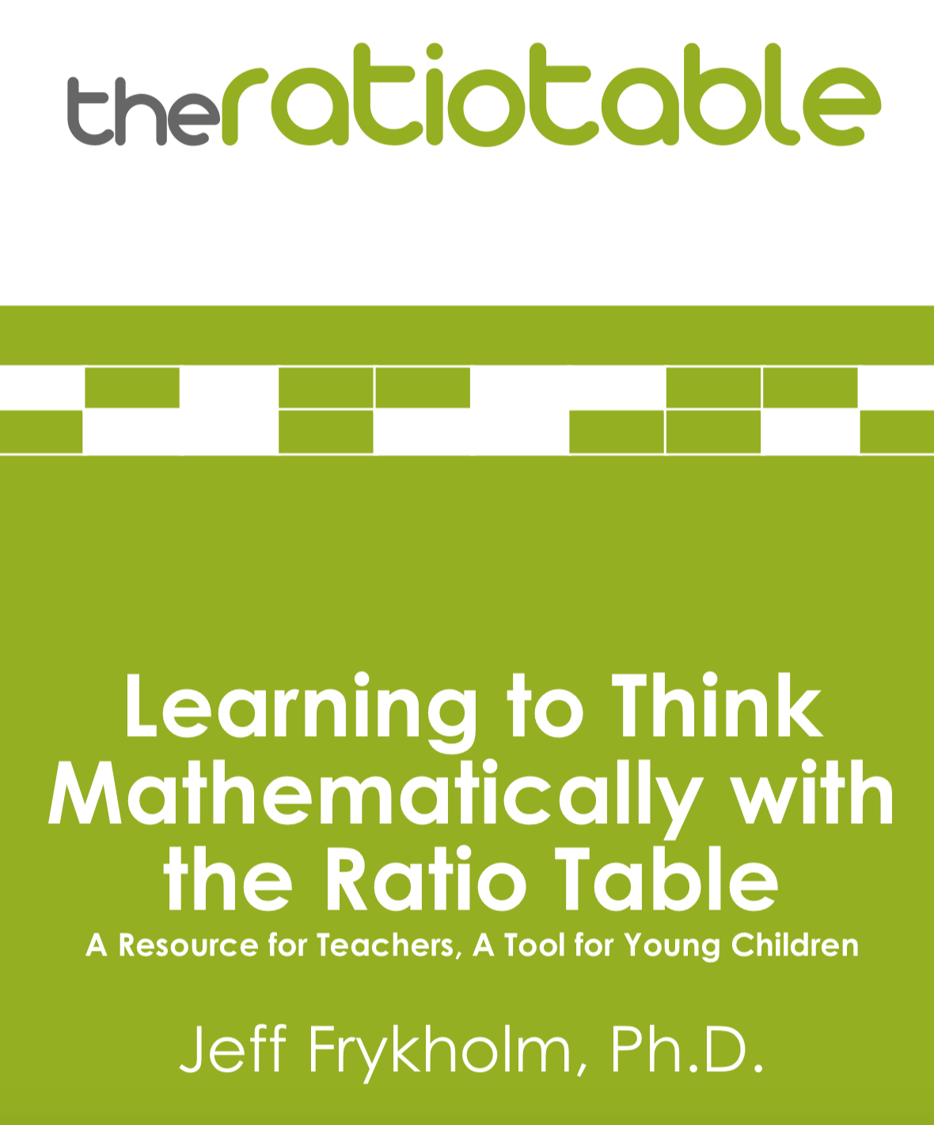
Mathlearningcentre.org

Slide 34
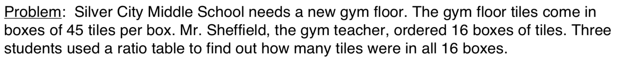







Combining or removing columns
Caution: misconceptions about adding and subtracting
Careful use of vocabulary

Slide 35

@mathsmumof2
The double number line

Slide 36


@studymaths

Slide 37
5 bags of crisps cost £1.35.
Calculate the cost of:
1 bag, 10 bags, 30 bags, 100 bags
How many bags cost £16.20?
Bags of crisps | 1 | 5 | 10 | 30 |  | 100
Cost £ |  | 1.35 |  |  | 16.20
Use proportion, left and right or up and down!
Divide to find the Multiplier
Ellie buys 40cm of this ribbon and it costs her 62p
Calculate the cost of:
120cm b) 20cm c) 100cm d) 340cm
How much ribbon costs:
a) £2.48 b) £3.10 c) £2.79

Slide 38
Delving deeper in the multplication

Slide 39
2
5 | 7.5
6 | 10
9
15 | 6
 | 4

Slide 40


@berniewestacott
Multiplying by fractions and their reciprocals

Slide 41
Exploring Proportion Problems

Slide 42


Standards Units N6

Slide 43

Mixedattainmentmaths.com

Slide 44
Developing multiplicative reasoning across the curriculum

Slide 45








Slide 46

Converting units, currency etc.

Slide 47



Those ‘double’ proportion

Slide 48

Best Buy: SSDDProblems.com
Rachel Mahoney

Slide 49



Percentages

Slide 50
Don Steward percentages

Slide 51



Mathshko.com
@giftedhko

Slide 52

Growth and Decay
Reverse Percentages

Slide 53



Pie Charts

Slide 54

Any types of scaling
Similar shapes, enlargement

Slide 55

Including Area or Volume

Slide 56



Compound Measures
Makeemthinkmaths.com
@McGuirea499

Slide 57
When it gets tricky!

Slide 58




$$a :b=c :d$$
$$\frac{a}{b}=\frac{c}{d}$$

Slide 59

Involving algebra

Slide 60
Further resources
DonSteward.blogspot.com - Proportion
Makeemthinkmaths.com @McGuirea499
N6 Standards Unit
NCETM.org.uk Multiplicative Reasoning
ICAAMS-maths.org
Mathshko.com

Slide 61
A Spotlight on
Multiplicative Reasoning
Nikki Cooper
@mathszest

