Slide 1
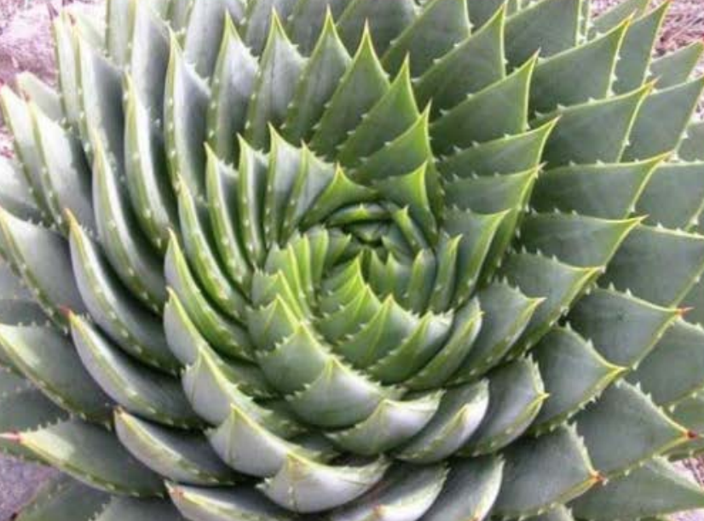
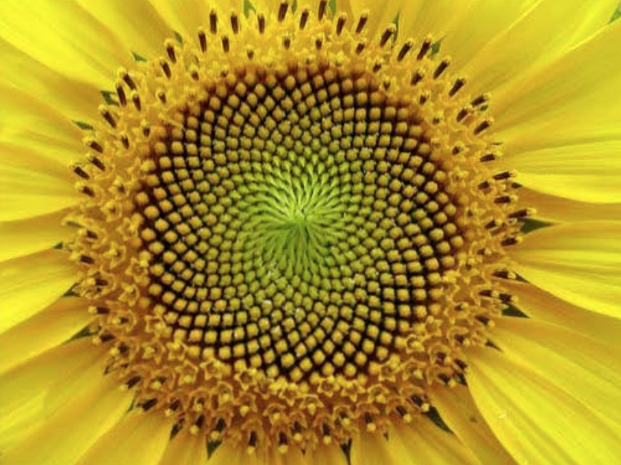
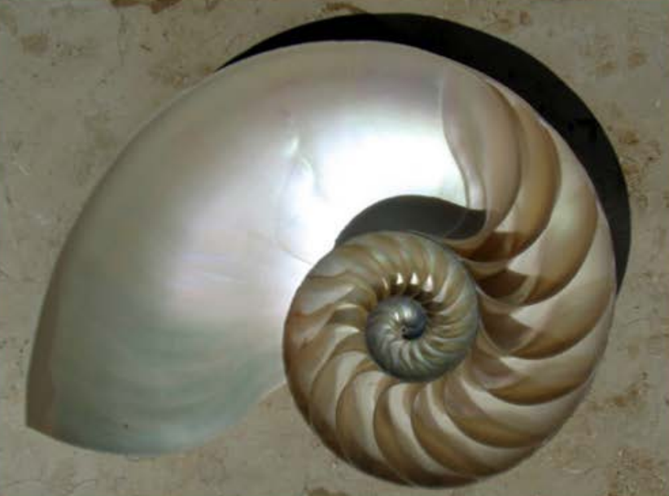
A very special sequence…
Vi Hart Fibonacci

Slide 2

1, 1,

Slide 3
Choose 2 starting numbers
Find the first 5 terms of your own Fibonacci sequence
Tell your partner the 4th and 5th terms.
Can they find your starting number?

Slide 4
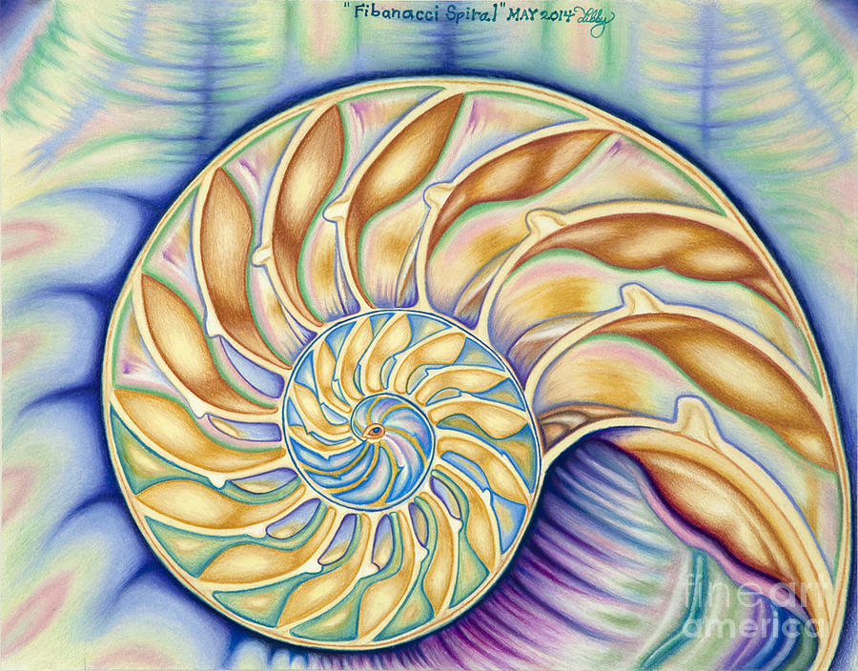


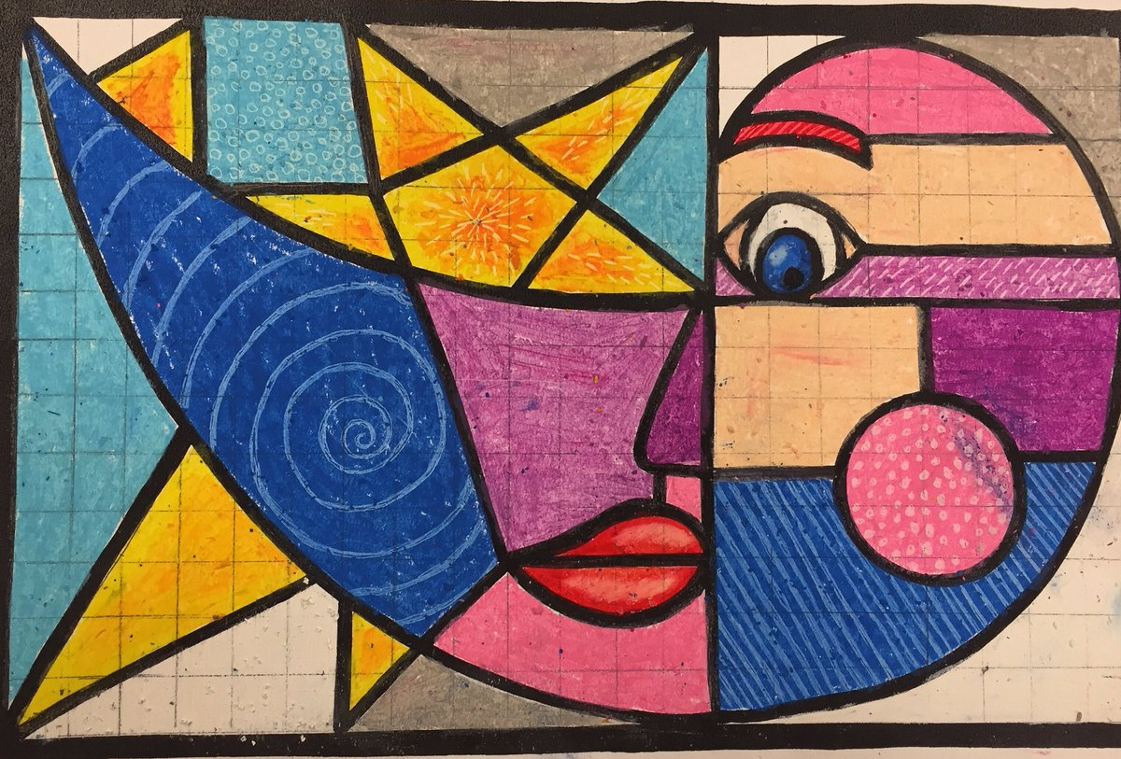
Fibonacci Spiral is a drawing by Taryn Libby

Slide 5
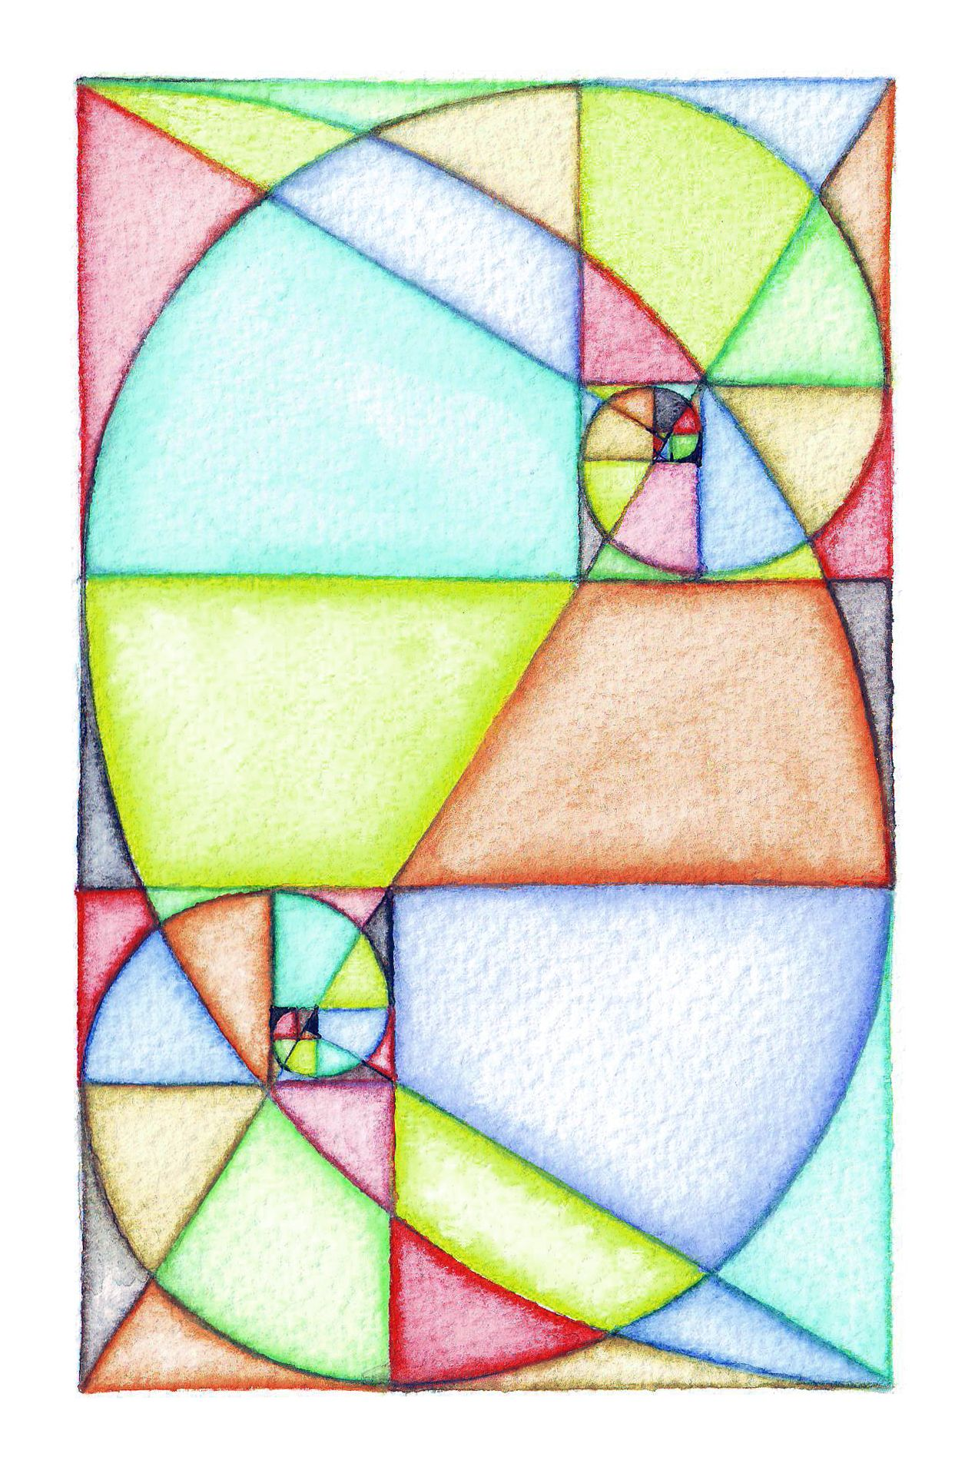
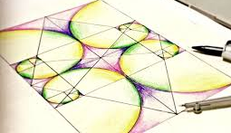
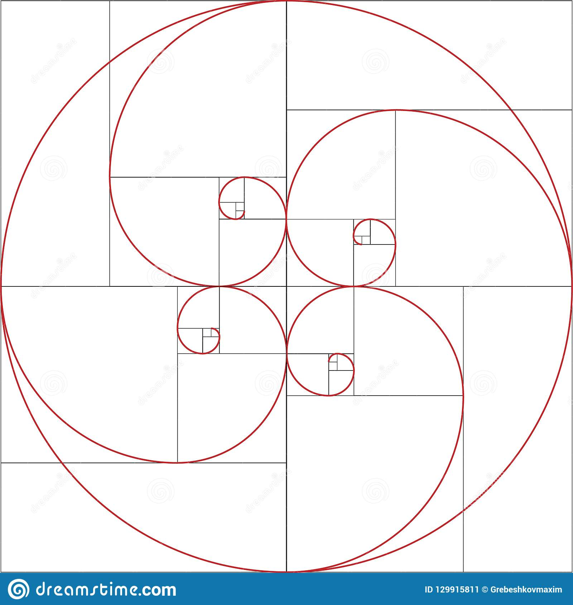
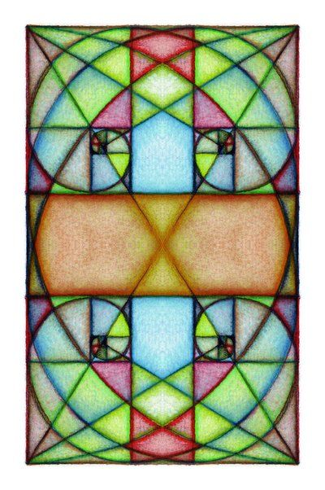
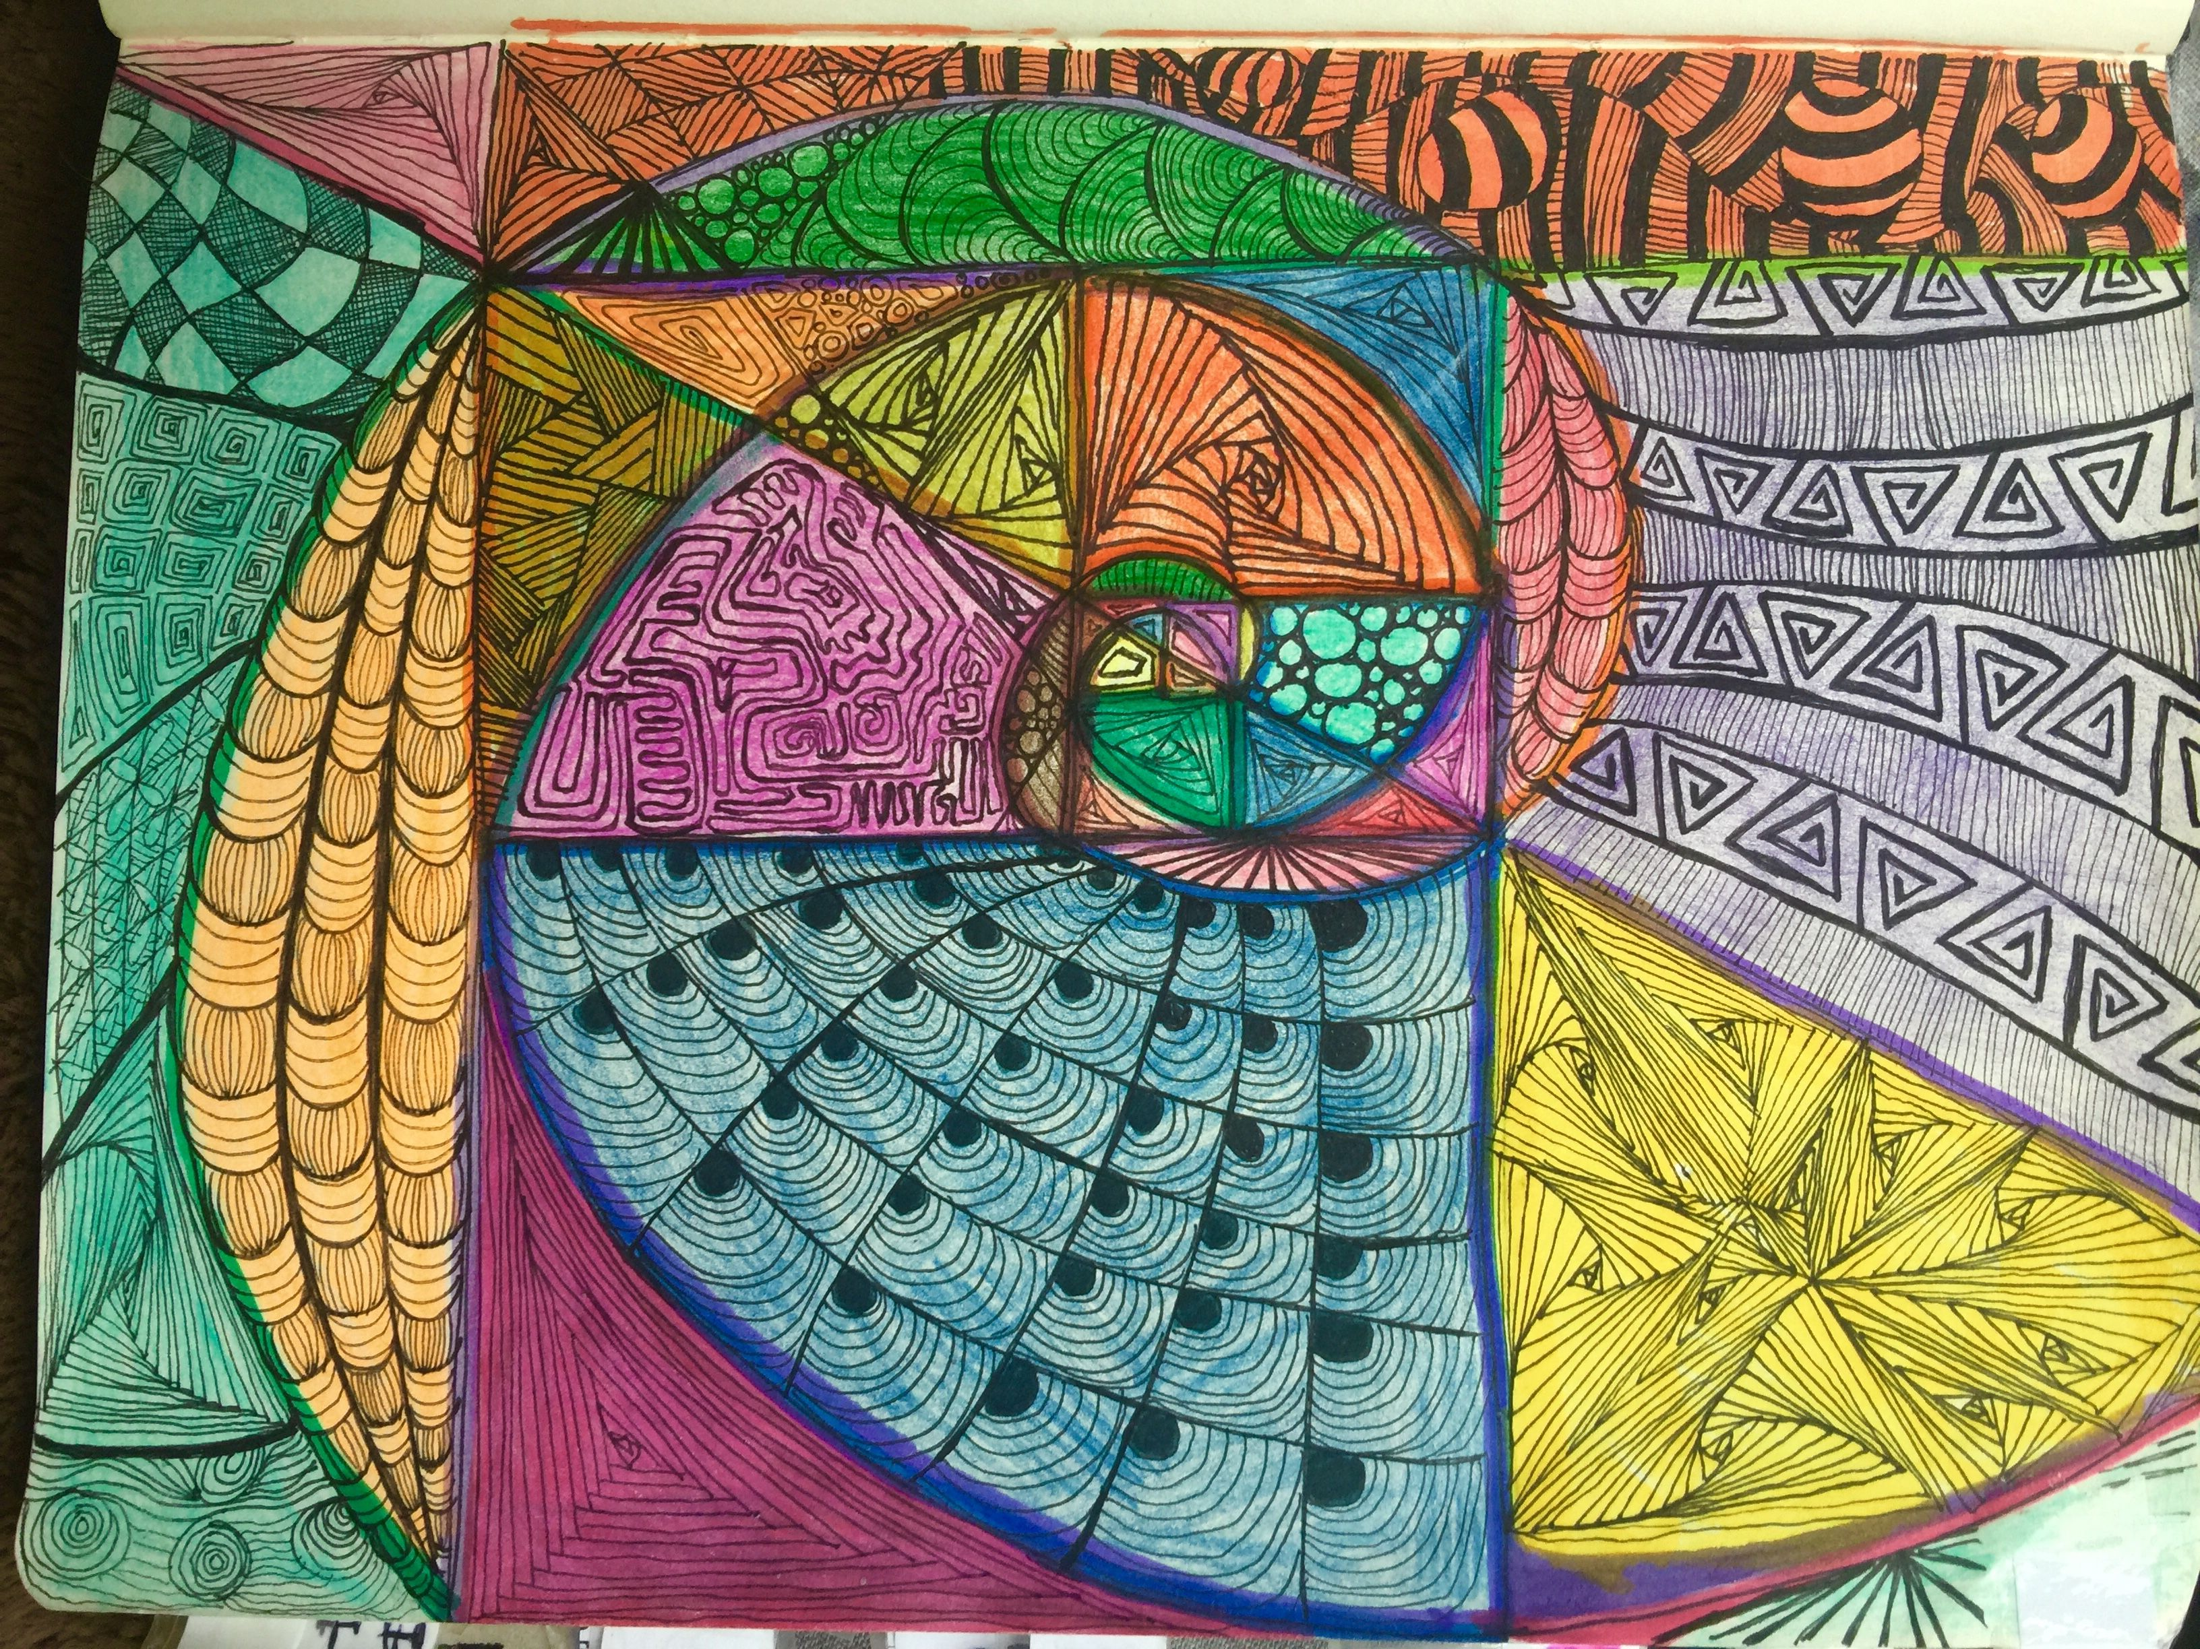
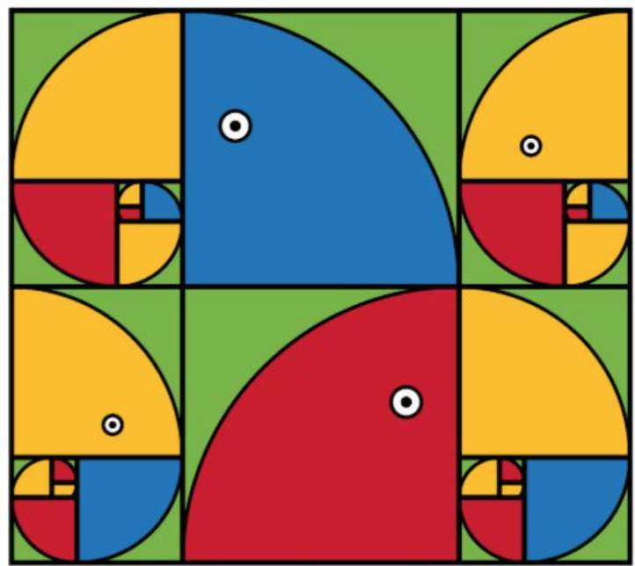

Slide 6

2. Draw a 2x2 square above
3. Draw a 3x3 square on the right
1. Start at 1!
1. Draw 1 square to the left
2
2
3
1
1
1
1
1
1
1
5. Draw a 5x5 square below
8. Draw an 8x8 square on the left
2
3
8
2
3
1
1
1
1
5
5

Slide 7
13. Now it starts getting big!
Draw a 13x13 square above
21. And a 21x21 square to the right
13
13
21
8
2
3
8
2
3
1
1
1
1
5
5

Slide 8
Draw your spiral.
Stop from the top right of your first square and go in order to each diagonally opposite corner.
A pair of compasses will make it more accurate.

Slide 9
Draw your spiral.
Start from the top right of your first square and go in order to each diagonally opposite corner.
A pair of compasses will make it more accurate.

Slide 10
Now be creative and decorate your Fibonacci spiral.

