Slide 1


Slide 2
Q1. What percentage of the population is below the mean?

Slide 3
Q2. What percentage of the population is within 1 standard deviation of the mean?

Slide 4
Q3. What percentage of the population is more than 2 standard deviation away from the mean?

Slide 5
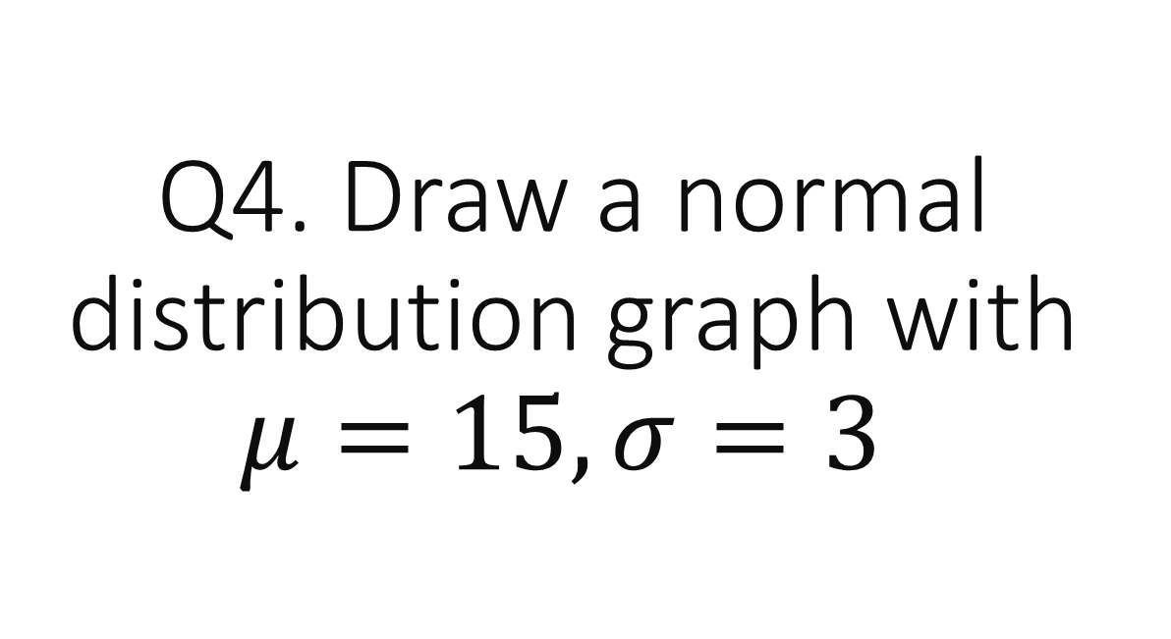
Q4. Draw a normal distribution graph with $μ=15, σ=3$

Slide 6
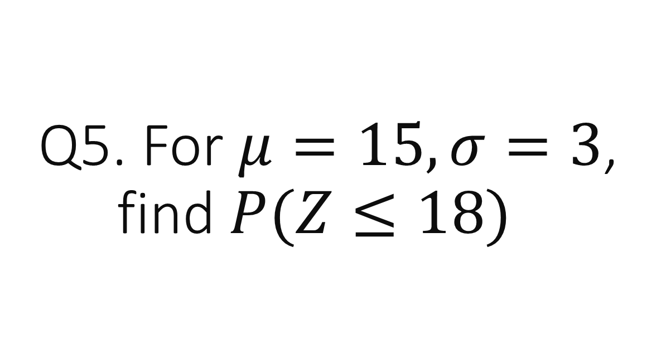
Q5. For $μ=15, σ=3$, find $P(Z≤18)$

Slide 7
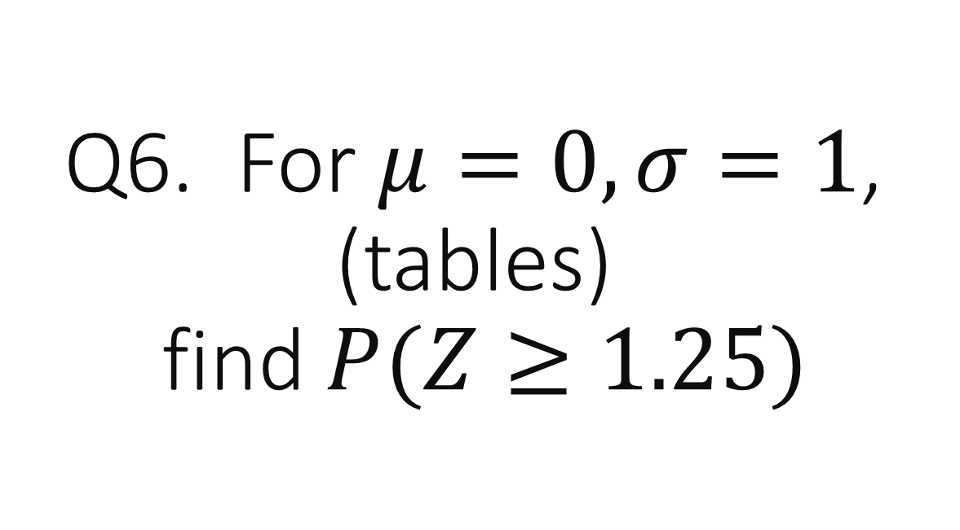
Q6. For $μ=0, σ=1$, (tables) find $P(Z≥1.25)$

Slide 8
Q7. How do you find the Z value needed to use the tables?

Slide 9
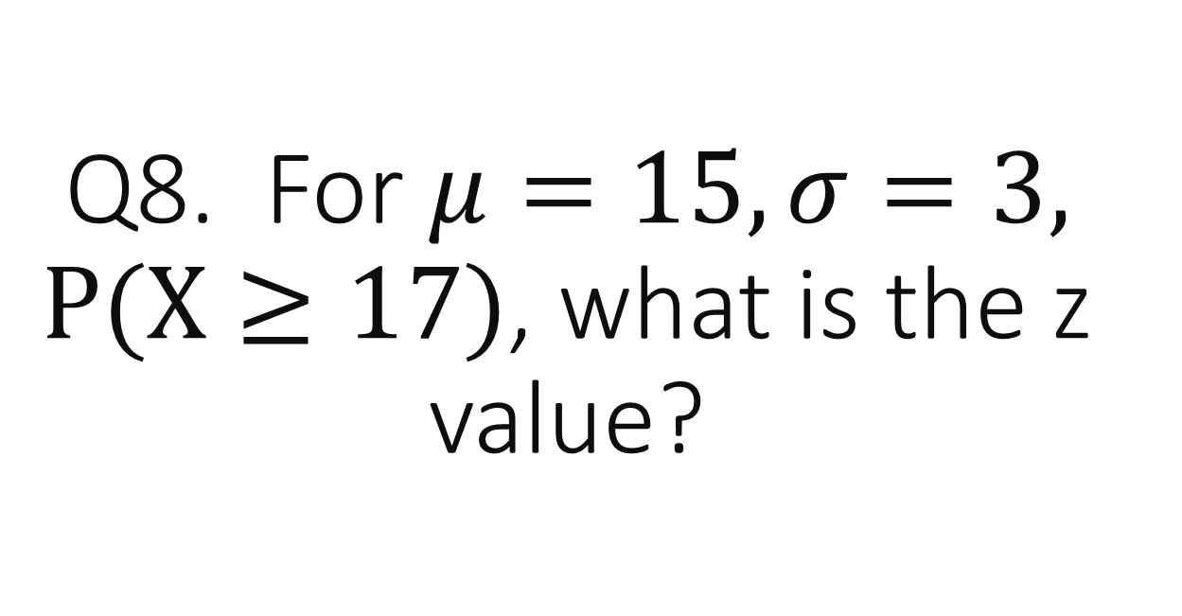
Q8. For $μ=15, σ=3, P(X≥17)$, what is the z value?

Slide 10
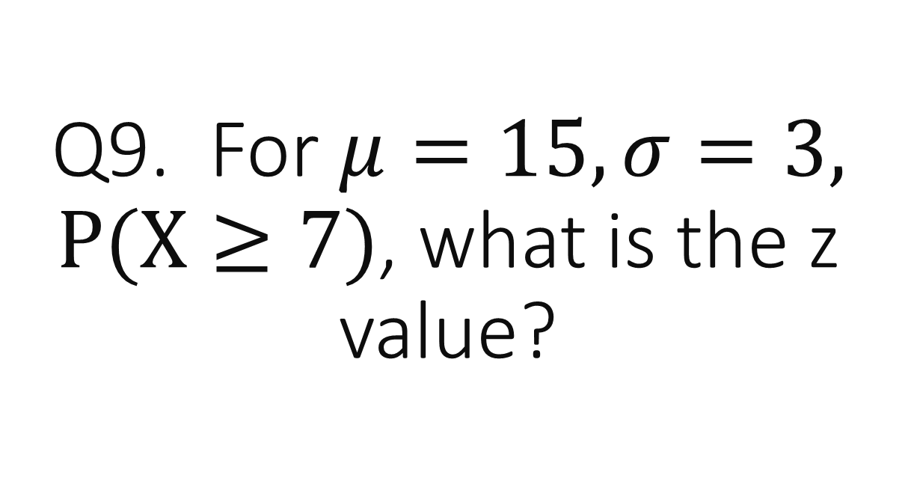
Q9. For $μ=15, σ=3, P(X≥7)$, what is the z value?

Slide 11
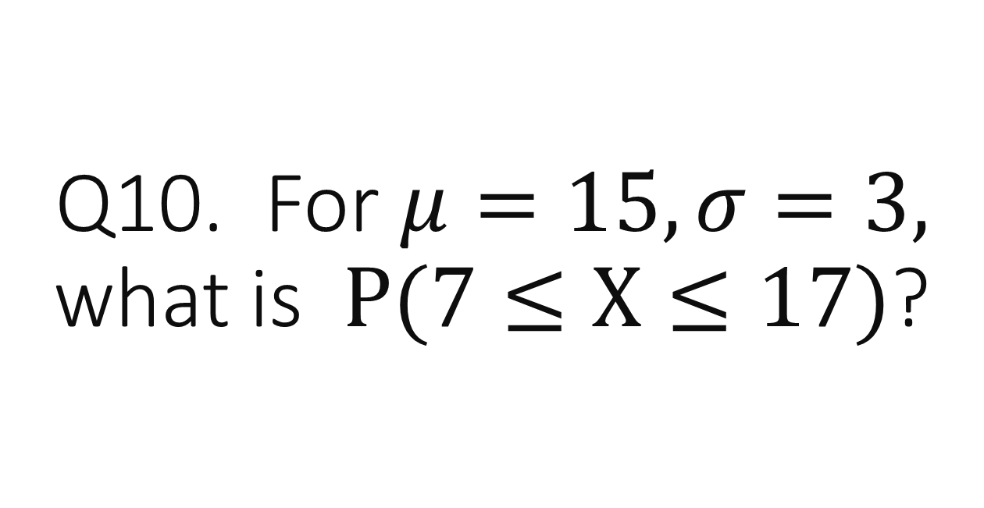
Q10. For $μ=15, σ=3,$ what is$P(7≤X≤17)$?

Slide 13
Q1. What percentage of the population is below the mean?
50%

Slide 14
Q2. What percentage of the population is within 1 standard deviation of the mean?
68%

Slide 15
Q3. What percentage of the population is more than 2 standard deviation away from the mean?
5%

Slide 16
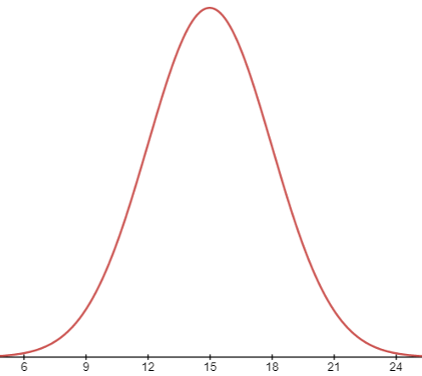
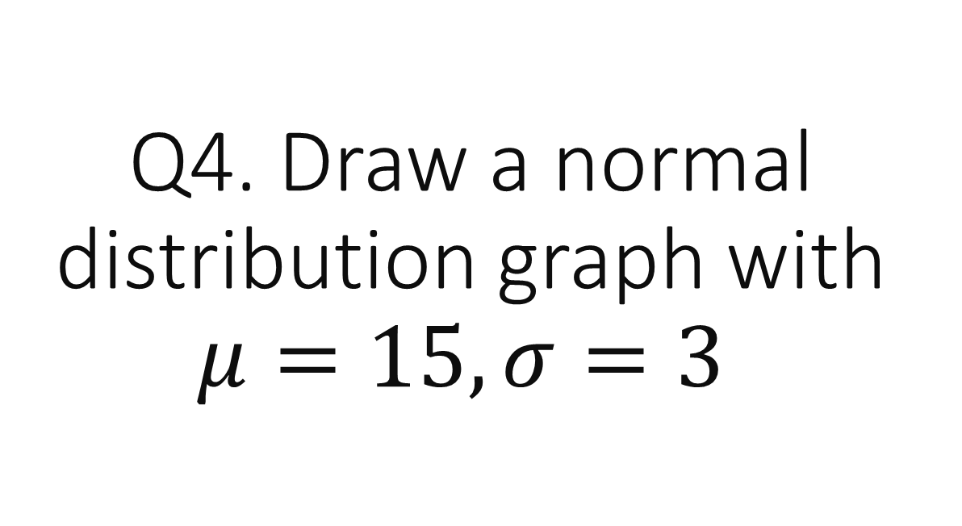
Q4. Draw a normal distribution graph with $μ=15, σ=3$

Slide 17
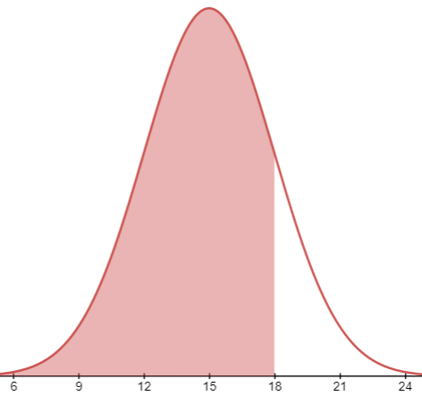
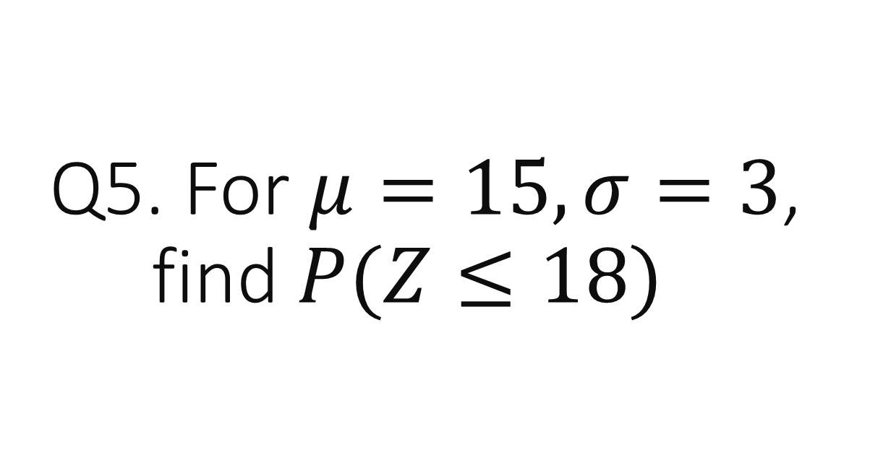
Q5. For $μ=15, σ=3$, find $P(Z≤18)$
50% + 34%
= 84%

Slide 18
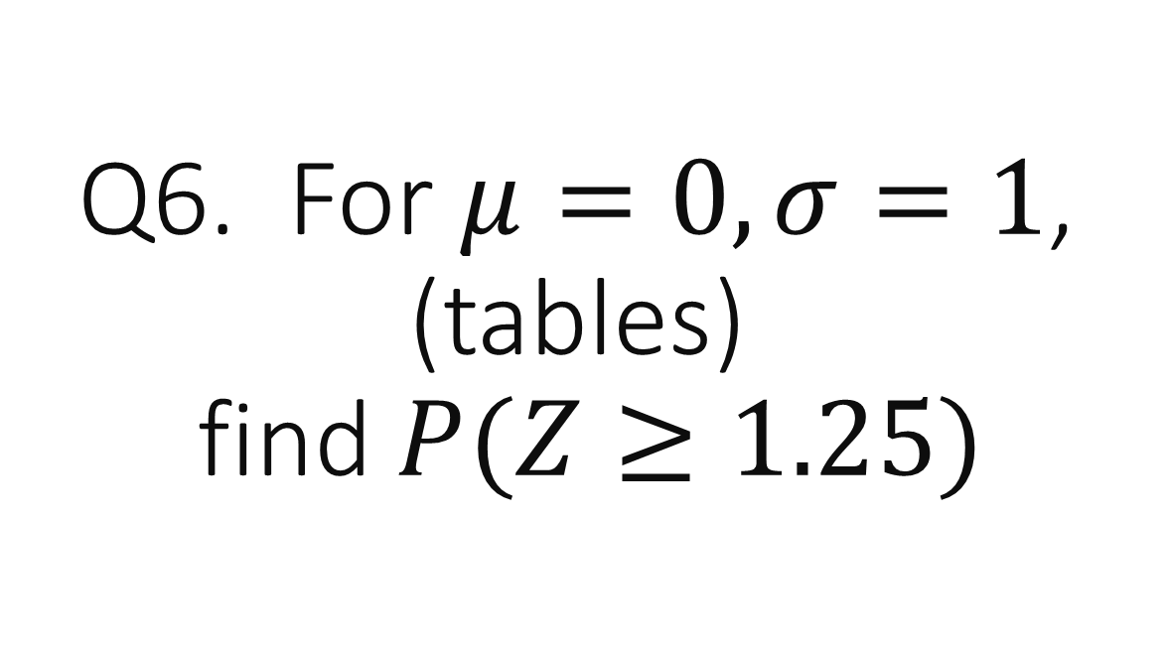
Q6. For $μ=0, σ=1$, (tables) find $P(Z≥1.25)$
0.1056

Slide 19
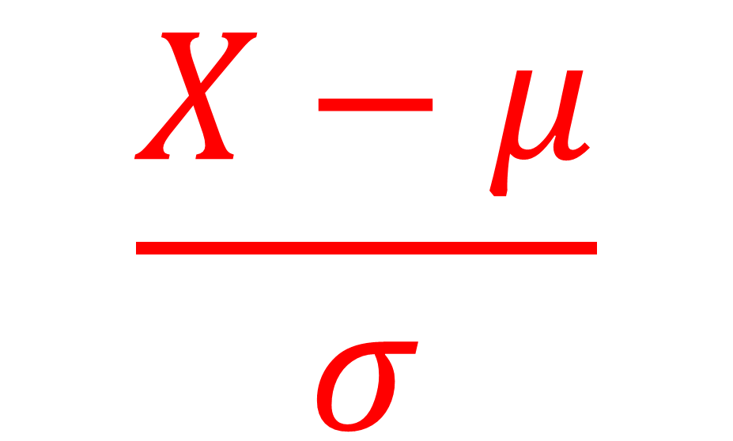
Q7. How do you find the Z value needed to use the tables?
$$\frac{X−μ}{σ}$$

Slide 20
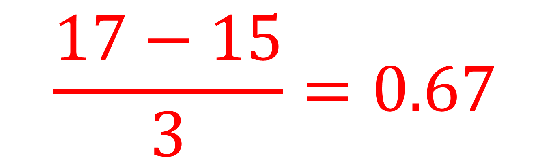
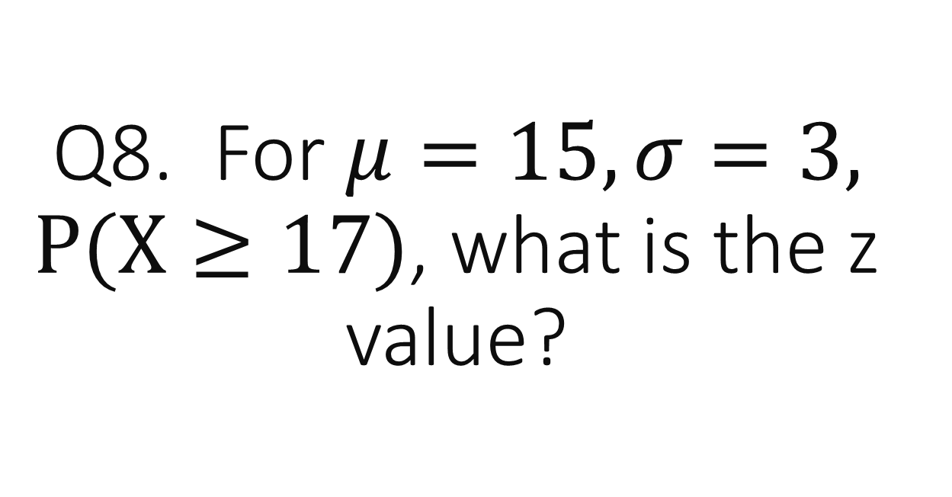
Q8. For $μ=15, σ=3, P(X≥17)$, what is the z value?
$$\frac{17−15}{3}=0.67$$

Slide 21
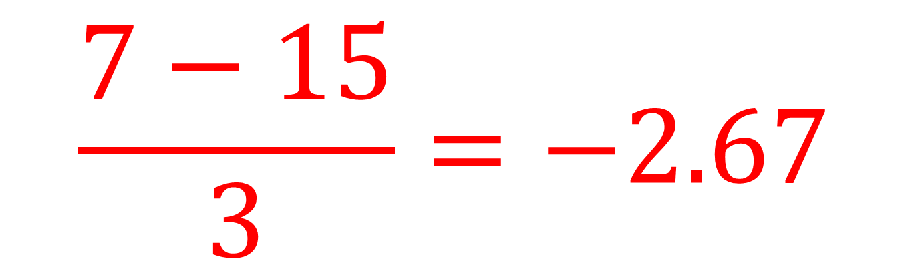
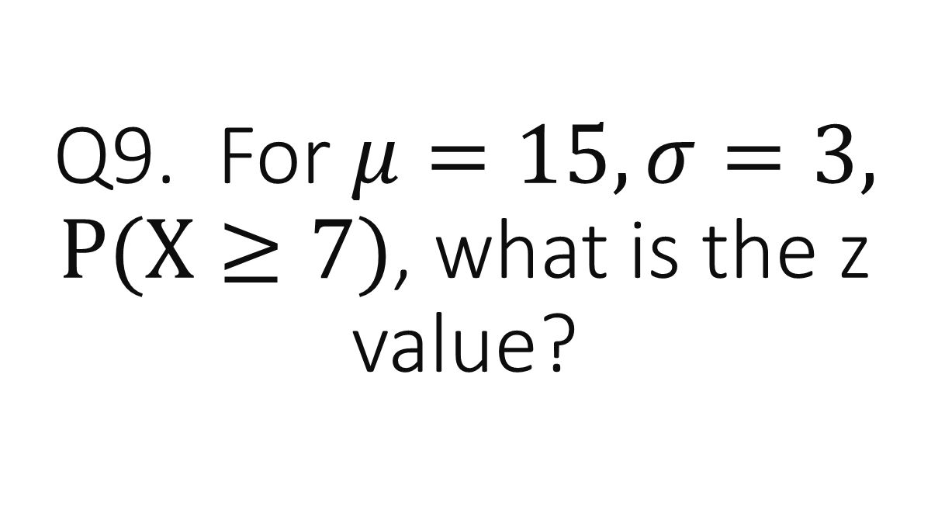
Q9. For $μ=15, σ=3, P(X≥7)$, what is the z value?
$$\frac{7−15}{3}=−2.67$$

Slide 22

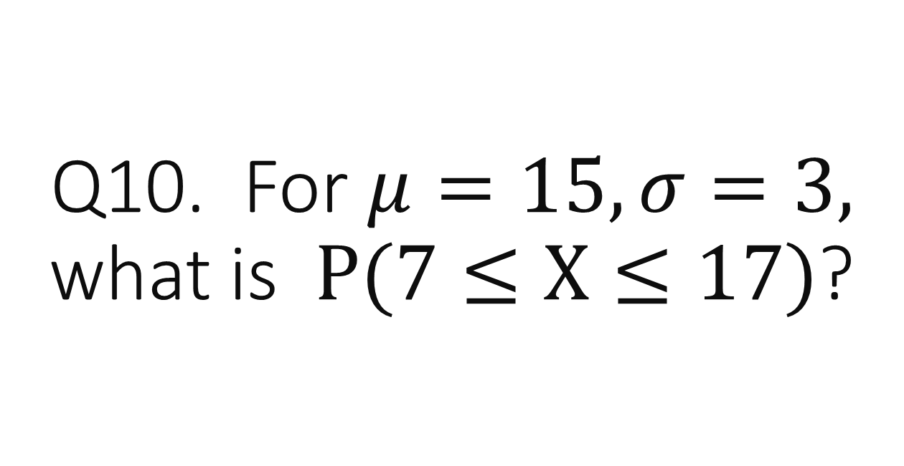
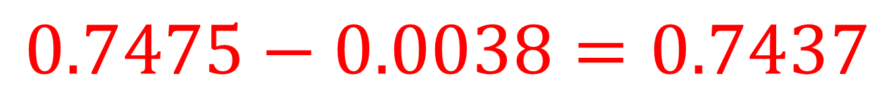
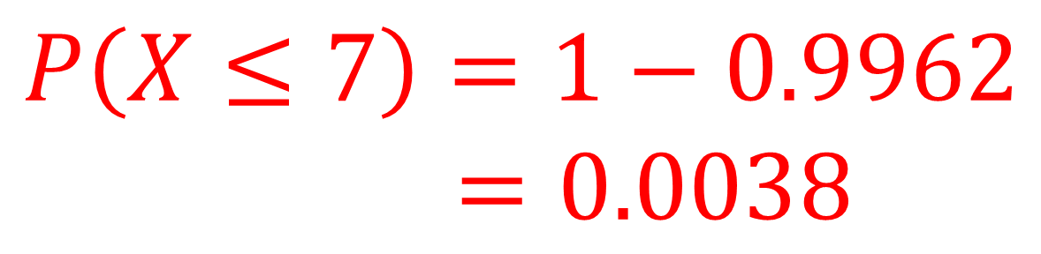
Q10. For $μ=15, σ=3,$ what is$P(7≤X≤17)$?
$$P\left(X≤17\right)=0.7475$$
$$P\left(X≤7\right)=1−0.9962$$
$$=0.0038$$
$$0.7475−0.0038=0.7437$$

