Slide 1
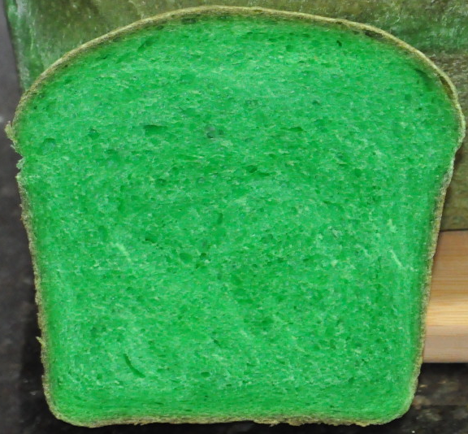

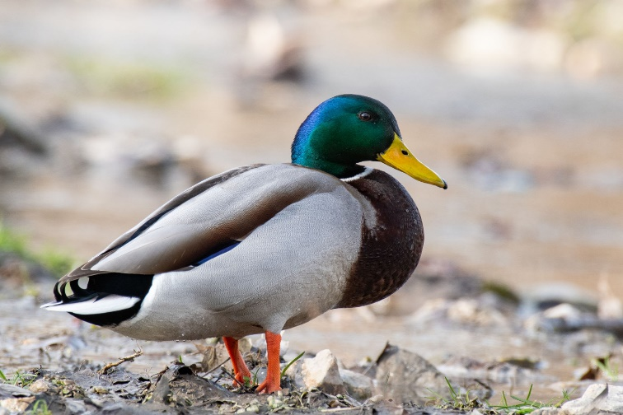
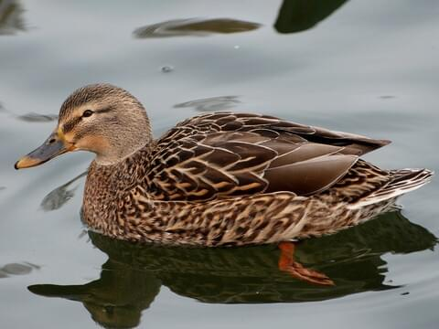
Mallard Ducks
Males
Females
Green Bread
Green Head
Plain Head

Slide 2


Original idea: Indifferent to green bread
New idea: Prefer green bread

Slide 3





Probabilities
Original idea: $P\left(Choose green\right)$
$$=0.5$$
$$>0.5$$
New idea: $P\left(Choose green\right)$

Slide 4
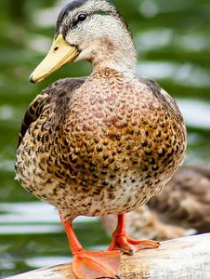
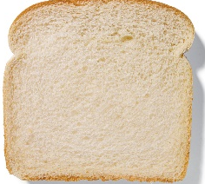
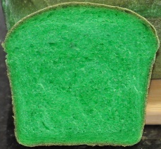
Original idea: If ducks are indifferent to green bread, how many would you expect to choose green first?

Slide 5


Is it very unlikely that our original idea was wrong?
No, there’s a reasonable chance our sample could have come from this population.
Yes, it is very unlikely our sample could have come from this population.

Slide 6
If my original idea is wrong, how unlikely do I need it to be for my sample (or a more extreme version), to have happened?
0.05
0
0.5
?
1
I want my sample (or more extreme) to be less than 5% likely to reject my original idea

Slide 7


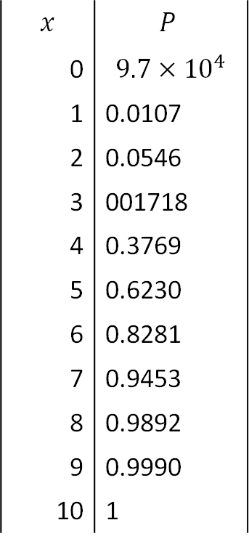

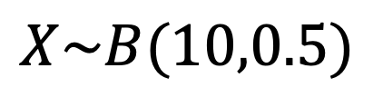

$$x$$ | $$P$$
0 | $$9.7×{10}^{4}$$
1 | 0.0107
2 | 0.0546
3 | 001718
4 | 0.3769
5 | 0.6230
6 | 0.8281
7 | 0.9453
8 | 0.9892
9 | 0.9990
10 | 1
$$X\sim B(10,0.5)$$
0
0.5
0.95
1
$$P\left(9 or more ducks choose green\right)=$$
$$1−0.9893$$
$$=0.0107$$
$$0.0107<0.05$$

Slide 8


$$0.0107<0.05$$
There is sufficient evidence to reject our original idea and support the claim that female mallards prefer green bread.

Slide 9
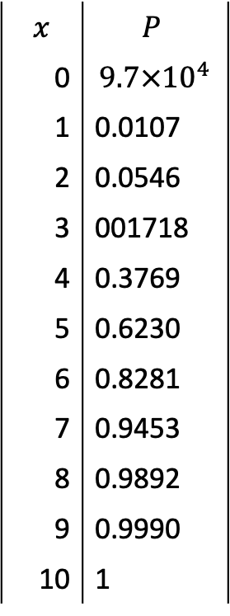
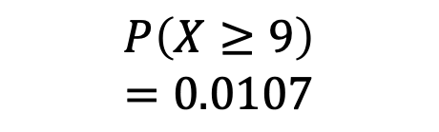

$$x$$ | $$P$$
0 | $$9.7×{10}^{4}$$
1 | 0.0107
2 | 0.0546
3 | 001718
4 | 0.3769
5 | 0.6230
6 | 0.8281
7 | 0.9453
8 | 0.9892
9 | 0.9990
10 | 1
$$X\sim B(10,0.5)$$
0
0.5
0.95
1
$$P\left(X≥8\right)$$
$$=0.0547$$
$$P\left(X≥9\right)$$
$$=0.0107$$
How many in my sample need to choose green for the probability to be less than 5%?
So 9 or more needed to choose green to be less than 5% likely

