Slide 1
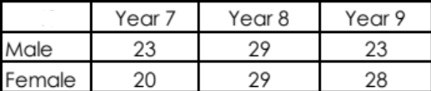
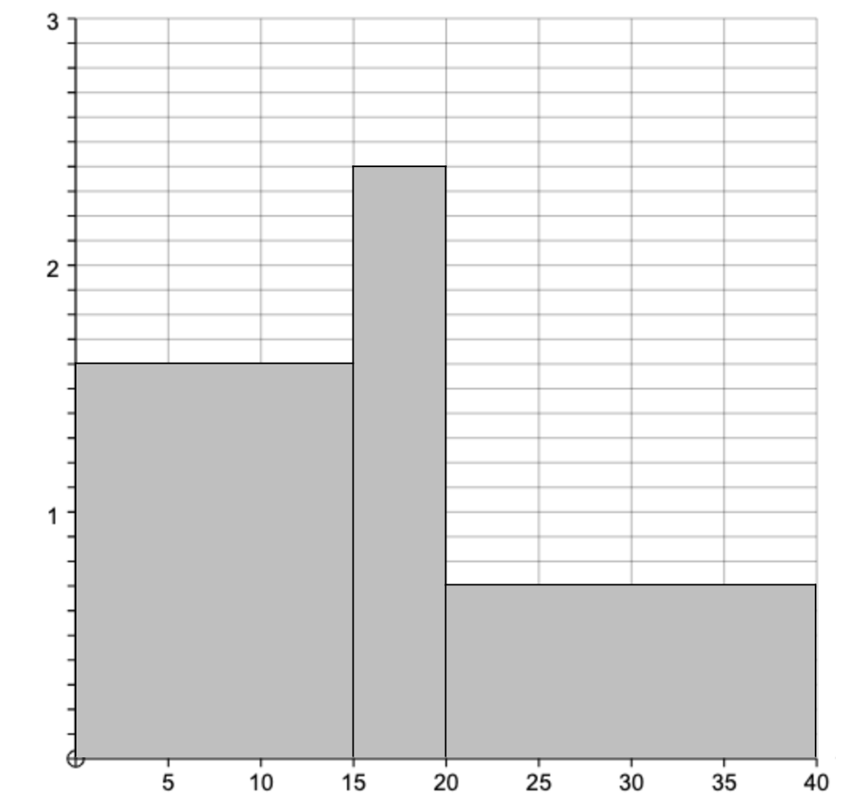
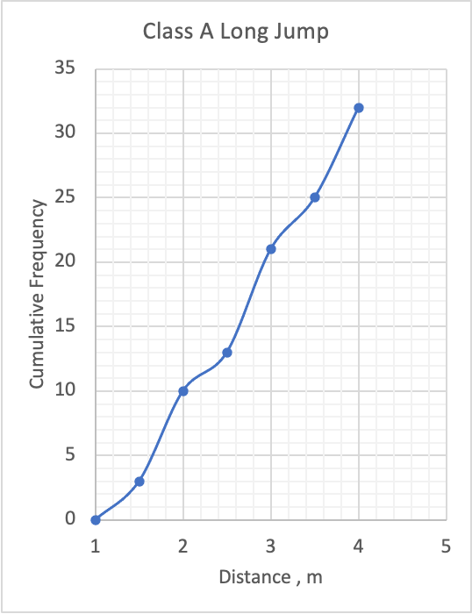
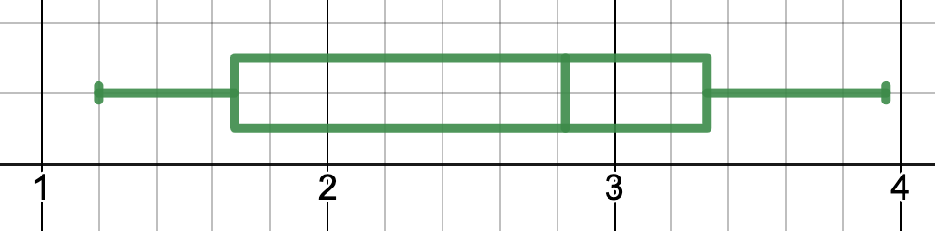

Core Maths Paper 1 Revision Mat – Data and Estimation
Continuous Data
Data and Sampling
The following table gives some frequencies for a sample of data:
Estimate the mean
Estimate the standard deviation
Construct a cumulative frequency graph
Construct a histogram
The largest size was 8.7 and the smallest was 0.3. Draw a boxplot.
Describe how to take a systematic sample of 12 people from a population of 250.
A sample of 40 students is required from the following. Work out how many of each year group is required.
Discrete Data
The following distances, in km, are how far some students travel to primary schools.
Draw a stem and leaf diagram for this data.
Find the median distance travelled.
Find the interquartile range.
The distances travelled by students to get to secondary schools have a median of 3 and IQR of 2.1. Compare the data.
1.3 | 3.2 | 2 | 0.3 | 1.3
1.1 | 3.3 | 2.1 | 1.1 | 3
2 | 3.4 | 0.1
 |  |  | Frequency
0 | < x ≤ | 1 | 9
1 | < x ≤ | 4 | 19
4 | < x ≤ | 6 | 1
6 | < x ≤ | 11 | 21
Histograms
The histogram has a frequency of 100. Work out the frequency of each class.
Estimation
Estimate how many students attend secondary education (11-18).
Estimate how many days it would take to walk the length of the north pole to the south pole.
Estimate how many cups of coffee are drunk in the UK in a month.
Cumulative Frequency and Boxplots
The cumulative frequency and box plot shows the distances, in m, of students in the long jump.
What proportion of students
in each class jumped further
than 3.3m?
Compare the distances
jumped by class A and
class B.
Class B Long Jump

Slide 2
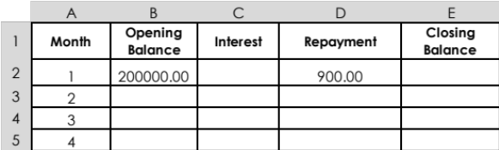
Core Maths Paper 1 Revision Mat – Personal Finance
AER
The interest details for 3 different accounts are given below. By calculating the AER, correct to 3 decimal places, state which account has the best annual equivalent rate.
Account A earns annual compound interest rate of 8.77%, paid every 12 months.
Account B earns annual compound interest rate of 8.69%, paid every 4 months.
Account C earns annual compound interest rate of 8.66%, paid every 1 months.
RPI
Tax , NI and Student Loans
In 1992 the RPI was 113.5.
In 1998 the RPI was 119.8.
An item cost £16.90 in 1992. How much did it cost in 1998?
In 2006 the RPI was 112.2.
In 2016 the RPI was 117.2.
An item cost £3.40 in 2016. How much did it cost in 2006?
Calculate the net monthly pay for an annual salary of £190959
Assuming no personal allowance.
Including a personal allowance of £12570.
Calculate the net monthly pay for an annual salary of £111522.
Calculate the net pay for an annual salary of £37302, for someone paying back a student loan from after September 2012.
£9946 is invested in account with an annual compound interest rate of 3% for 10 years. How much will be in the account at the end of the time?
£28767 is needed for a payment after 6 years.
If the annual compound interest rate is 2%, how much should be invested?
Prices are expected to increase by 1.1% per year correct to 2 significant figures. If the current price is £266000, what is the maximum price it will be in 2 years time.
Percentages and approximations
APR
A loan with interest rate 3.1 % is taken out over 2 years and is paid back in 2 repayments of £1988. Calculate the amount of the loan.
A loan of £900 is taken out over 2 years and is paid back in a single instalment with an APR of 6.9%. Calculate the total repayment of the loan.
A loan of £1700 is taken out over 2 years and is paid back in 2 instalments with an APR of 2.8%. The first instalment is £850. Calculate the value of the 2nd instalment.
A loan of £3731.96 is taken out over 2 years and is paid back in 2 equal instalments with an APR of 3.8%. Calculate the amount of each instalment.
Mortgages and Spreadsheet
A mortgage has an annual interest rate of 4.2%, taken from the opening balance of £200000, and a monthly repayment of £900.
What formula would go in cell C2?
What formula would go in cell B3?
How much of the mortgage is still owed after 4 months?

Slide 3
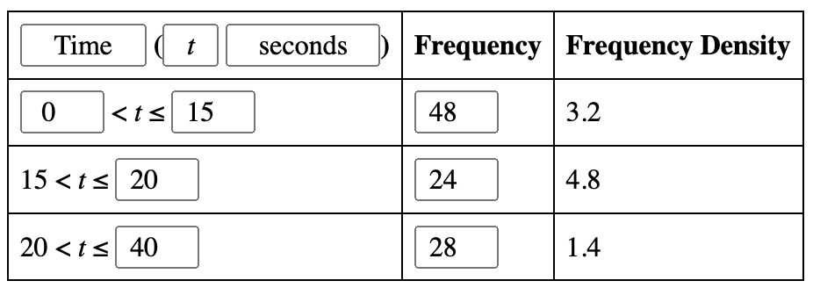
11, 15, 14
Median | 1.9
IQR | 1.6
Mean | 4.71
Standard Deviation | 5.83
0 | 1 3
1 | 1 1 3 3
2 | 0 0 1
3 | 0 2 3 4
CF | fd
9 | 9
28 | 6.33
29 | 0.5
50 | 4.2
A: 9/32 = 28%
B: 25%
A: Med = 2.7m IQR = 3.4 – 2.1 = 1.3
B: Med = 2.8 IQR = 3.3 – 1.7 = 1.6

Slide 4
 |  | Tax |  |  |  | Tax |  |  |  | Tax
Salary | 190959 |  |  | Salary | 190959 |  |  | Salary | 111522
Lower band | 37700 | 7540 |  | Lower band | 37700 | 7540 |  | Lower band | 37700 | 7540
Higher band | 112300 | 44920 |  | Higher band | 112300 | 44920 |  | Higher band | 61252 | 24500.8
Upper band | 40959 | 18431.55 |  | Upper band | 28389 | 12775.05 |  |  | Total | 32040.8
 | Total | 70891.55 |  |  | Total | 65235.05 |  |  |  | NI
 |  | NI |  |  |  | NI |  | Higher band | 61252 | 1990.69
Higher band | 140689 | 4924.115 |  | Higher band | 140689 | 4924.115 |  | Lower band | 37700 | 4995.25
Lower band | 40702 | 5494.77 |  | Lower band | 40702 | 5494.77 |  |  | Total | 6985.94
 | Total | 10418.885 |  |  | Total | 10418.885 |  | Total Deductions |  | 39026.74
Total Deductions |  | 81310.435 |  | Total Deductions |  | 75653.935 |  | Net pay | Annual | 72495.26
Net pay | Annual | 109648.565 |  | Net pay | Annual | 115305.065 |  |  | Monthly | 6041.27
 | Monthly | 9137.38 |  |  | Monthly | 9608.76 |  |  | Weekly | 1394.14
 | Weekly | 2108.63 |  |  | Weekly | 2217.41
Salary | 37302
Lower band | 24732 | 4946.4
 |  | NI
Lower band | 24732 | 3276.99
Student loan | 10007 | 900.63
Total Deductions |  | 8223.39
Net pay | Annual | 29078.61
 | Monthly | 2423.22
 | Weekly | 559.20
1028.48
1250
922.73
8.770 | A
8.944 | B
9.012 | C
9.012 | C
13366.59
1973
25544.27
4.2 | A | B | C | D | E
1 | Month | Opening Balance | Interest | Repayment | Closing Balance
2 | 1 | 200000.00 | 700.00 | 900.00 | 199800.00
3 | 2 | 199800.00 | 166.50 | 900.00 | 199066.50
4 | 3 | 199066.50 | 331.78 | 900.00 | 198498.28
5 | 4 | 198498.28 | 496.25 | 900.00 | 198094.53
 |  |  |  |  | 198094.03
272153.18
17.84
3.25

