Slide 1

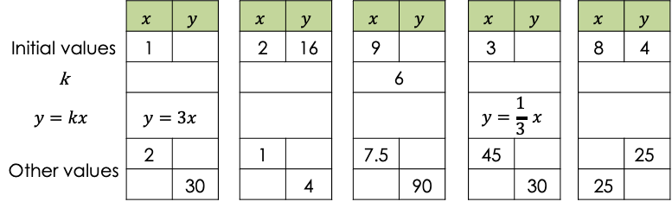
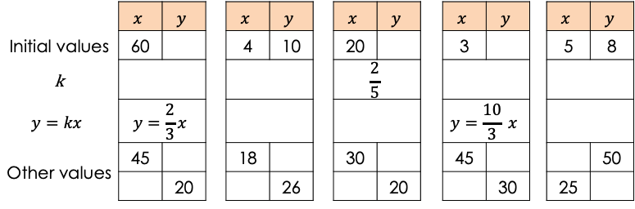

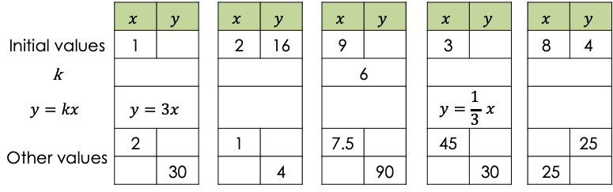



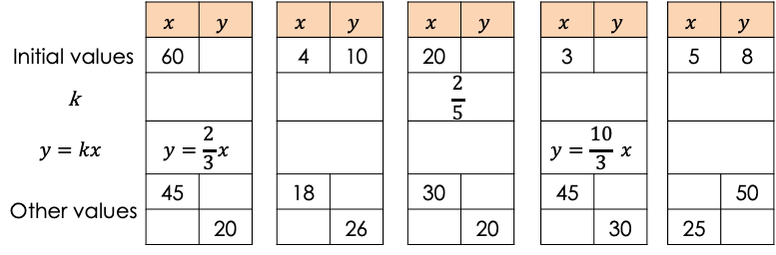
 | $$x$$ | $$y$$ |  | $$x$$ | $$y$$ |  | $$x$$ | $$y$$ |  | $$x$$ | $$y$$ |  | $$x$$ | $$y$$
Initial values | 1 |  |  | 2 | 16 |  | 9 |  |  | 3 |  |  | 8 | 4
k |  |  |  |  |  |  | 6
$$y=kx$$ | $$y=3x$$ |  |  |  |  |  |  |  |  | $$y=\frac{1}{3} x$$
Other values | 2 |  |  | 1 |  |  | 7.5 |  |  | 45 |  |  |  | 25
Other values |  | 30 |  |  | 4 |  |  | 90 |  |  | 30 |  | 25
 | $$x$$ | $$y$$ |  | $$x$$ | $$y$$ |  | $$x$$ | $$y$$ |  | $$x$$ | $$y$$ |  | $$x$$ | $$y$$
Initial values | 1 |  |  | 2 | 16 |  | 9 |  |  | 3 |  |  | 8 | 4
k |  |  |  |  |  |  | 6
$$y=kx$$ | $$y=3x$$ |  |  |  |  |  |  |  |  | $$y=\frac{1}{3} x$$
Other values | 2 |  |  | 1 |  |  | 7.5 |  |  | 45 |  |  |  | 25
Other values |  | 30 |  |  | 4 |  |  | 90 |  |  | 30 |  | 25
 | $$x$$ | $$y$$ |  | $$x$$ | $$y$$ |  | $$x$$ | $$y$$ |  | $$x$$ | $$y$$ |  | $$x$$ | $$y$$
Initial values | 60 |  |  | 4 | 10 |  | 20 |  |  | 3 |  |  | 5 | 8
k |  |  |  |  |  |  | $$\frac{2}{5}$$
$$y=kx$$ | $$y=\frac{2}{3}x$$ |  |  |  |  |  |  |  |  | $$y=\frac{10}{3} x$$
Other values | 45 |  |  | 18 |  |  | 30 |  |  | 45 |  |  |  | 50
Other values |  | 20 |  |  | 26 |  |  | 20 |  |  | 30 |  | 25
 | $$x$$ | $$y$$ |  | $$x$$ | $$y$$ |  | $$x$$ | $$y$$ |  | $$x$$ | $$y$$ |  | $$x$$ | $$y$$
Initial values | 60 |  |  | 4 | 10 |  | 20 |  |  | 3 |  |  | 5 | 8
k |  |  |  |  |  |  | $$\frac{2}{5}$$
$$y=kx$$ | $$y=\frac{2}{3}x$$ |  |  |  |  |  |  |  |  | $$y=\frac{10}{3} x$$
Other values | 45 |  |  | 18 |  |  | 30 |  |  | 45 |  |  |  | 50
Other values |  | 20 |  |  | 26 |  |  | 20 |  |  | 30 |  | 25
 | $$x$$ | $$y$$ |  | $$x$$ | $$y$$ |  | $$x$$ | $$y$$ |  | $$x$$ | $$y$$ |  | $$x$$ | $$y$$
Initial values | 1 |  |  | 2 | 16 |  | 9 |  |  | 3 |  |  | 8 | 4
k |  |  |  |  |  |  | 6
$$y=kx$$ | $$y=3x$$ |  |  |  |  |  |  |  |  | $$y=\frac{1}{3} x$$
Other values | 2 |  |  | 1 |  |  | 7.5 |  |  | 45 |  |  |  | 25
Other values |  | 30 |  |  | 4 |  |  | 90 |  |  | 30 |  | 25
 | $$x$$ | $$y$$ |  | $$x$$ | $$y$$ |  | $$x$$ | $$y$$ |  | $$x$$ | $$y$$ |  | $$x$$ | $$y$$
Initial values | 1 |  |  | 2 | 16 |  | 9 |  |  | 3 |  |  | 8 | 4
k |  |  |  |  |  |  | 6
$$y=kx$$ | $$y=3x$$ |  |  |  |  |  |  |  |  | $$y=\frac{1}{3} x$$
Other values | 2 |  |  | 1 |  |  | 7.5 |  |  | 45 |  |  |  | 25
Other values |  | 30 |  |  | 4 |  |  | 90 |  |  | 30 |  | 25
 | $$x$$ | $$y$$ |  | $$x$$ | $$y$$ |  | $$x$$ | $$y$$ |  | $$x$$ | $$y$$ |  | $$x$$ | $$y$$
Initial values | 60 |  |  | 4 | 10 |  | 20 |  |  | 3 |  |  | 5 | 8
k |  |  |  |  |  |  | $$\frac{2}{5}$$
$$y=kx$$ | $$y=\frac{2}{3}x$$ |  |  |  |  |  |  |  |  | $$y=\frac{10}{3} x$$
Other values | 45 |  |  | 18 |  |  | 30 |  |  | 45 |  |  |  | 50
Other values |  | 20 |  |  | 26 |  |  | 20 |  |  | 30 |  | 25
 | $$x$$ | $$y$$ |  | $$x$$ | $$y$$ |  | $$x$$ | $$y$$ |  | $$x$$ | $$y$$ |  | $$x$$ | $$y$$
Initial values | 60 |  |  | 4 | 10 |  | 20 |  |  | 3 |  |  | 5 | 8
k |  |  |  |  |  |  | $$\frac{2}{5}$$
$$y=kx$$ | $$y=\frac{2}{3}x$$ |  |  |  |  |  |  |  |  | $$y=\frac{10}{3} x$$
Other values | 45 |  |  | 18 |  |  | 30 |  |  | 45 |  |  |  | 50
Other values |  | 20 |  |  | 26 |  |  | 20 |  |  | 30 |  | 25

Slide 2


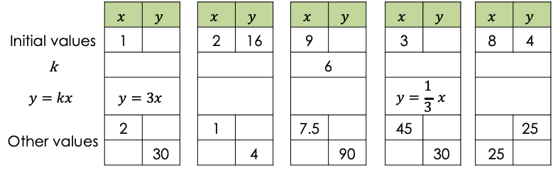
 | $$x$$ | $$y$$ |  | $$x$$ | $$y$$ |  | $$x$$ | $$y$$ |  | $$x$$ | $$y$$ |  | $$x$$ | $$y$$
Initial values | 1 |  |  | 2 | 16 |  | 9 |  |  | 3 |  |  | 8 | 4
k |  |  |  |  |  |  | 6
$$y=kx$$ | $$y=3x$$ |  |  |  |  |  |  |  |  | $$y=\frac{1}{3} x$$
Other values | 2 |  |  | 1 |  |  | 7.5 |  |  | 45 |  |  |  | 25
Other values |  | 30 |  |  | 4 |  |  | 90 |  |  | 30 |  | 25
 | $$x$$ | $$y$$ |  | $$x$$ | $$y$$ |  | $$x$$ | $$y$$ |  | $$x$$ | $$y$$ |  | $$x$$ | $$y$$
Initial values | 60 |  |  | 4 | 10 |  | 20 |  |  | 3 |  |  | 5 | 8
k |  |  |  |  |  |  | $$\frac{2}{5}$$
$$y=kx$$ | $$y=\frac{2}{3}x$$ |  |  |  |  |  |  |  |  | $$y=\frac{10}{3} x$$
Other values | 45 |  |  | 18 |  |  | 30 |  |  | 45 |  |  |  | 50
Other values |  | 20 |  |  | 26 |  |  | 20 |  |  | 30 |  | 25

