Slide 1

Core Maths Paper 2 Revision Mat – Normal Distribution and Confidence Intervals
Normal Distribution Basics
Normal Distribution
Sketch the normal distribution curve
Label the key features
2) What are the percentages for 1, 2 and 3 standard deviations?
1). A random variable X is normal distributed with mean 2 and standard deviation 0.2.
Calculate the probability that X is less than 2.4.
2) A random variable X is normal distributed with mean 3 and standard deviation 0.4.
Calculate the probability that X is greater than 3.5.
3) A random variable X is normal distributed with mean 3 and variance 0.04.
Calculate the probability that X is greater than 2.7.
4) A random variable X is normal distributed with mean 947 and standard deviation 189.4.
Calculate the probability that X is between 1206.5 and 935.6.
5) A random variable X is normal distributed with mean 737 and standard deviation 184.3.
The probability that x is greater than a value is 1%. What is this value?
6) A random variable X is normal distributed with mean 1.8 and standard deviation 0.1.
The probability that x is less than a value is 39%. What is this value?
Confidence Interval Basics
What is the formula to calculate the confidence interval?
2) What are the z values for 90%, 95% and 99%?
Confidence Intervals
In a sample of 35 items, the mean is μ and standard deviation is 119.6.
The total value of these items is 33495.
Construct a 90% confidence interval for μ in the form [ , ]
In a sample of 65 items, the mean is μ and variance is 0.36.
The total value of these items is 591.5.
Construct a 99% confidence interval for μ in the form [ , ]

Slide 2
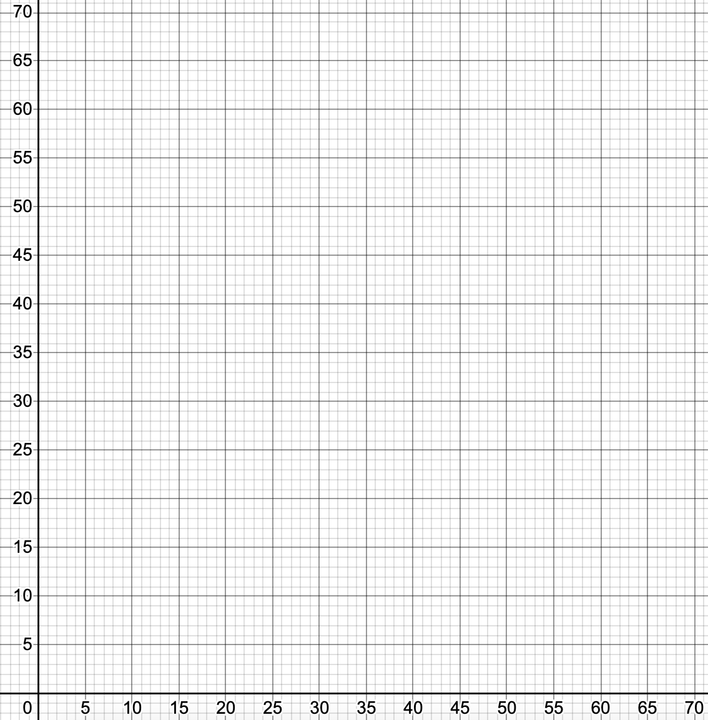
Core Maths Paper 2 Revision Mat – Correlation and Regression
PMCC and Line of Regression
Find the Product Moment Correlation Coefficient for the following data:
x: 9 14 26 5 24 35 37 46 44 64
y: 14 15 20 31 39 25 36 45 58 63
Find the equation for the line of regression of y on x for the above data.
Another x value is given as 64.
Use the line of regression to predict the y value.
Scatter Graph Correlation
1) Is x or y the most reliable predictor of z?
x: 1 23 21 17 36 25 46 29 50 46
y: 21 17 19 34 36 45 42 38 48 62
z: 9 15 17 32 37 36 40 21 50 54
2) Plot your answer to (1) and z on the graph
3) Find the equation for the line of regression and plot onto the graph.
PMCC and Line of Regression
Find the Product Moment Correlation Coefficient for the following data:
x: 4 14 25 27 26 40 42 15 43 55
y: 59 58 42 36 41 36 31 30 40 1
Find the equation for the line of regression for the above data.
Another x value is given as 32.7.
Use the line of regression to predict the y value.
Another x value is given as 0.5.
Would the line of regression give a reliable prediction for the y value?
Explain your reasoning.

Slide 3
0.9772
0.1056
0.9332
0.4387
1165.74
1.77
[923.75,990.25]
[8.91,9.29]

Slide 4
0.81
y=0.05+0.88x
56.37
-0.78
y=57.36-0.76x
57.36

