Slide 1
Teaching and Developing
Core Maths
Nikki Cooper
@mathszest

Slide 2
Gender Parity
Now in its 14th year, the Global Gender Gap Report 2020 benchmarks 153 countries on their progress towards gender parity in four dimensions: Economic Participation and Opportunity, Educational Attainment, Health and Survival and Political Empowerment.
Match the country with the Gender Parity rank in the 153 countries
United Kingdom
1st
United States
21st
Iceland
53rd
Saudi Arabia
81st
Japan
121st
Russia
146th

Slide 3
Teaching and Developing
Core Maths
Nikki Cooper
@mathszest
Teacher: 14 years, 3 schools
Teaching core maths: 3 years – 1 exam sitting!
2nd in dept, KS3 lead, T&L across curriculum
From 4th July: Head of Department!!

Slide 4


Document
2010

Slide 5
According to the Higher Education STEM project, many students arrive at university with unrealistic expectations of the mathematical and statistical demands of their subjects, leading to a lack of confidence and anxiety by the students.
Stem Learning

Slide 6
180 ‘early adopter’ sixth forms and colleges offer Core Maths
September 2014
September 2015
Core Maths is available to all schools and colleges – approx 200 more centres offer Core Maths

Slide 7
Approximately 3000 students from 200 centres take the first Core Maths exams.
June 2016

Slide 8
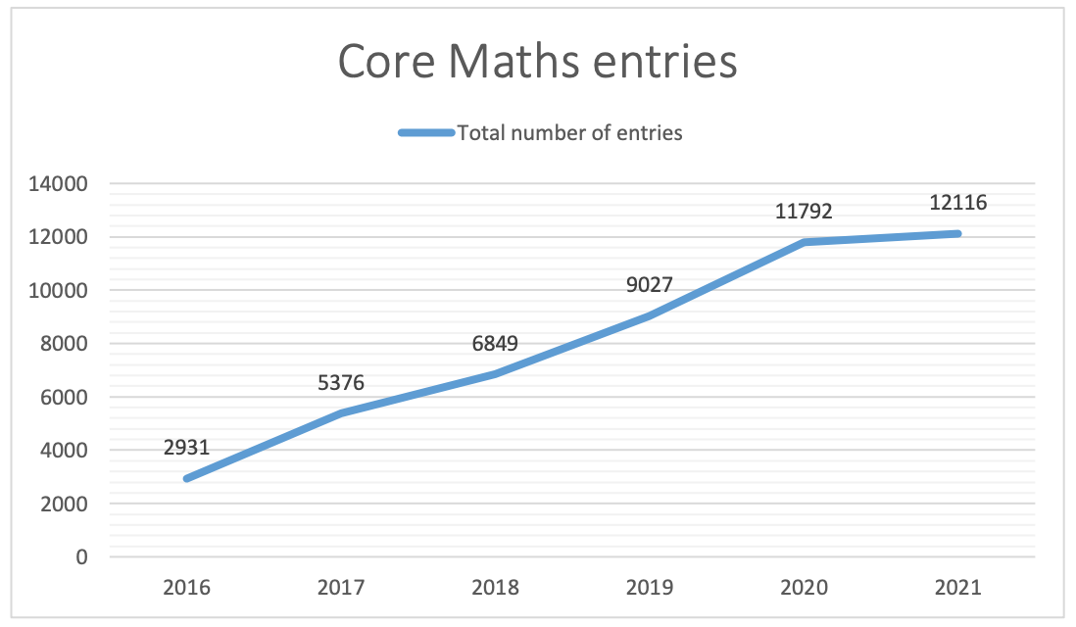
MEI: Summary of Core Maths Entries and Results

Slide 9
About Core Maths
“Core Maths has been designed to maintain and develop real-life maths skills. What you study is not purely theoretical or abstract; it can be applied on a day-to-day basis in work, study or life and most courses will include a financial maths element. It will also help with other A-level subjects – in particular with science, geography, business studies, psychology and economics.”
STEM CMSP

Slide 10
University Offers
Recognition of Level 3 Mathematical Studies
– reducing offers
– strong encouragement!

Slide 11
Advance Maths Premium
£600 per year per additional student above the baseline (mean number of maths students 2015-16 and 2016-17 within your centre)

Slide 12
Exam Board Options
AQA
Mathematical Studies
EDEXCEL
Mathematics in Context
Paper 1
Data, estimation, personal finance
Paper 2 A, B or C
Critical Analysis
A: Normal distribution, correlation and regression.
B: Critical path and risk analysis
C: Graphical techniques
2 Papers
Application of statistics
Probability
Linear programming
Sequences and growth
AMSP Comparison of Core Maths Qualifications

Slide 13
OCR
Quantitative Problem Solving
OCR
Quantitative Reasoning
Paper 1 Quantitative Reasoning
Compound measures and dimensional analysis
Normal distribution
Logarithmic and exponential functions
Spreadsheets for financial problems
Probability for risk assessment
Paper 2 Statistical Problem Solving
Hypothesis testing
Standard deviation
Normal distribution
Chi Squared test
Paper 2 Critical Maths
Estimation
Probability
Statistical experiments

Slide 14
CITY AND GUILDS
Using and Applying Mathematics
NCFE
Mathematics for Everyday Life
Mathematical modelling
Mathematical comprehension
Communicating with mathematics
Personal finance
Understanding commerce
Understanding chance
Understanding data

Slide 15

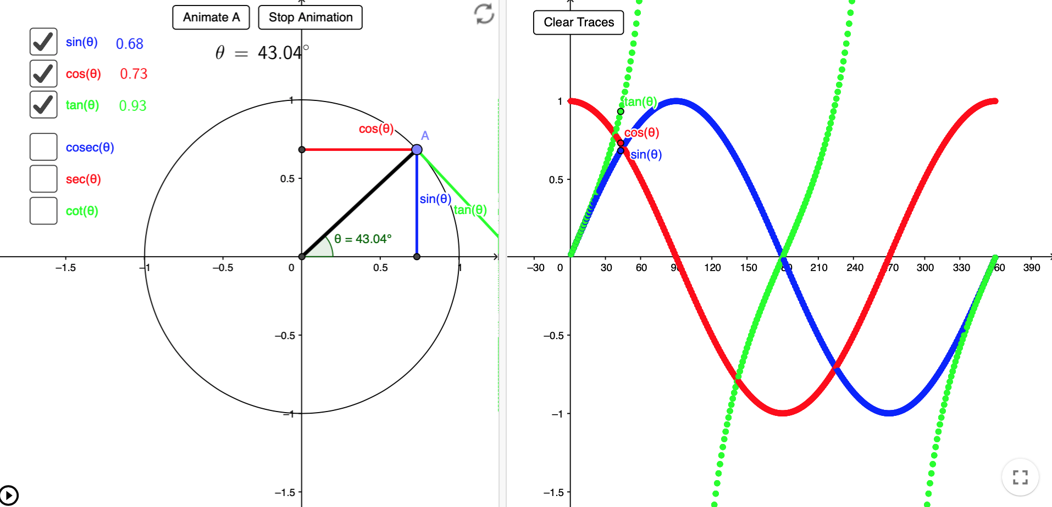
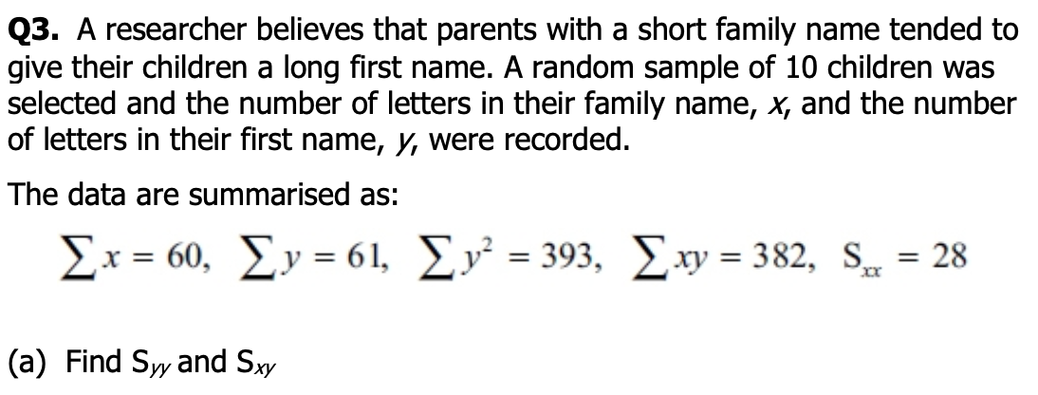

Slide 16
AQA Option 2A
Fermi Estimation
Percentages and Personal Finance
Analysis of Data
Normal Distribution
Correlation and Regression
Critical Analysis

Slide 17

Where to start?

Slide 18

AMSP
Core Maths

Slide 19
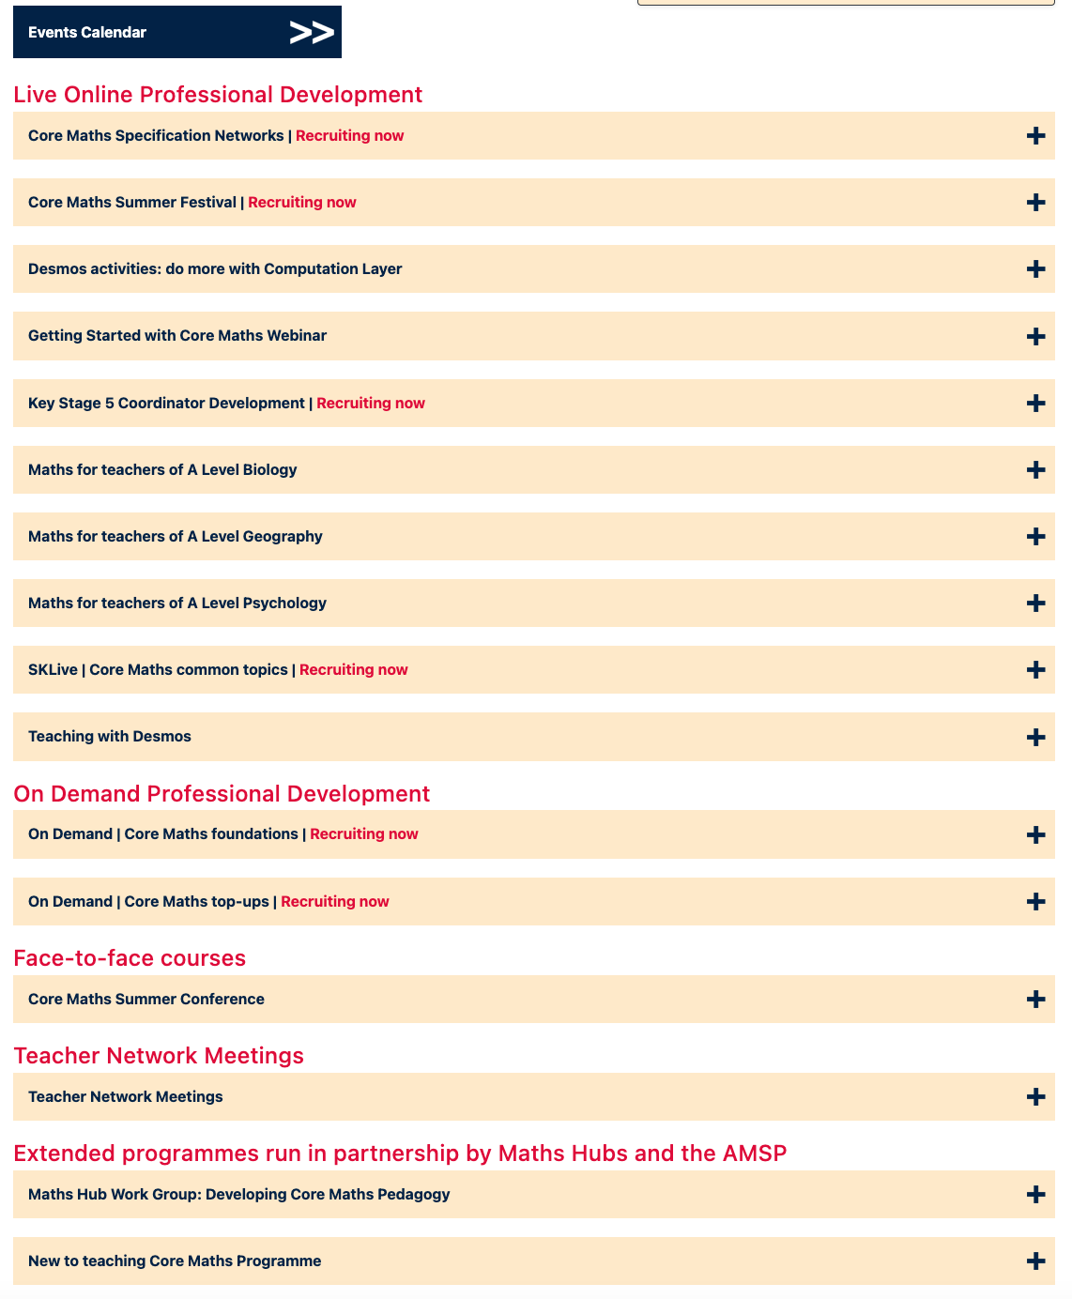
Teacher Development
Whole school start up
New teachers to Core Maths
Developing teaching of Core Maths
Network Meetings

Slide 20


Slide 21
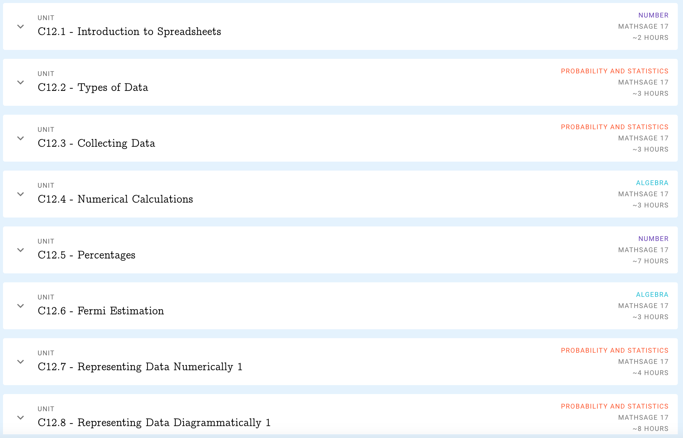
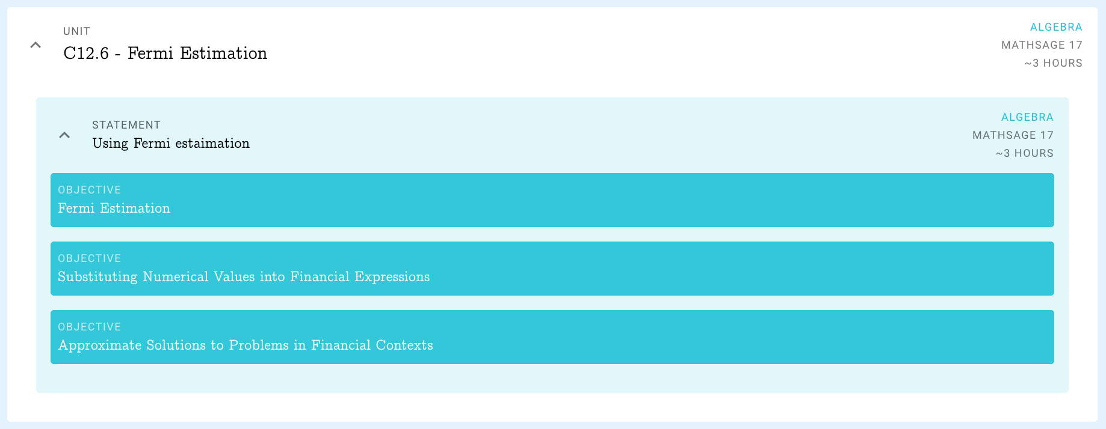
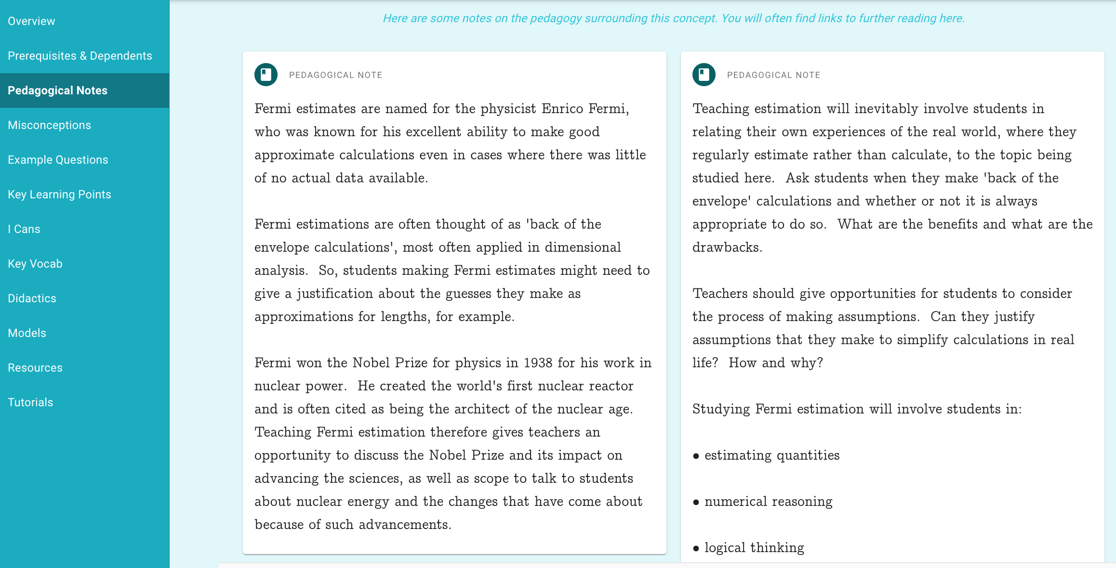

Slide 22

Catherine Van Sarloos Padlet

Slide 23
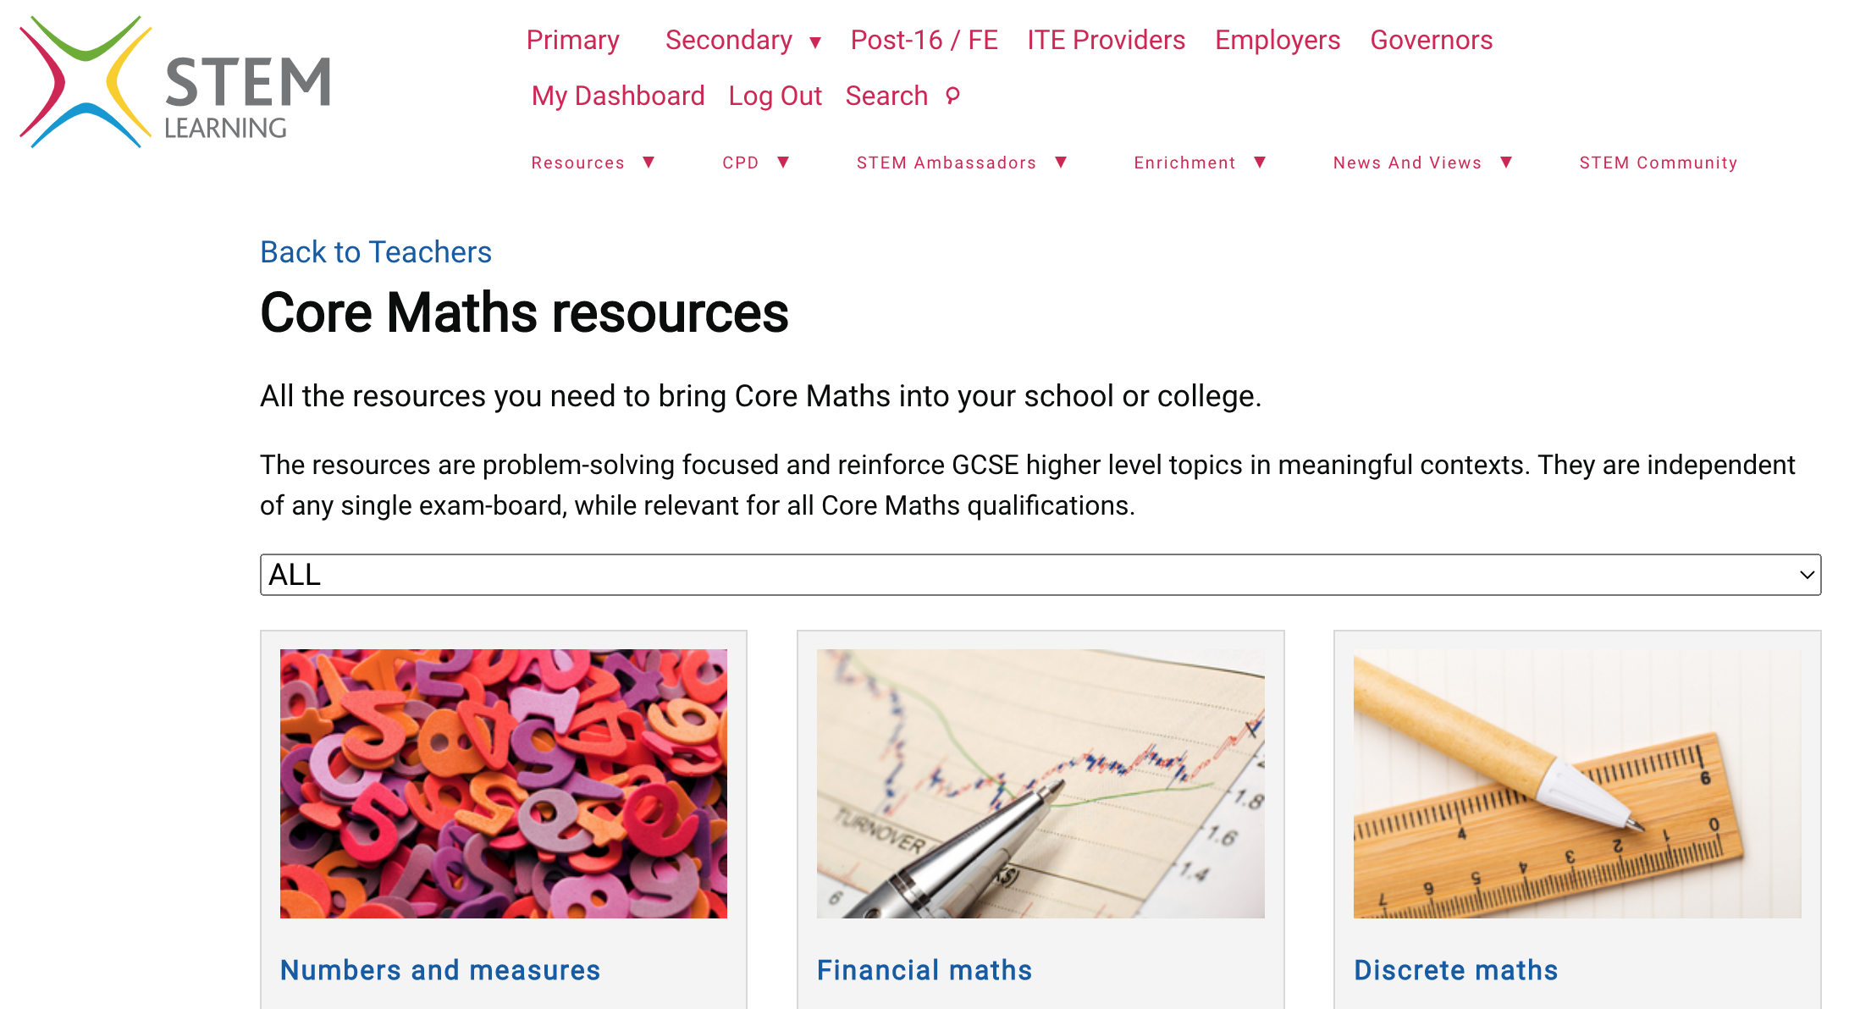

Slide 24


Slide 25
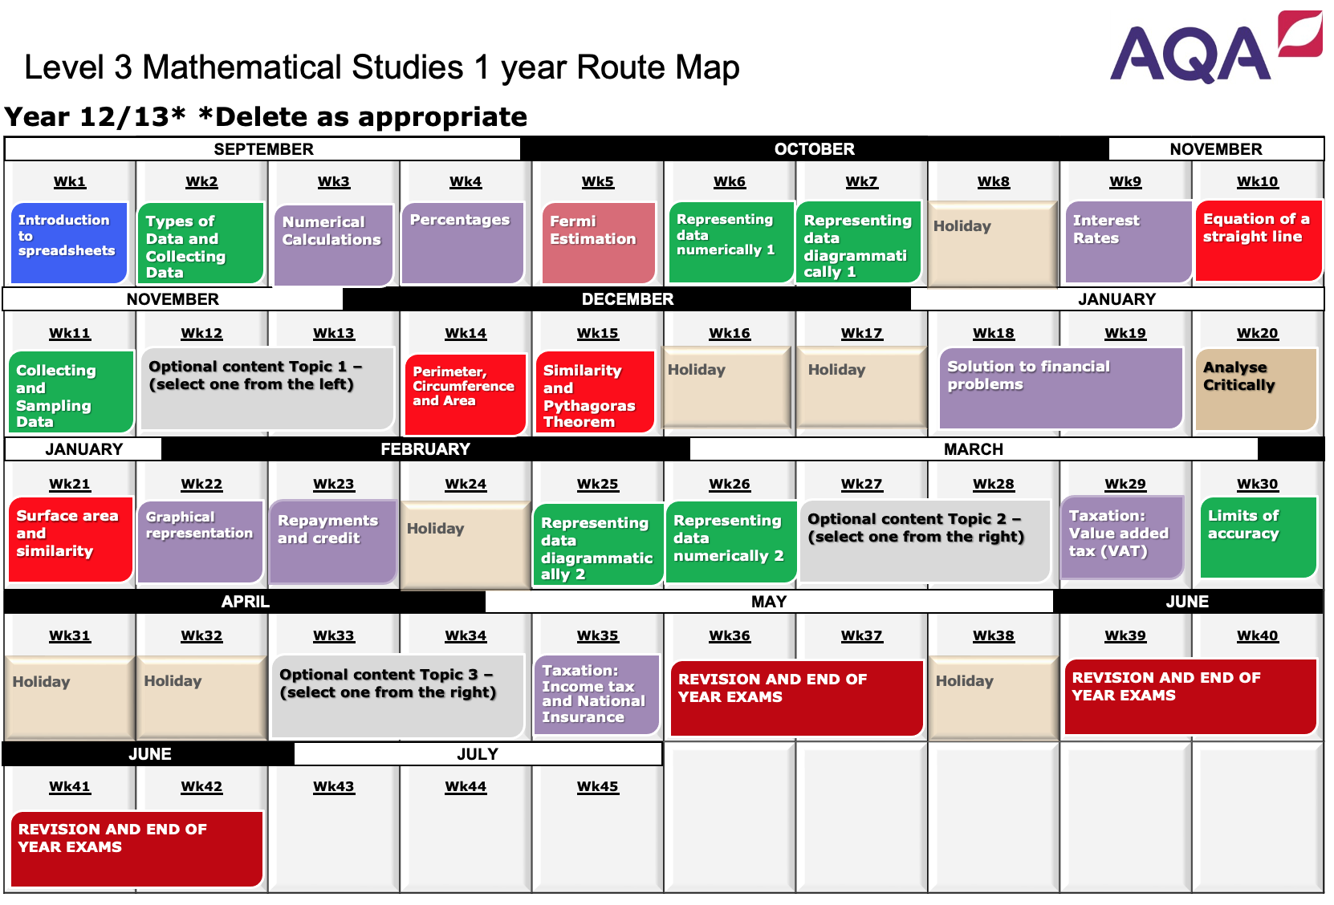
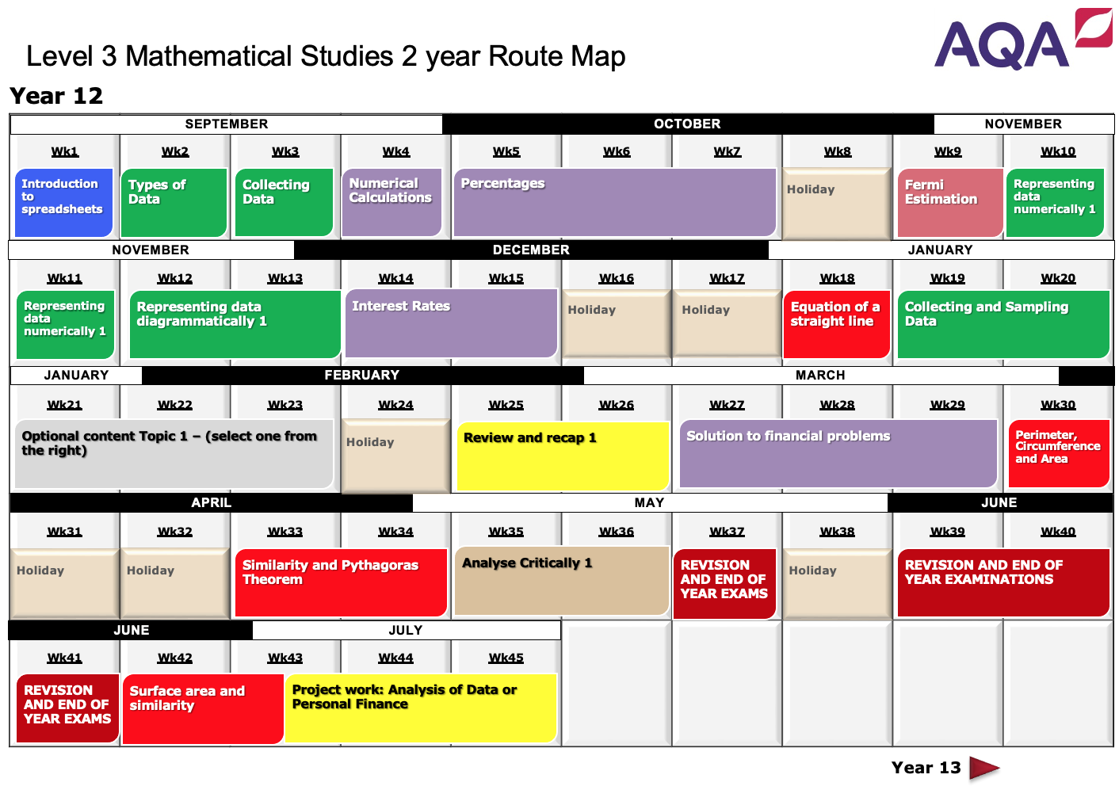
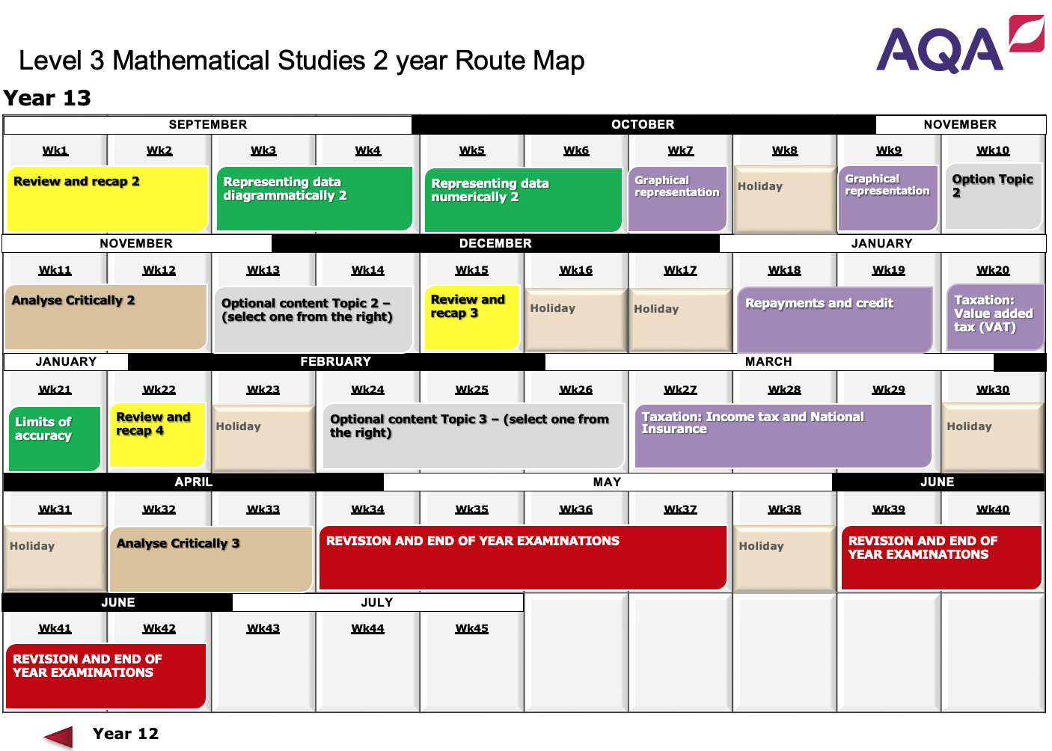
One Year or Two Year Route Maps

Slide 26
Introduction to Spreadsheets (Slide 1 of 2)
Continued on next page
 | Subject content: | Online resources:
 | It is expected that spreadsheets and tables will be used throughout the teaching and learning of this Mathematical Studies specification. Spreadsheet formulae will include: “=A1+A2+A3” to sum values in cells “=2*B3” to multiply a value in a given cell “=SUM(A1:A10)” | Anthropometric Data - Nuffield Foundation DISCUSS Regression and Correlation - Nuffield Foundation Pay rates for men and women - Nuffield Foundation Stature - Nuffield Foundation Climate Prediction - Nuffield Foundation Cup of Coffee - Nuffield Foundation Test Run - Nuffield Foundation Ozone Holes - Nuffield Foundation Measuring Inflation - Nuffield Foundation Eurovision 2015 – Nuffield Foundation Mammals - Nuffield Foundation Module Results - Nuffield Foundation Pulse Rates - Nuffield Foundation Exponential growth – MEI (Username: mei-imps Password: imps) Compound Interest – MEI (Username: mei-imps Password: imps) Student Loans 1 – MEI (Username: mei-imps Password: imps)
F1.1 | substituting numerical values into spreadsheets
View next page

Slide 27
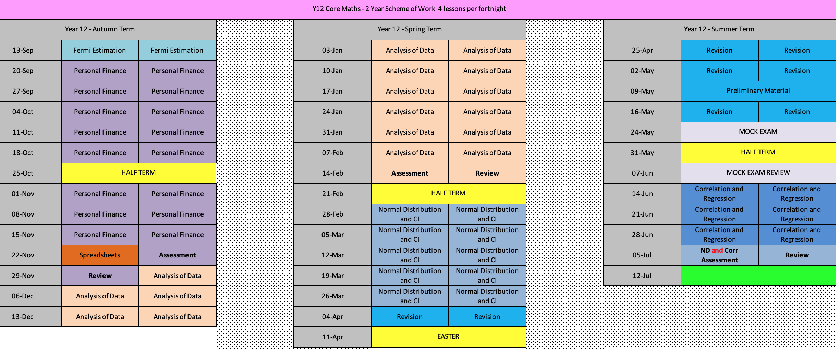
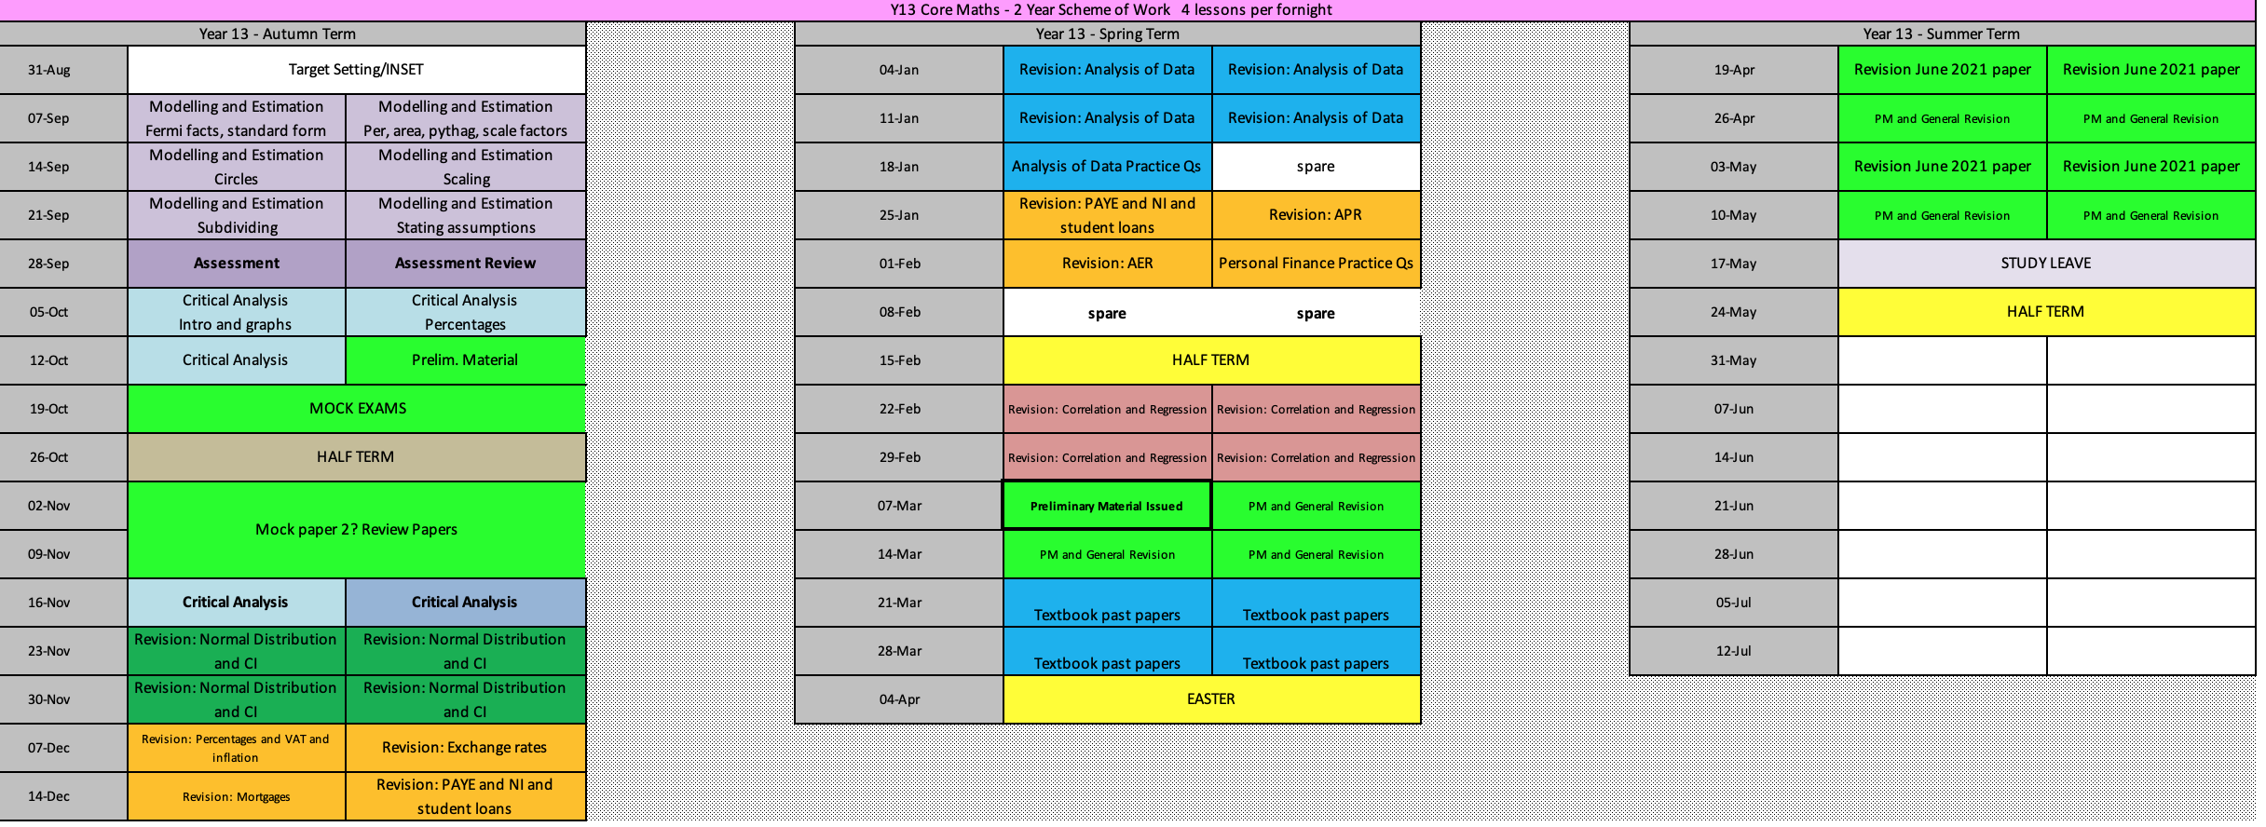

Slide 28
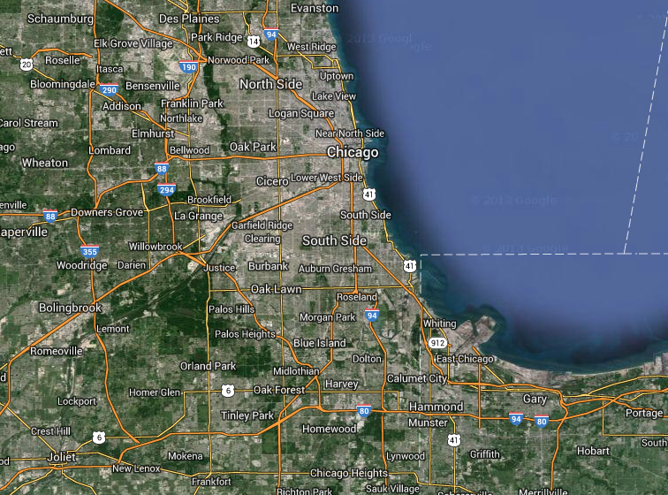
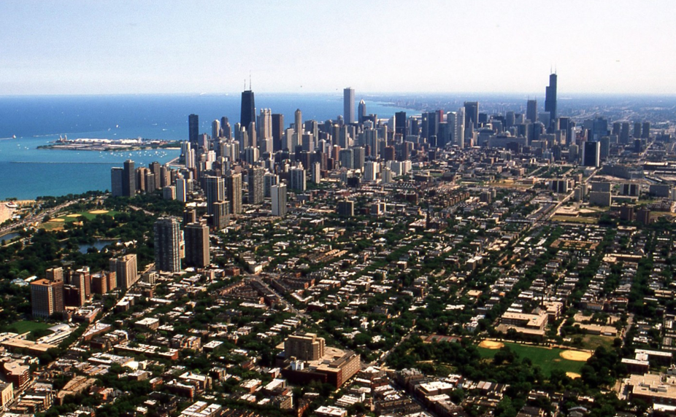
Fermi Estimation
How many piano tuners are there in Chicago?

Slide 29
Questions that might help:
What is the population of Chicago?
What is the average number of people to a household?
What proportion of households have regularly tuned pianos?
How many times do you tune a piano a year?
How many pianos can one tuner tune a day (including travel)?
How many days a year does a piano tuner work?

Slide 30
Estimation
Distances
Populations
Speeds
Volumes
Times or life spans
Assumptions based on what you know

Slide 31
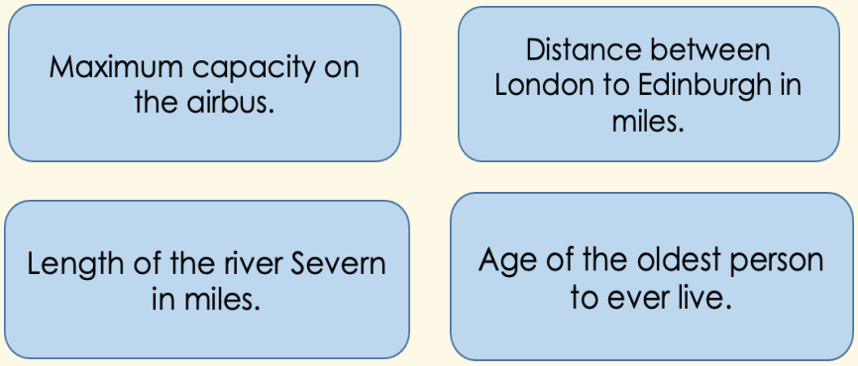
Put in ascending order

Slide 32
Maximum capacity on the airbus.
Distance between London to Edinburgh in miles.
853
333
Length of the river Severn in miles.
Age of the oldest person to ever live.
220
122
Age of the oldest person to ever live.
Length of the river Severn in miles.
Distance between London to Edinburgh in miles.
Maximum capacity on the airbus.

Slide 33
“Back of an envelope maths is an important and valuable life skill.”
“It is a tool that people in business use for quickly checking the viability of a new project.”
“Engineers use it to check if a proposed solution is likely to work.”
“And commentators on statistics use it to help make sense of the myriad numbers that are thrown out by politicians, ‘expert’ pundits and marketers.”
“It’s the maths you might use every day to ensure you aren’t getting ripped off by a so-called ‘deal’ that turns out to be anything but.”

Slide 34
Task – a bit of fun
Come up with your own Fermi Problem.
Is there something really random that you want to investigate?
It could be personal to you or completely random!
How many minutes of my life have I spent on social media?
How many hours have I spent at school in my lifetime?
How many calories have I consumed in my lifetime?
How many rashers of bacon are consumed in the UK each year?
The possibilities are endless!!

Slide 35
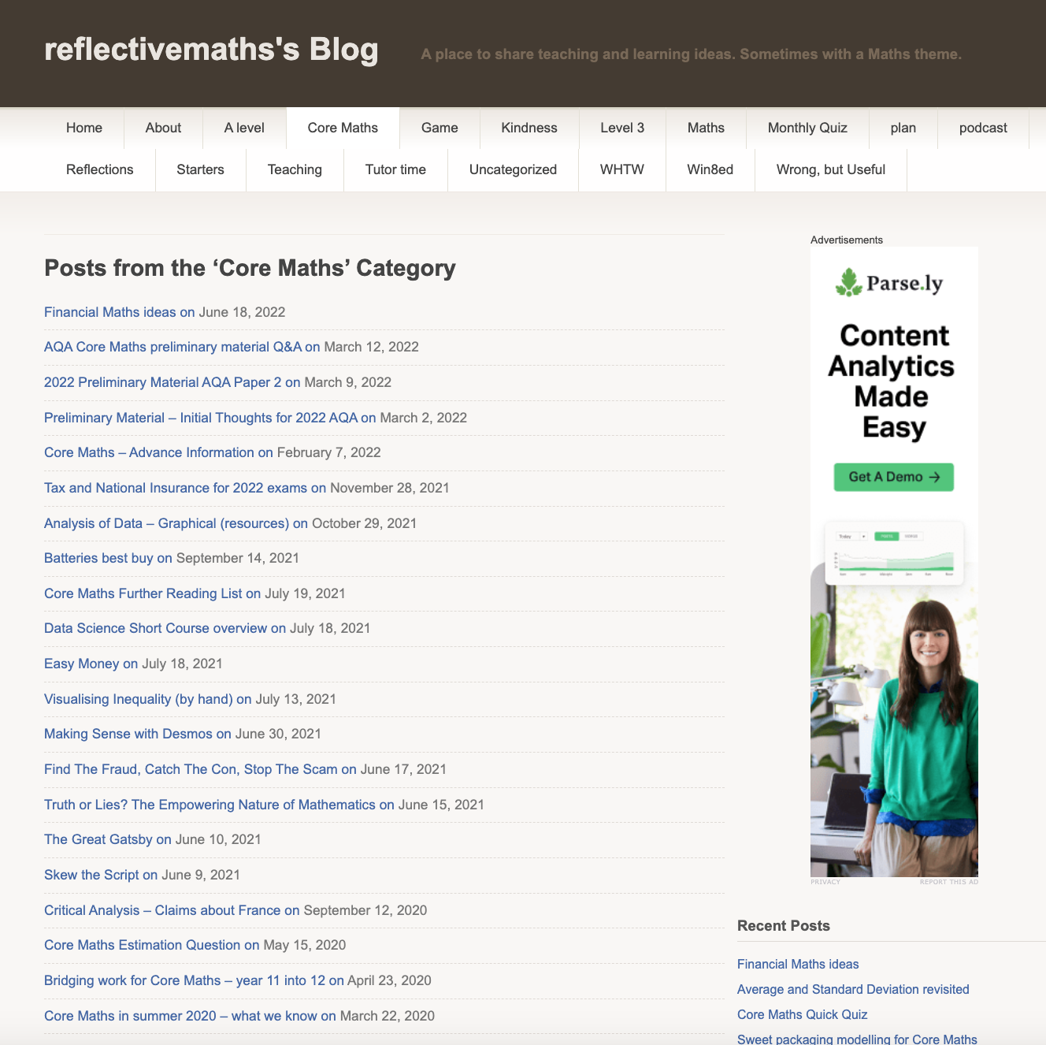
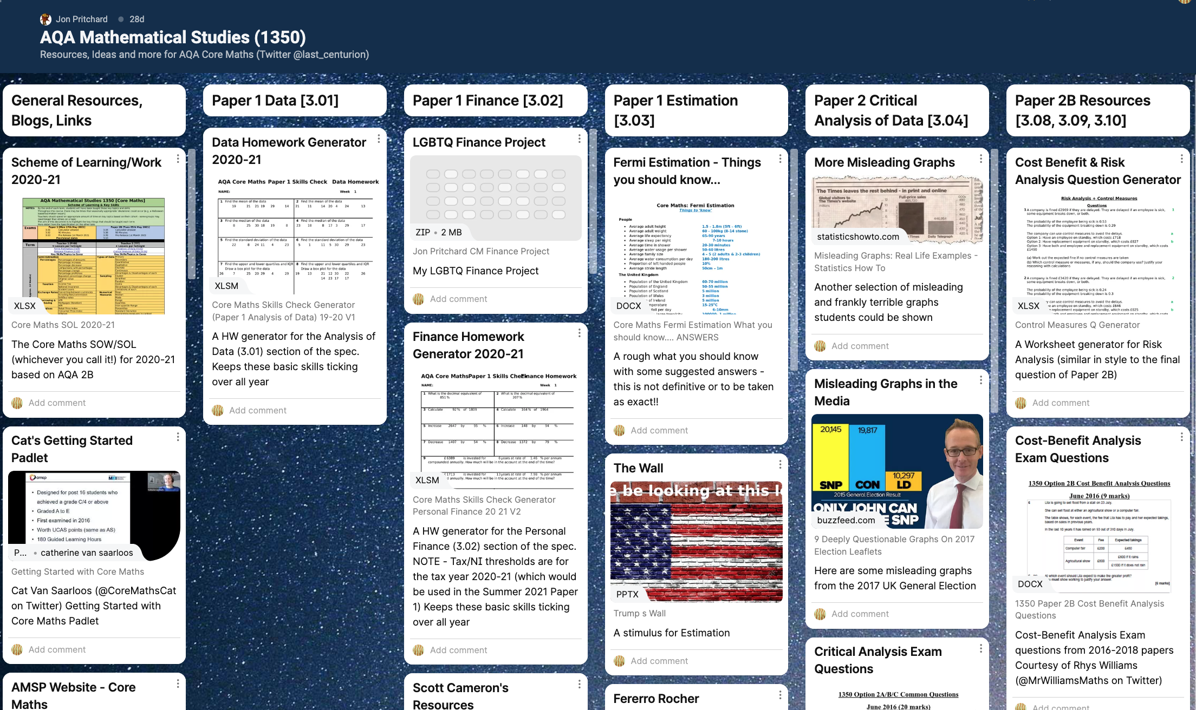
Resources for Estimation
@reflectivemaths blog
@last_centurion padlet

Slide 36
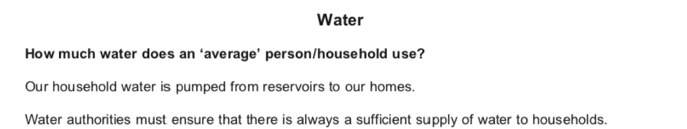
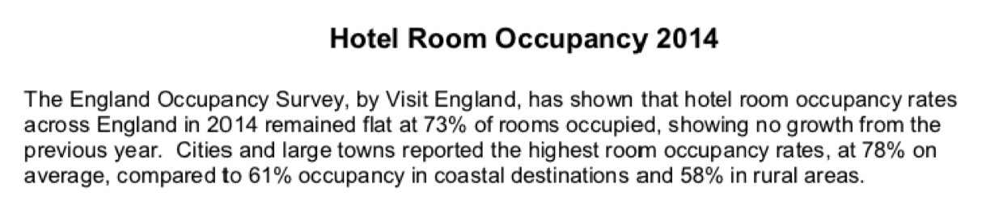
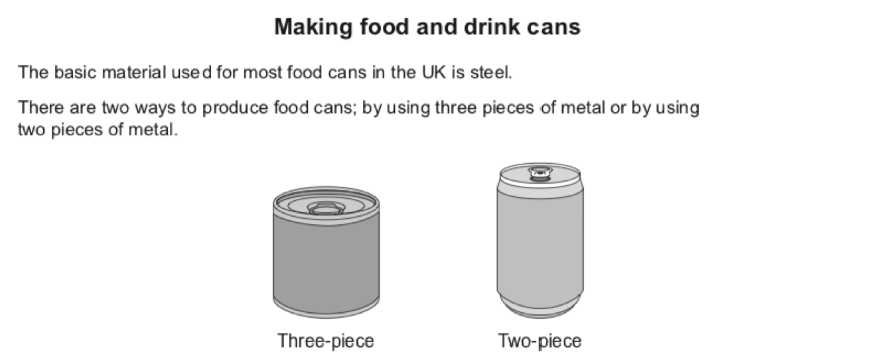
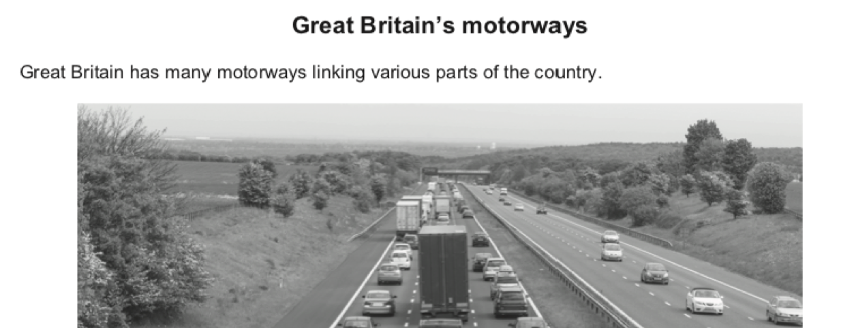
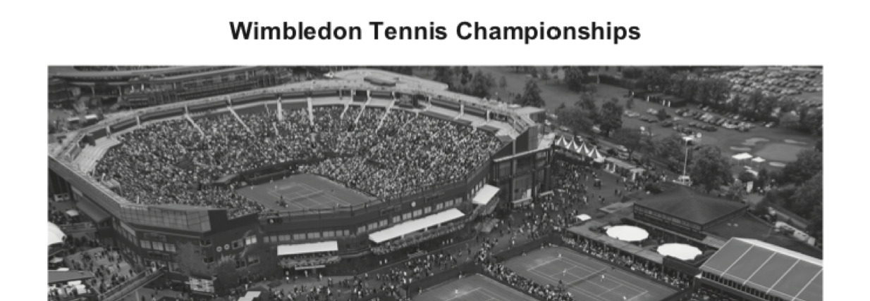
Modelling for Estimation

Slide 37
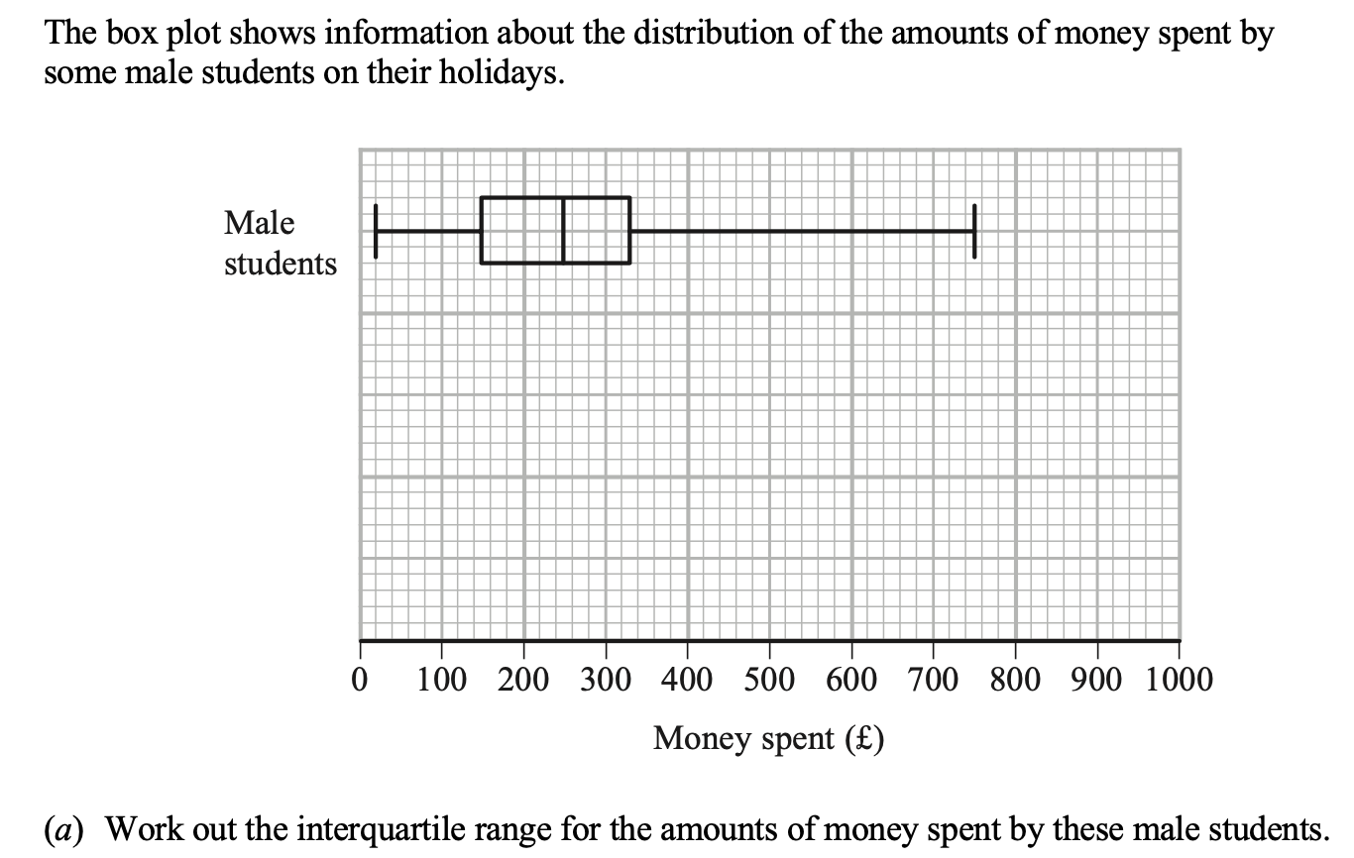
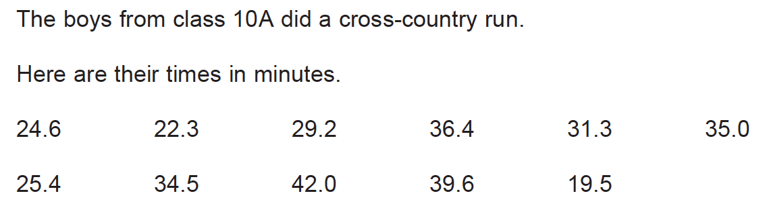
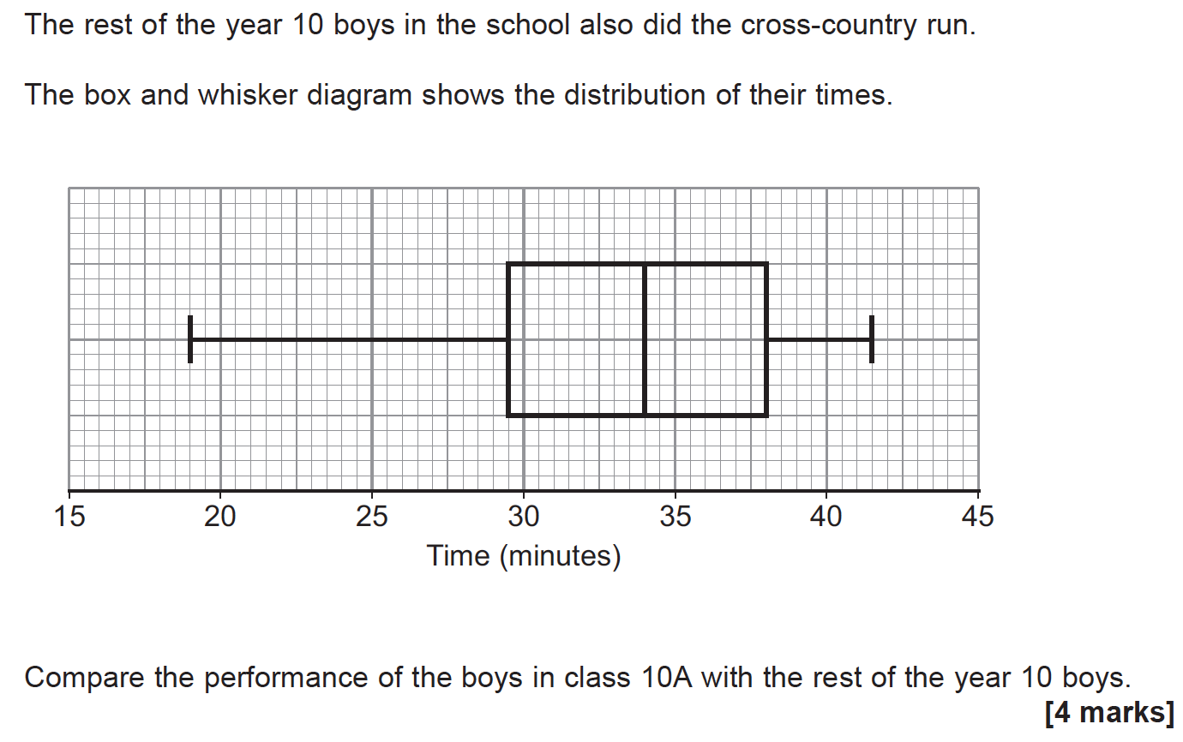
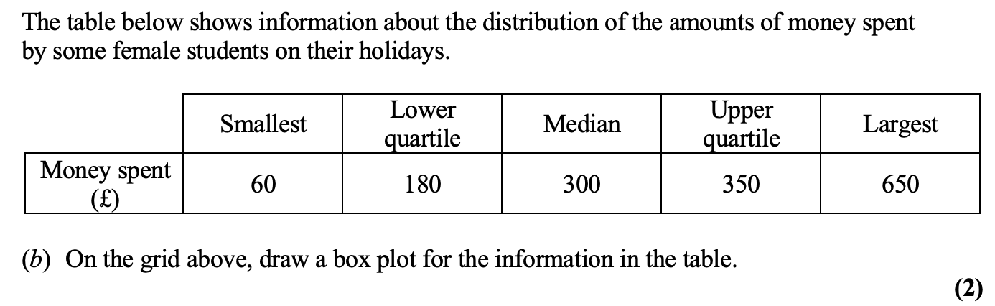
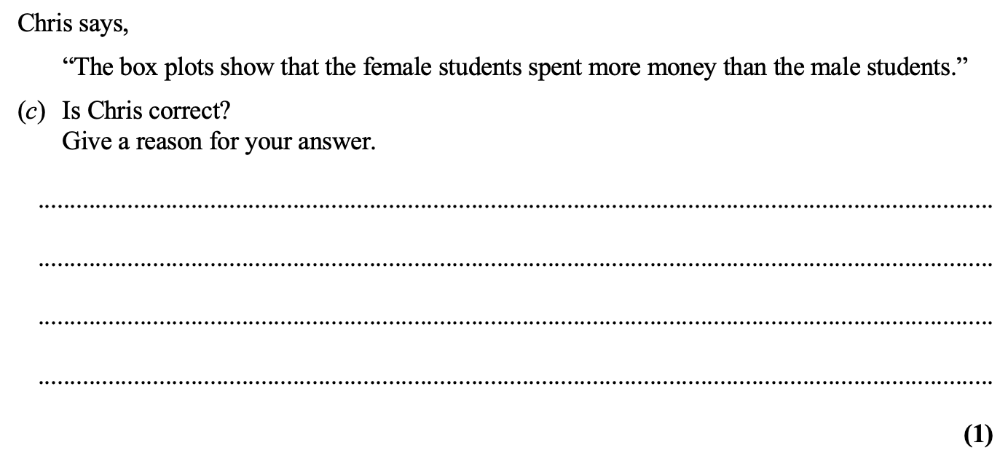
GCSE
or
Core Maths?

Slide 38
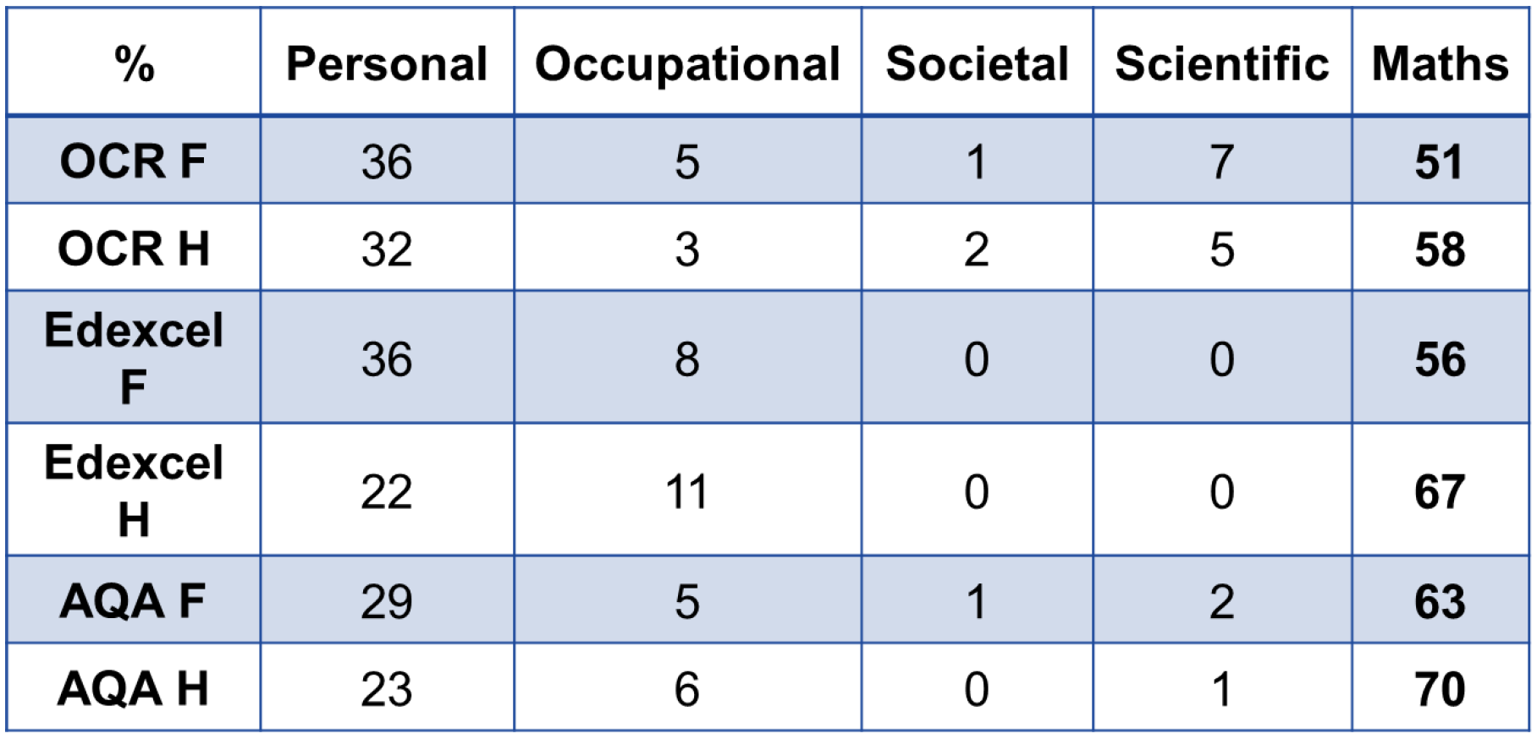
Bringing Data to Life
GCSE Maths Papers 2019 (from AMSP)

Slide 39
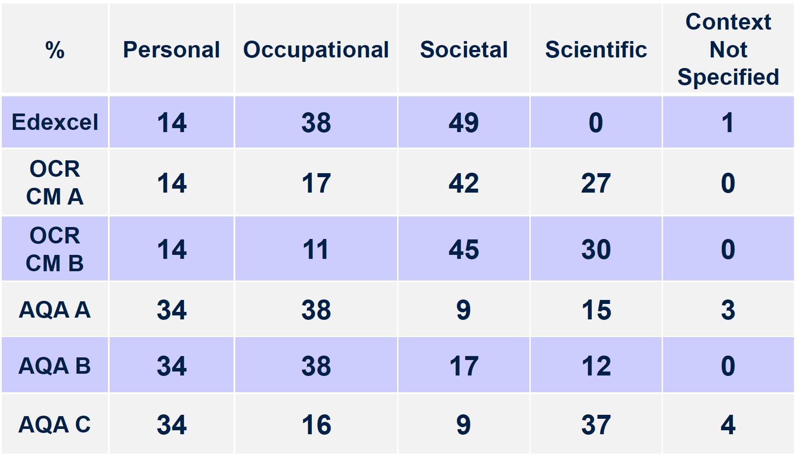
Bringing Data to Life
Core Maths Papers 2019 (from AMSP)

Slide 41
Box Plots
FILM A
FILM B
FILM C
Age of film viewer (years)
What do you notice?
What do think?
What do you want to ask?

Slide 42
Record breaking year for UK exports
A story about a chart…. @edconwaysky Data from ONS
As far as I can divine here's the answer. A US bank with London gold vaults shifted some of that gold from being "unallocated" to being "allocated". Effectively it moved it on its balance sheet. The gold stayed in the same vault but technically it shifted from UK ownership to US

Slide 43

Data as a starting point

Slide 44
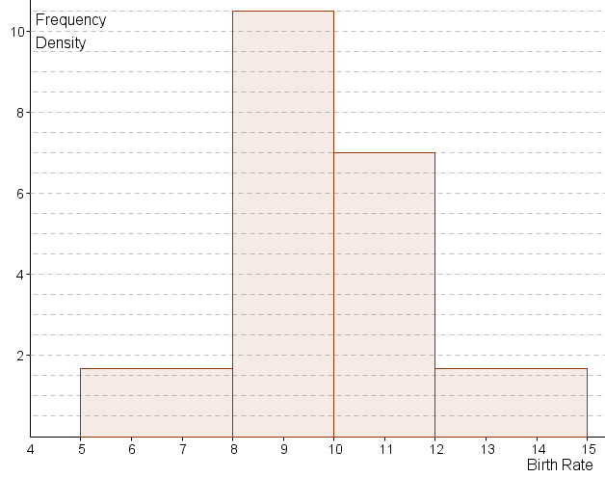
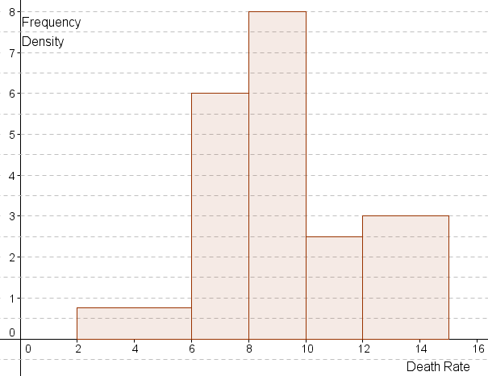
Interpreting:
European birth and death rates
1.67
Use these histograms to compile grouped frequency tables.
Compare European birth rates to death rates.
What questions do you have about these comparisons.
Notes:
Next show these histograms and ask students to ‘work backwards’ to draw up a pair of grouped frequency tables to this data.
Answers on next slide.

Slide 45
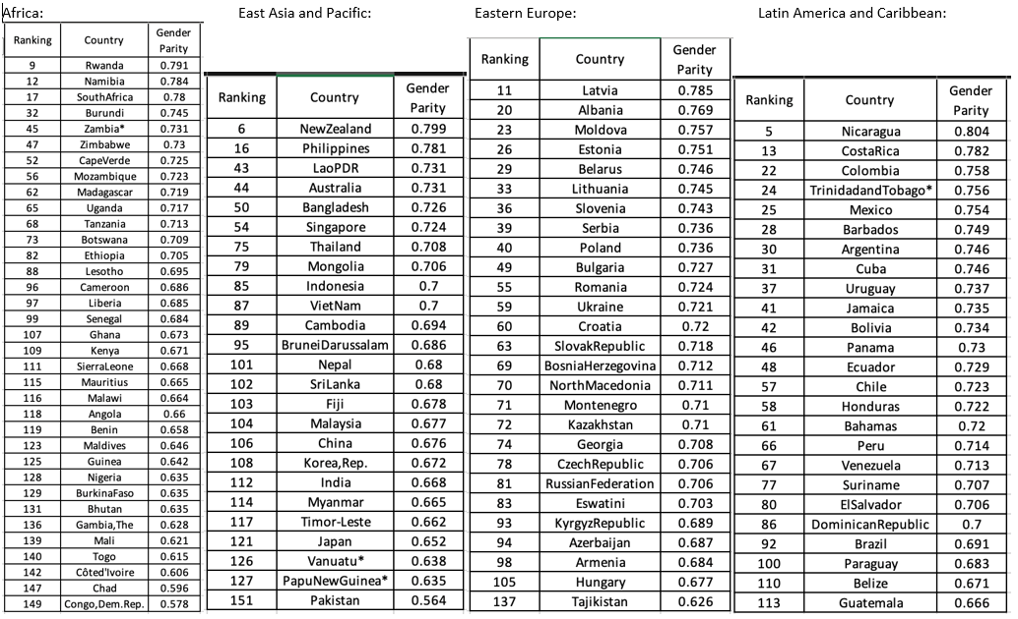
What can you discover about the gender parity for different regions of the world?

Slide 46
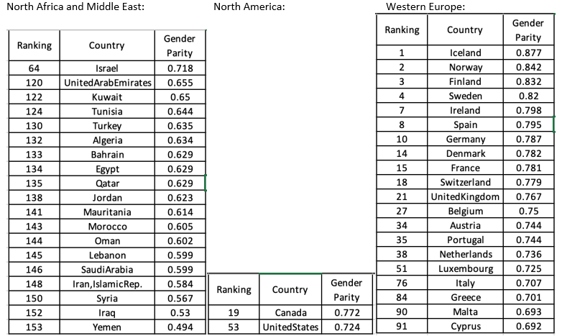

Slide 47
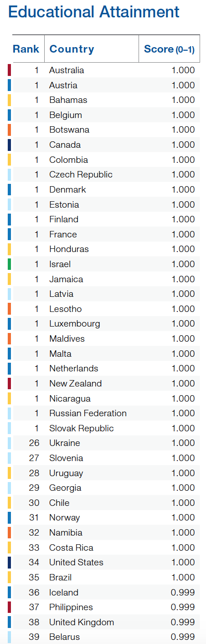
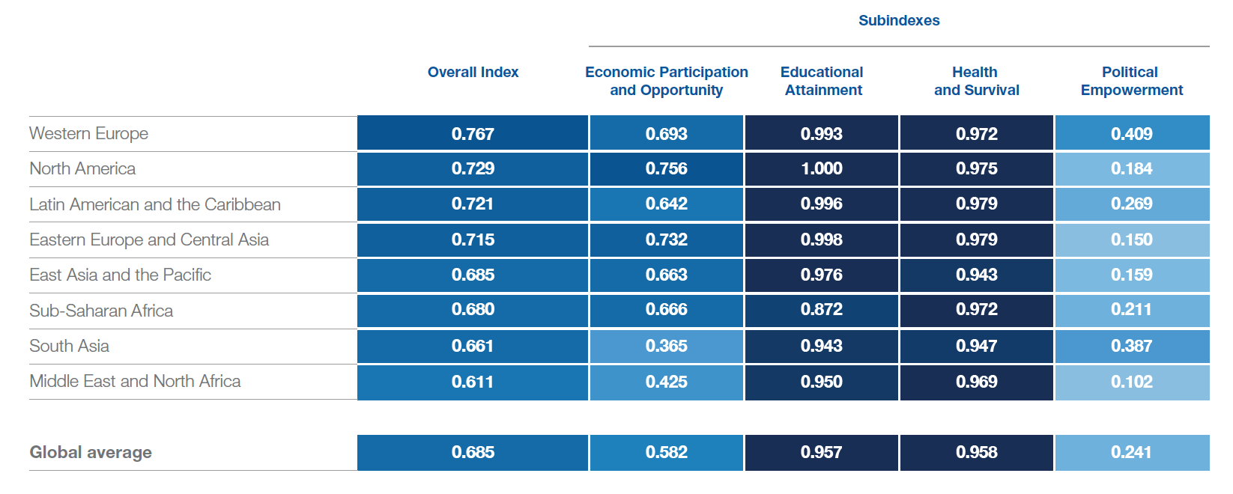
What do you notice?
What do you want to ask?

Slide 48
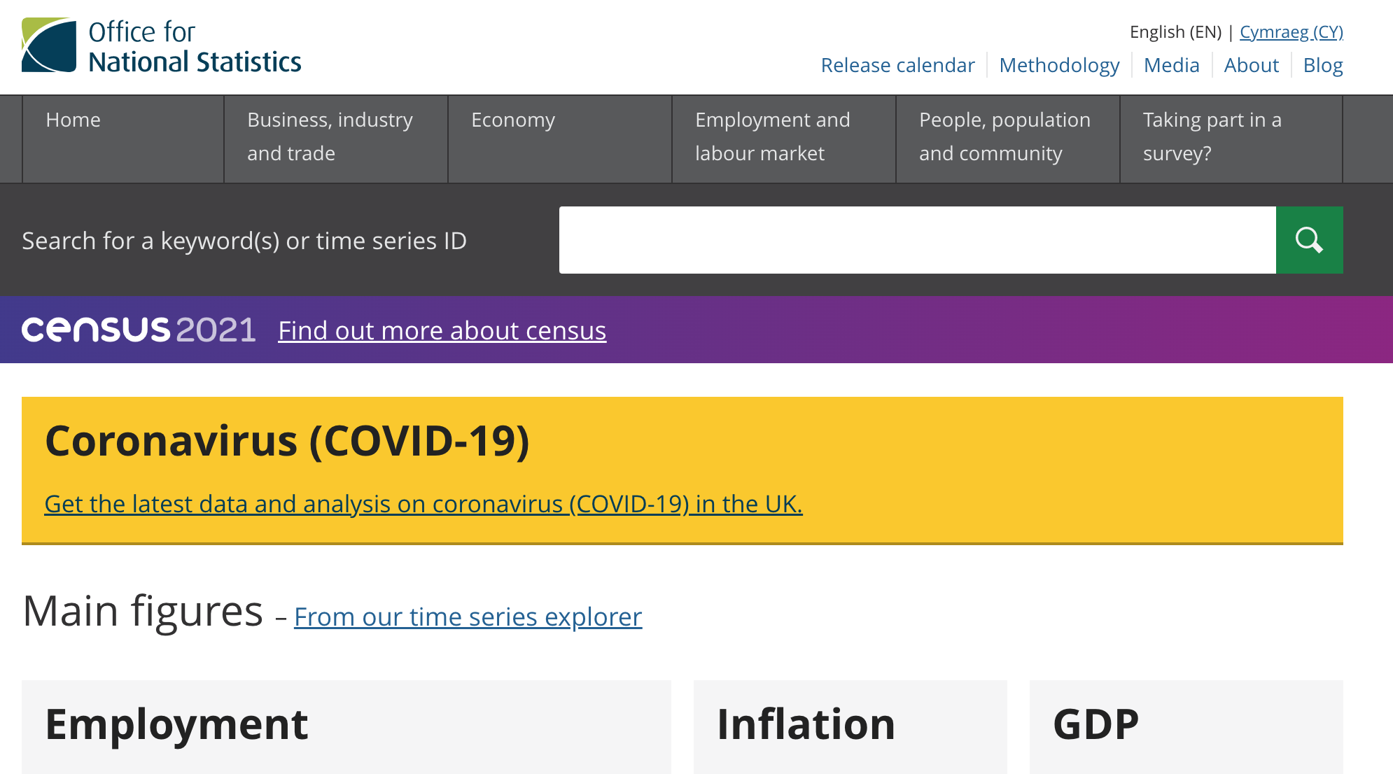

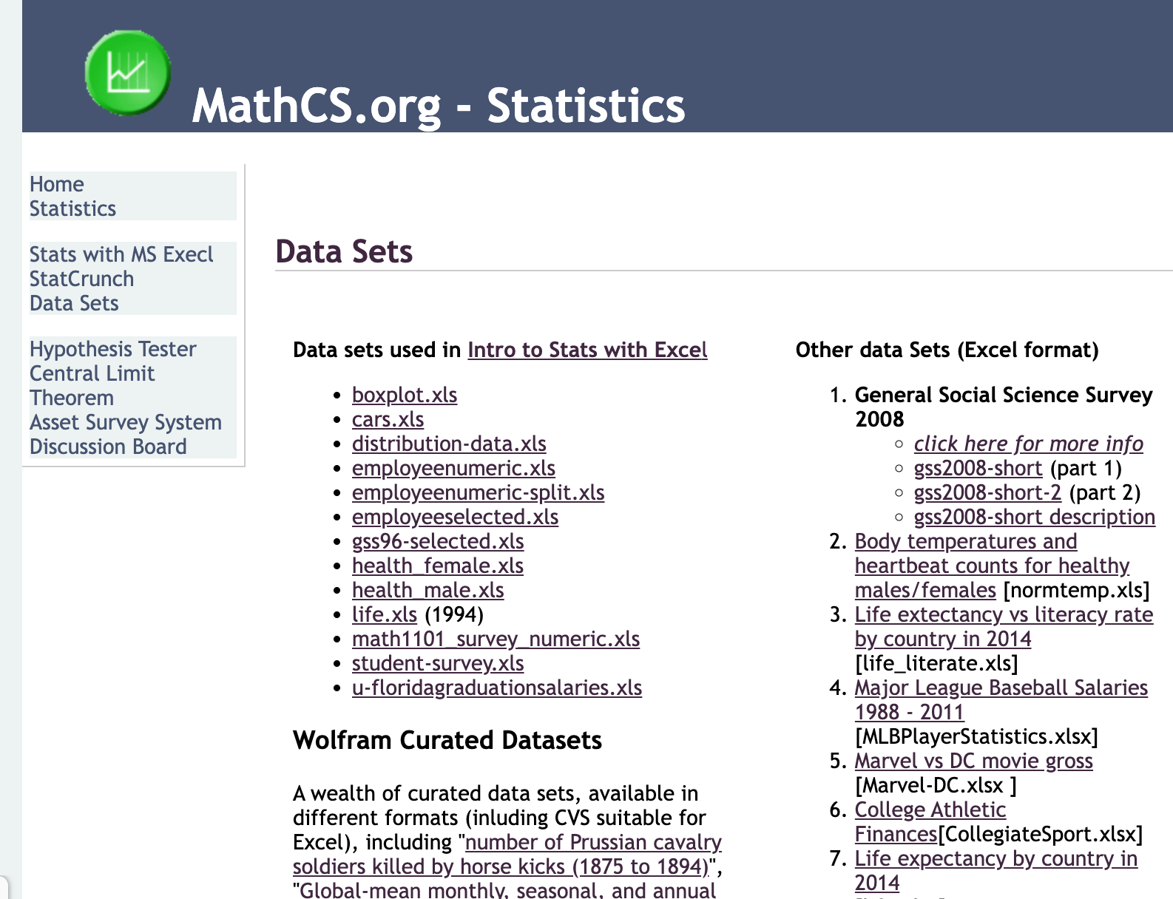

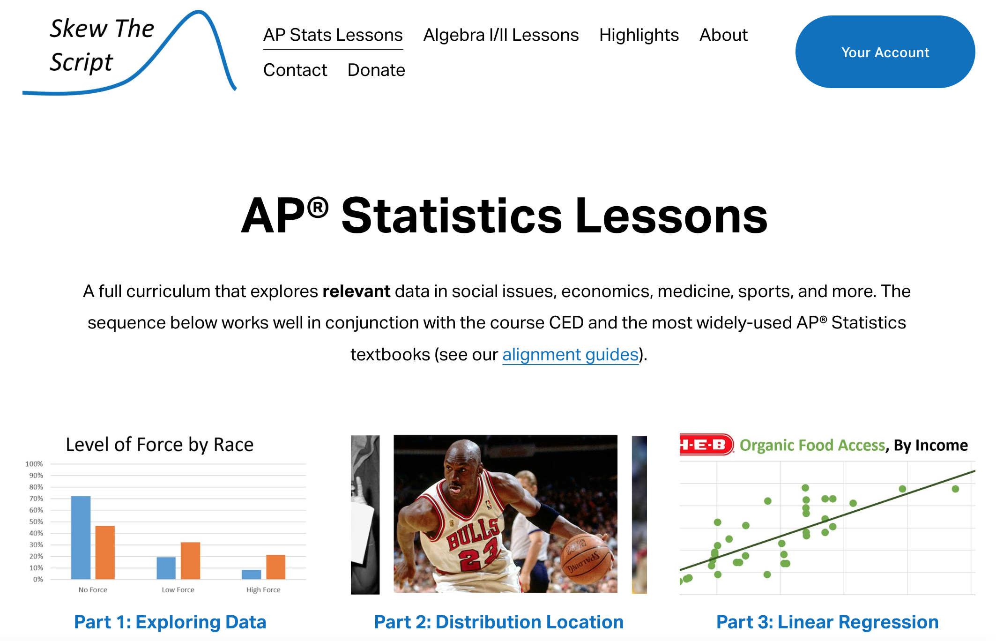
Where can we get data from?
Alevel Large Data Sets

Slide 49
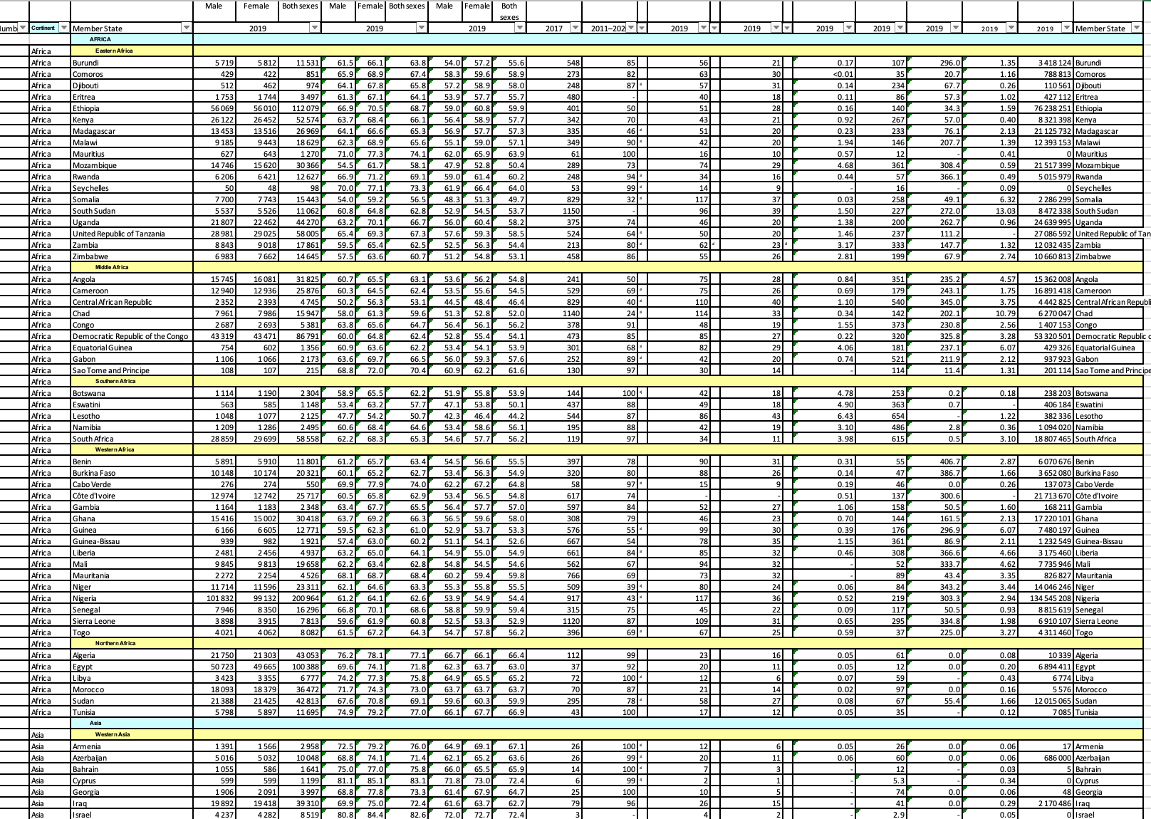
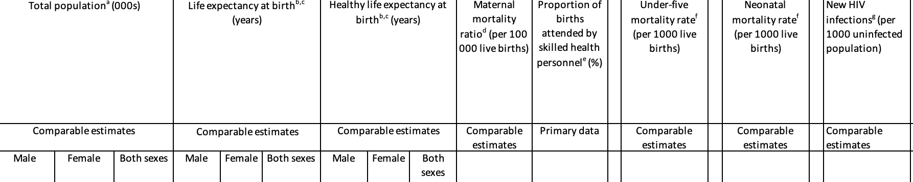
From sampling to representation to analysis to critical analysis

Slide 50




Standard Deviation
Population
$$σ_{x}$$
Sample
$$S_{x}$$

Slide 51
Personal Finance
A teacher on UPS 1 works 3 days a week.
She decides to go up to 4 days a week.
Her gross pay will increase by 33.3%.
What will happen to her net pay?

Slide 52
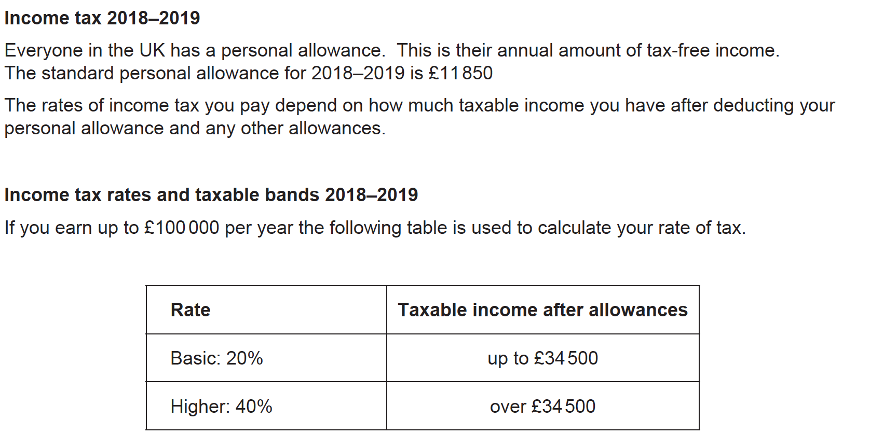
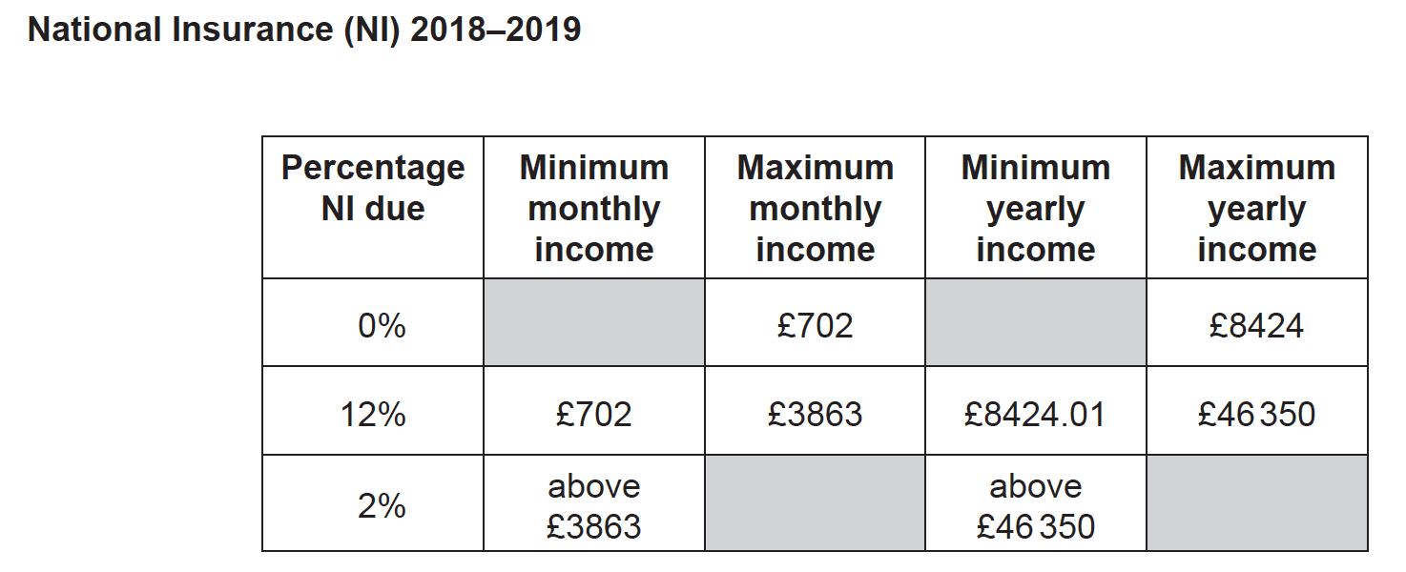
£36,646

Slide 53
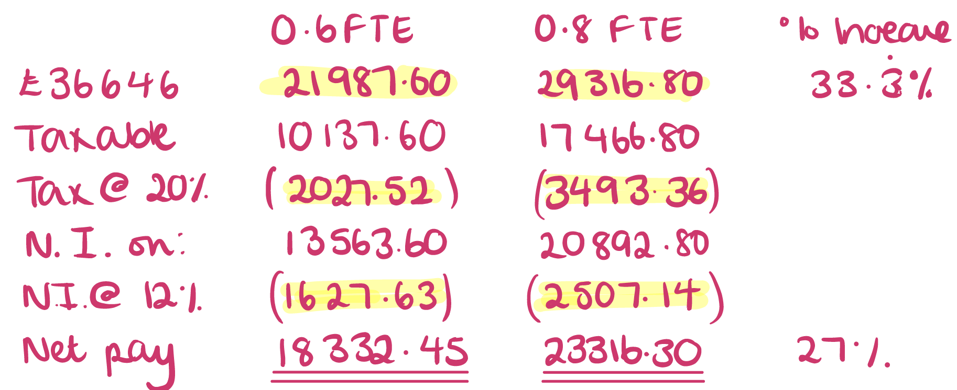
A teacher on UPS 1 works 3 days a week.
She decides to go up to 4 days a week.
Her gross pay will increase by 33.3%.
What will happen to her net pay?

Slide 54
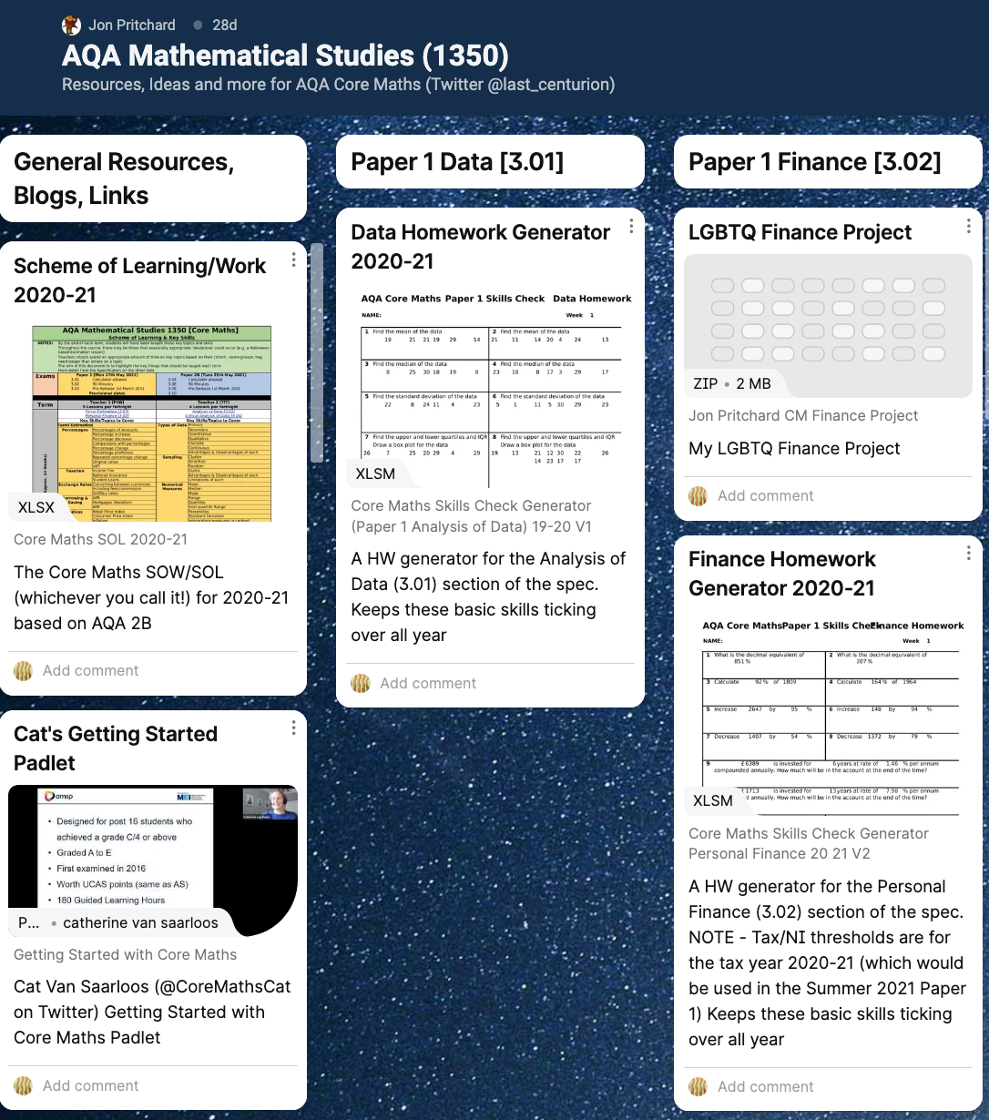
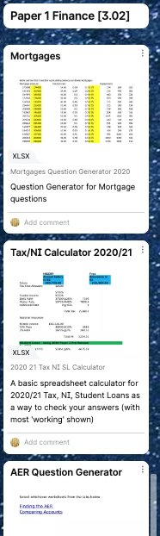


Resources for Personal Finance
@last_centurion padlet
@coremathscat padlet(s)

Slide 55
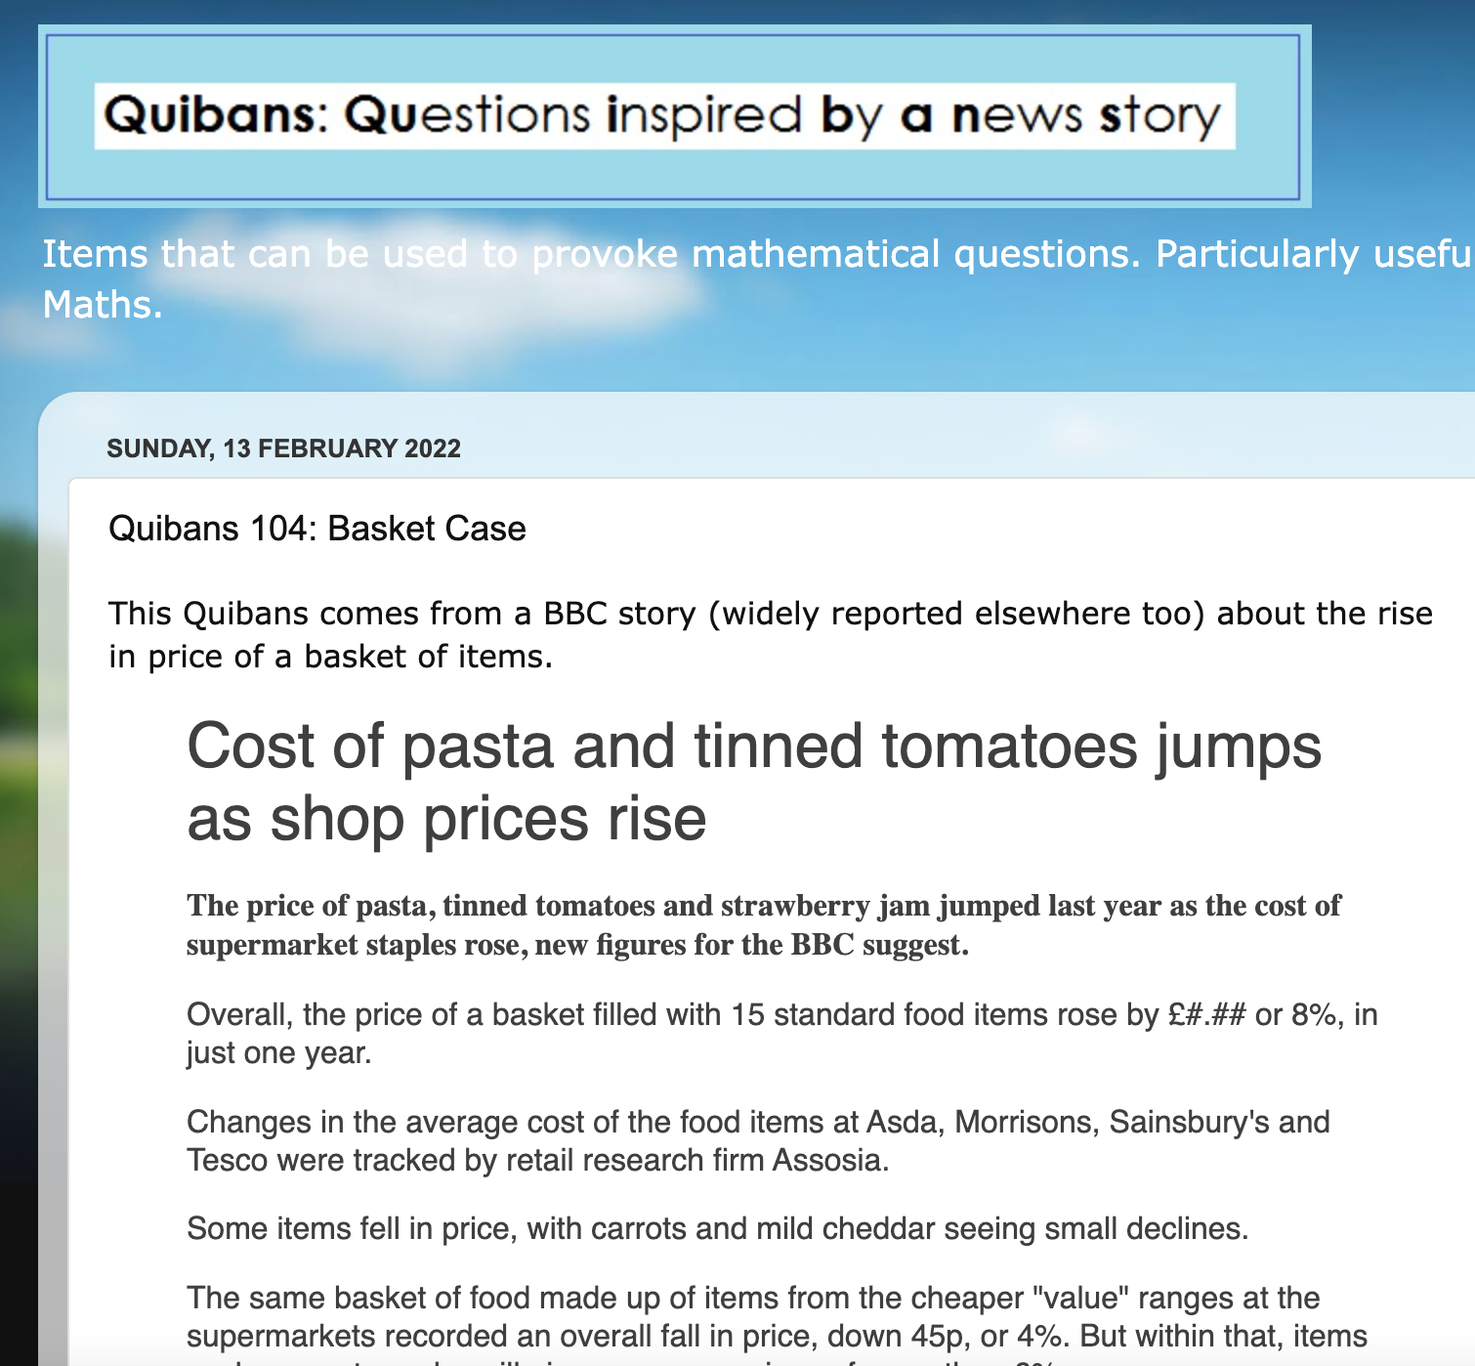
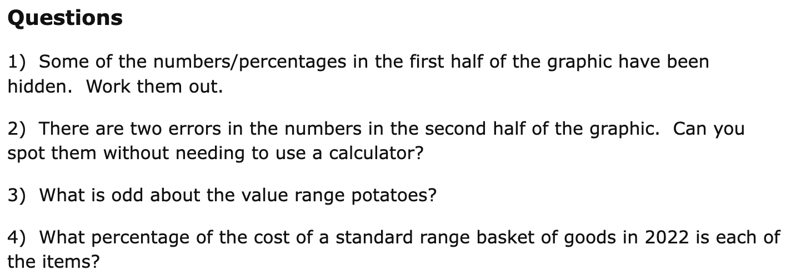
Financial Maths in the News

Slide 56



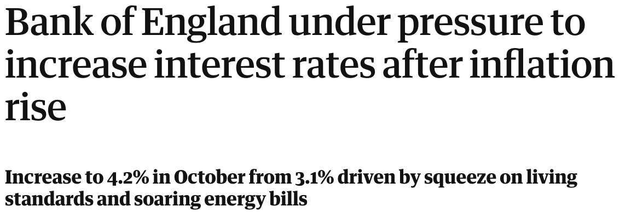

Slide 57
Normal Distribution

Slide 58
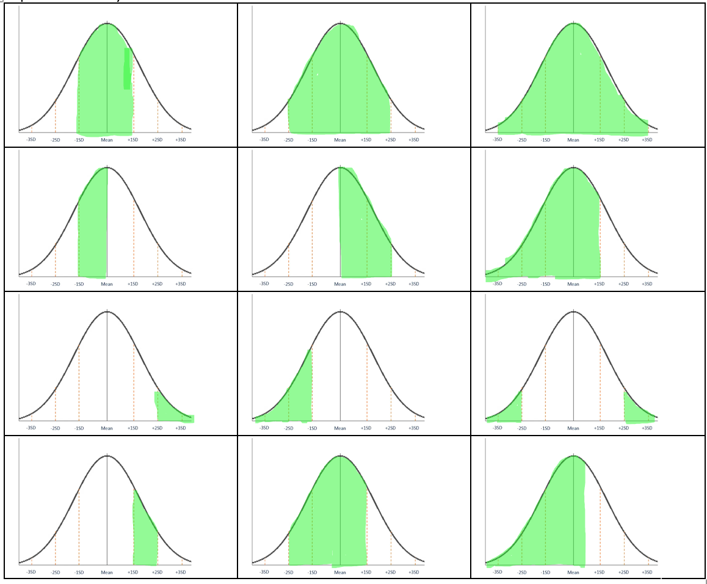
1, 2 and 3 standard deviations

Slide 59




Split up positive and negative z values.
“More or less than 50%”

Slide 60
Getting to know the curve
Top 5%
Lowest 10%
80% exceeded
Slowest 30%
Within 5% of the mean

Slide 61


Confidence Interval
Population
$$μ±z\left(\frac{σ}{\sqrt{n}}\right)$$
Sample
$$μ$$

Slide 62

Resources for Normal Distribution

Slide 63
Correlation and Regression
Mean Point
Dependent and Independent
Extrapolation and Interpolation
Gradient and y-intercept in context
Use some of the data sets!

Slide 64

Kahoot – Correlation so far!!
Notes:
Inter means between (think of inter-tutor tournaments). Extra means beyond (think of extra-terrestrials).

Slide 65
Interpreting the Regression Equation
The table gives data on the percentage of built up land and the biological health of the stream.
% urbanisation | Biological Health of Stream
60 | 9
43 | 11
43 | 13
34 | 23
27 | 31
25 | 31
21 | 21
18 | 23
11 | 27
8 | 37
8 | 39
8 | 29
7 | 31
7 | 43
5 | 33
4 | 35
2 | 37
Calculate the PMCC.
Comment on the result.
Find the regression equation.
What do the values mean?
What more do you want to know?

Slide 66

Critical Analysis

Slide 67

Risk Communication
Gerd Gigerenzer

Slide 68

@GraphCrimes
% share
% increase
% of
% points

Slide 69


Finding the Balance

Slide 70

Knowledge!

Slide 71

Key Skills

Slide 72



Slide 73
Finding the Balance

Slide 74
Teaching and Developing
Core Maths
Nikki Cooper
@mathszest

